Slide 1
4 Components of Change: VIST

Slide 2
4 components for change--V.I.S.T
V = Variation: Differences among individuals of the same species. Differences in phenotypes.

Slide 3
Variations = Differences

Slide 4
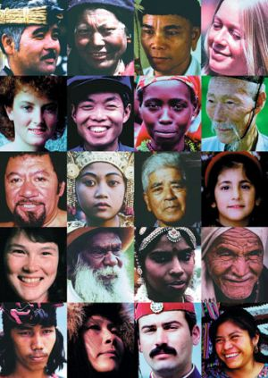
Humans

Slide 5
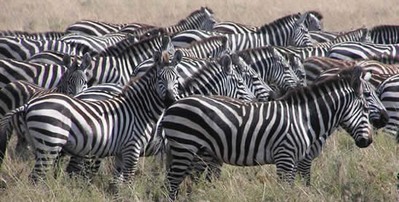
What are the variations for Zebra?

Slide 6
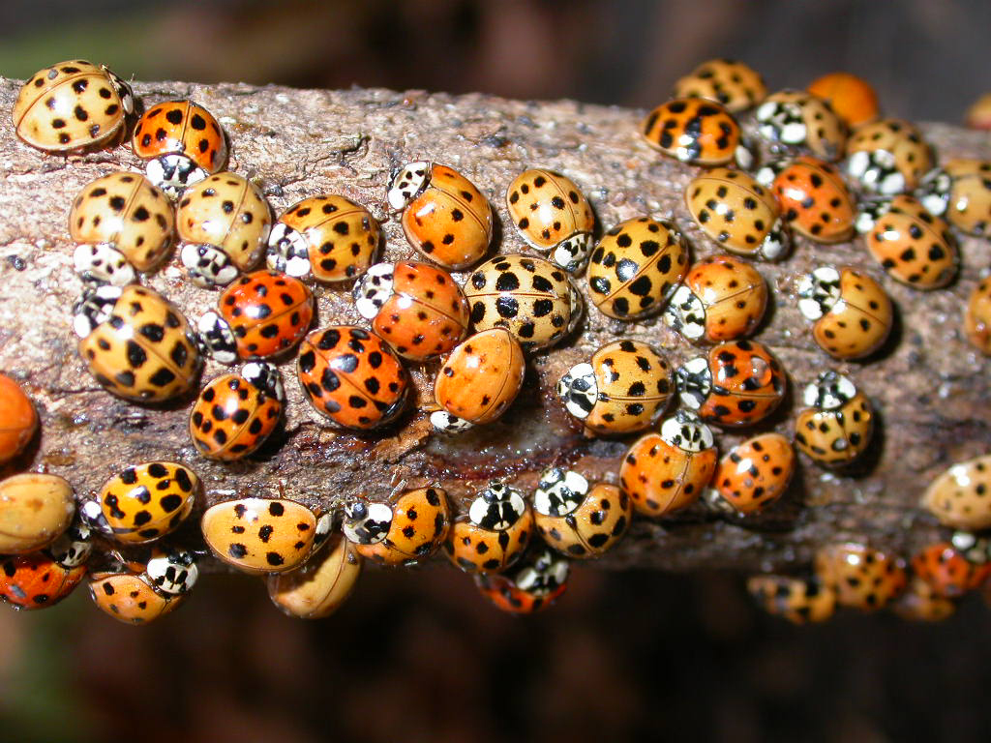
What are the variations for Lady Bugs?

Slide 7
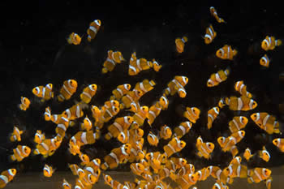
What are the variations for Clown Fish?

Slide 8
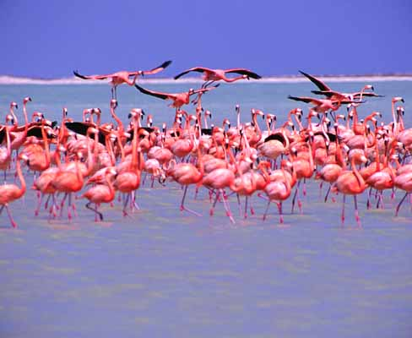
What are the variations for Flamingos?

Slide 9
Pick any animal you can think of and draw a picture in your Variation box showing the variations among that species

Slide 10
4 components for change--V.I.S.T
= Inheritance: Physical traits (phenotypes) are inherited from parents and are passed on to offspring in DNA.

Slide 11
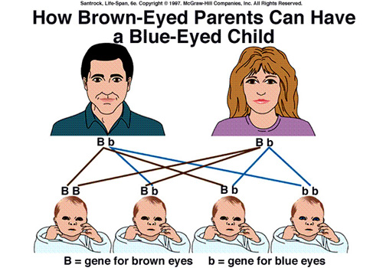

Slide 12
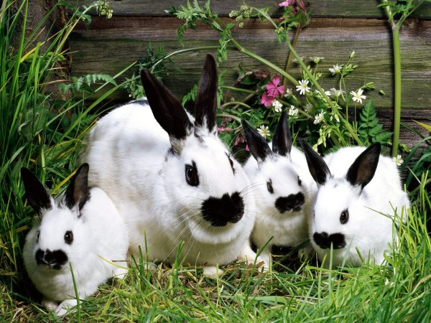

Slide 13
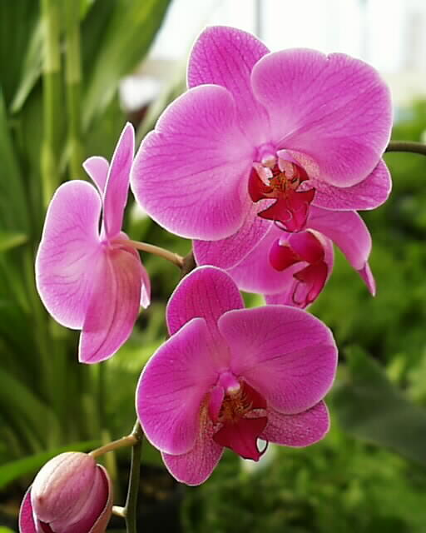

Slide 14
4 components for change--V.I.S.T
= Selection: Nature is unforgiving and plants and animals must compete and fight to stay alive. Organisms with traits (phenotypes) that are favorable to their survival get to live and pass on their genes to the next generation.

Slide 15
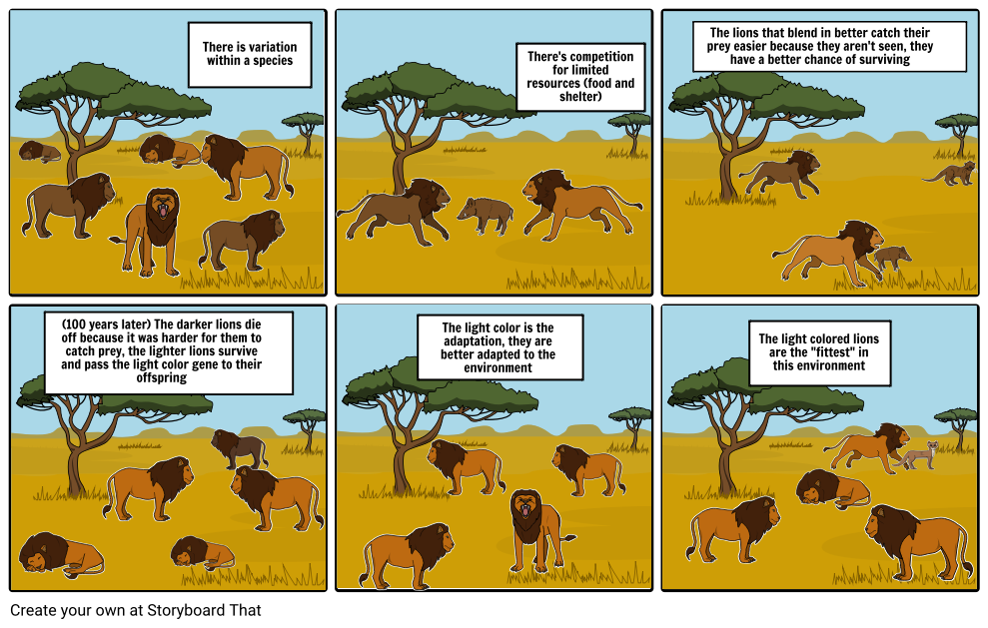

Slide 16
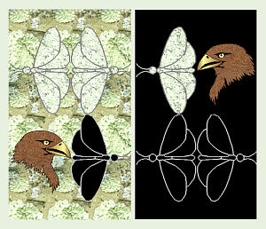

Slide 17
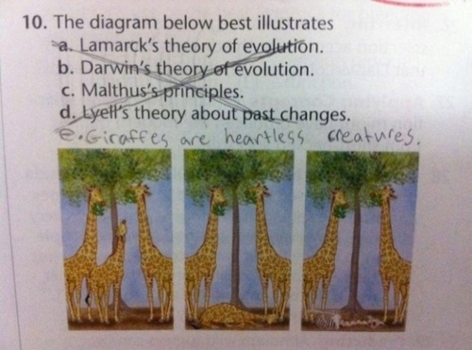

Slide 18
4 components for change--V.I.S.T
T = Time: Change takes time. Change can happen in a few generations, but major change, often takes long periods of time.

Slide 19
