Slide 1
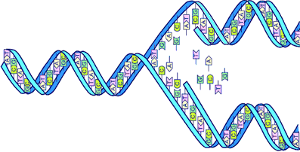
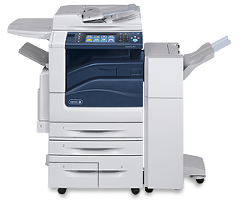
DNA Replication

Slide 2
MUST BE ABLE TO IDENTIFY
5’ AND 3’ direction!!!
Foglia

Slide 3
nucleotide
PO₄
N base
5′
CH₂
O
4′
1′
ribose
3′
2′
OH
Foglia

Slide 4
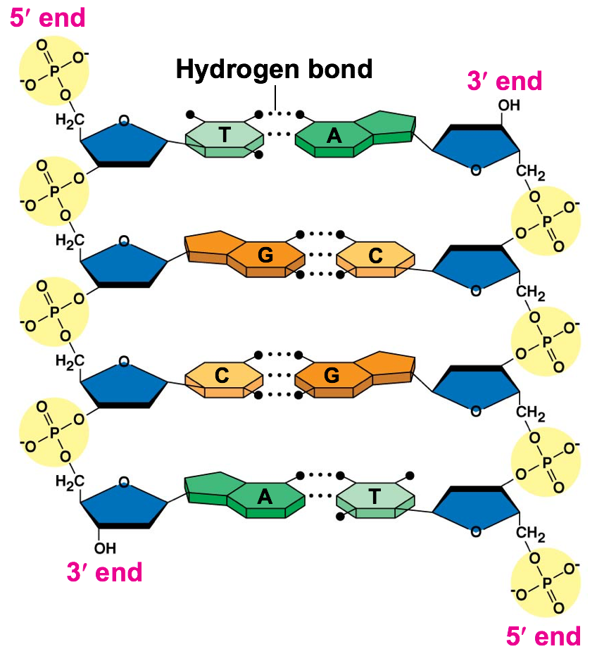

Slide 5
-ASE = enzyme
PRIMASE
HELICASE
LIGASE
POLYMERASE
TOPOISOMERASE
TELOMERASE

Slide 6
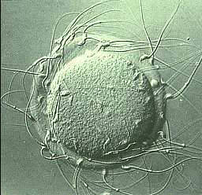
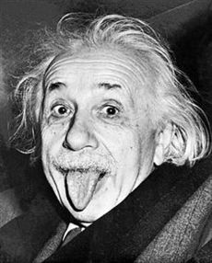

Slide 7
DNA Replication
DNA Replication is the process of making an exact copy of DNA
This occurs inside the nucleus ONLY before the cell divides by mitosis, meiosis or binary fission (cytoplasm)

Slide 8
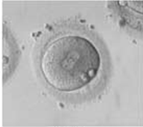
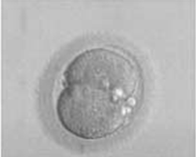
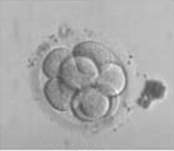
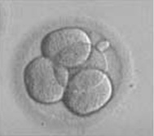
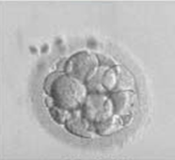
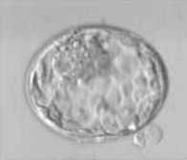

Slide 9
Semi-
Conservative
Conservative
Dispersive

Slide 11
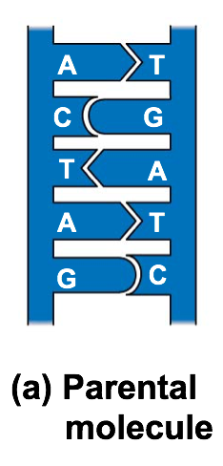
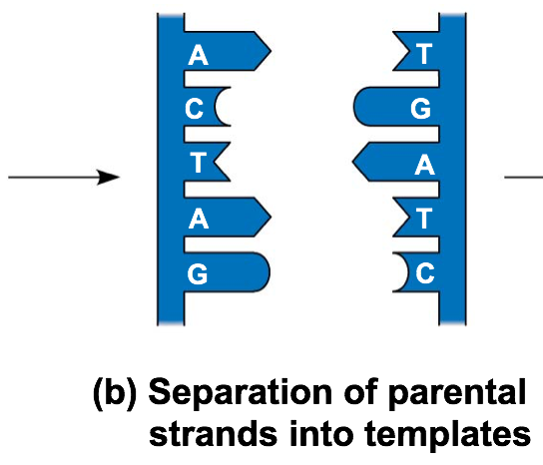
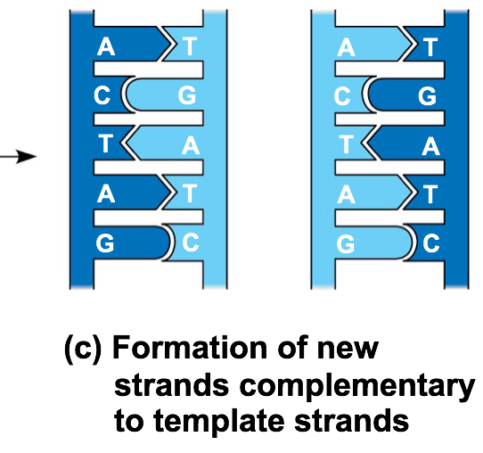
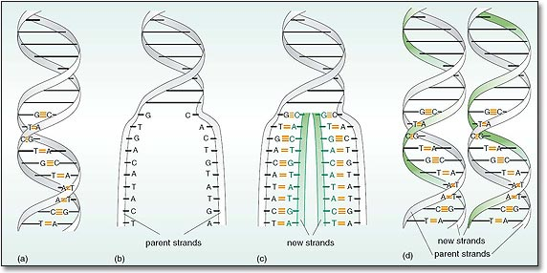
Semiconservative Model
Each of the new DNA molecules are exact copies of each other.
In each molecule there is one original strand and one new strand

Slide 12
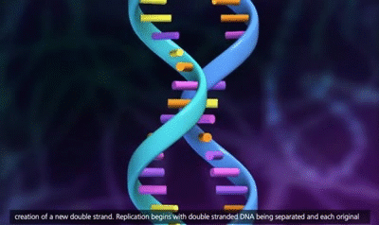

Slide 13
How do you make copies?
Step 1: A helicase enzymes unzips the two strands by breaking the hydrogen bonds between bases
Step 2: DNA polymerase enzymes add complimentary nucleotides to each of the original strands
Step 3: DNA polymerase enzymes are released leaving you with two identical DNA molecules

Slide 14
Step 1: Unzipping the DNA
Helicase enzymes bind to an origin of replication and unzip the two strands by breaking the hydrogen bonds… creating a replication bubble and replication forks
-Single stranded binding proteins bind to the strands to prevent them from re-connecting
-Topoisomerase helps relieve strain in the rest of the DNA molecule

Slide 15
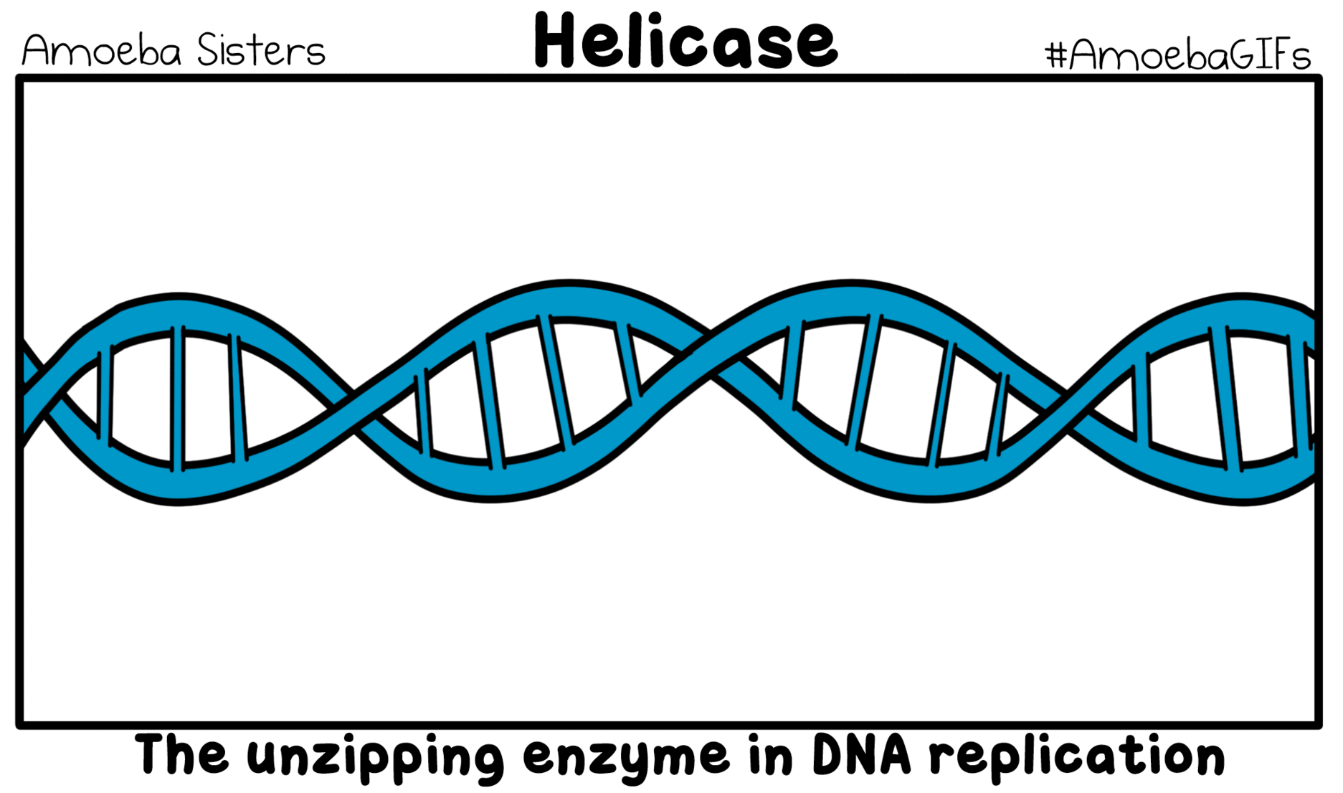

Slide 16
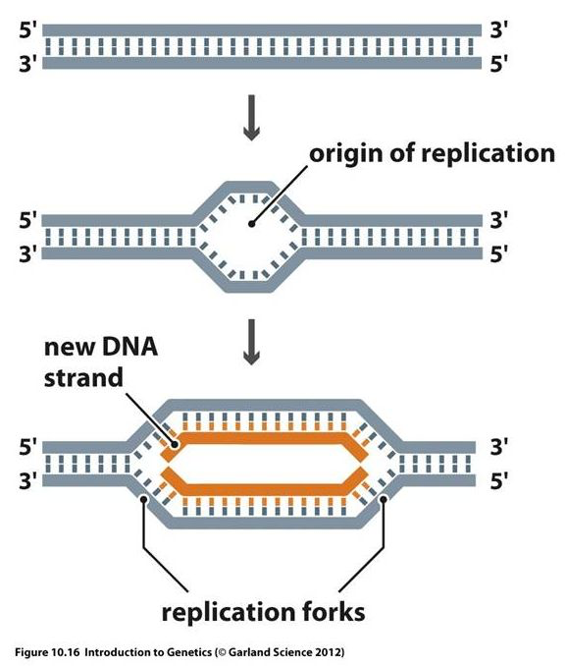
Sequence of DNA that basically says… HEY!!!START HERE
Origin of Replication

Slide 17
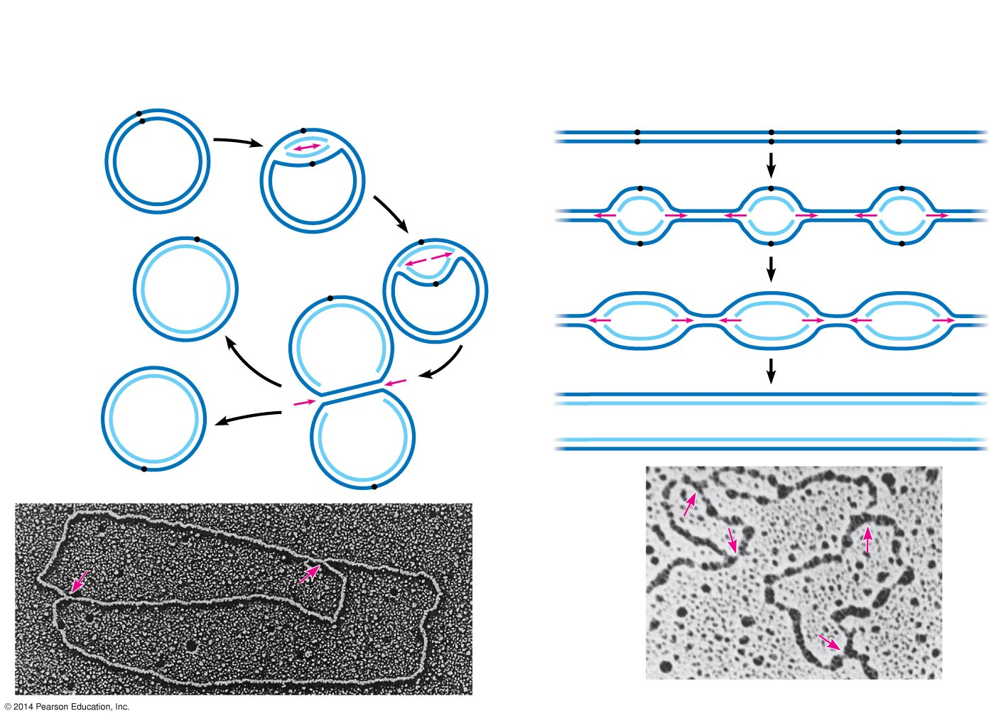
Figure 13.13
(a) Origin of replication in an E. coli cell
(b) Origins of replication in a eukaryotic
cell
Origin of
replication
Parental
(template) strand
Origin of
replication
Double-stranded
DNA molecule
Daughter
(new) strand
Parental (template)
strand
Daughter (new)
strand
Replication
fork
Double-
stranded
DNA
molecule
Replication
bubble
Replication fork
Bubble
Two
daughter DNA
molecules
Two daughter DNA molecules
0.5 μm
0.25 μm
Notes:
17
Figure 13.13 Origins of replication in E. coli and eukaryotes

Slide 18
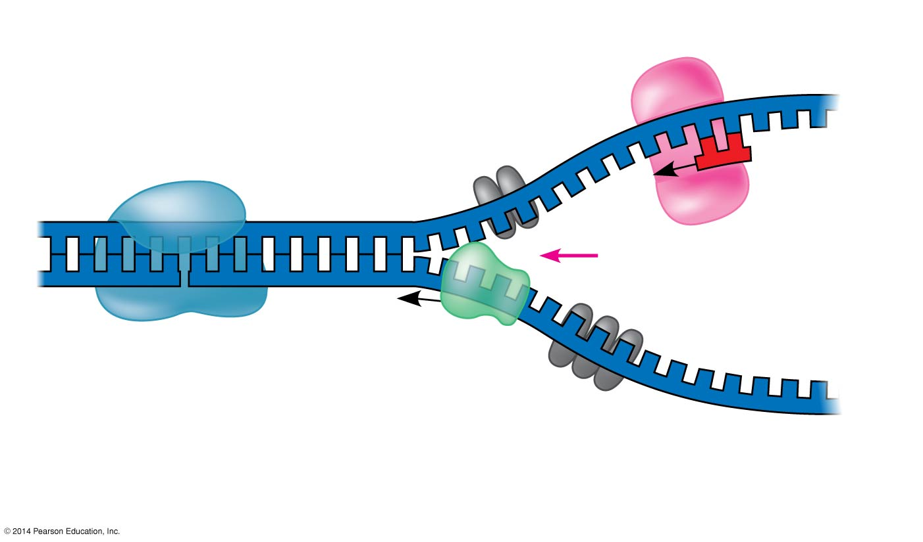
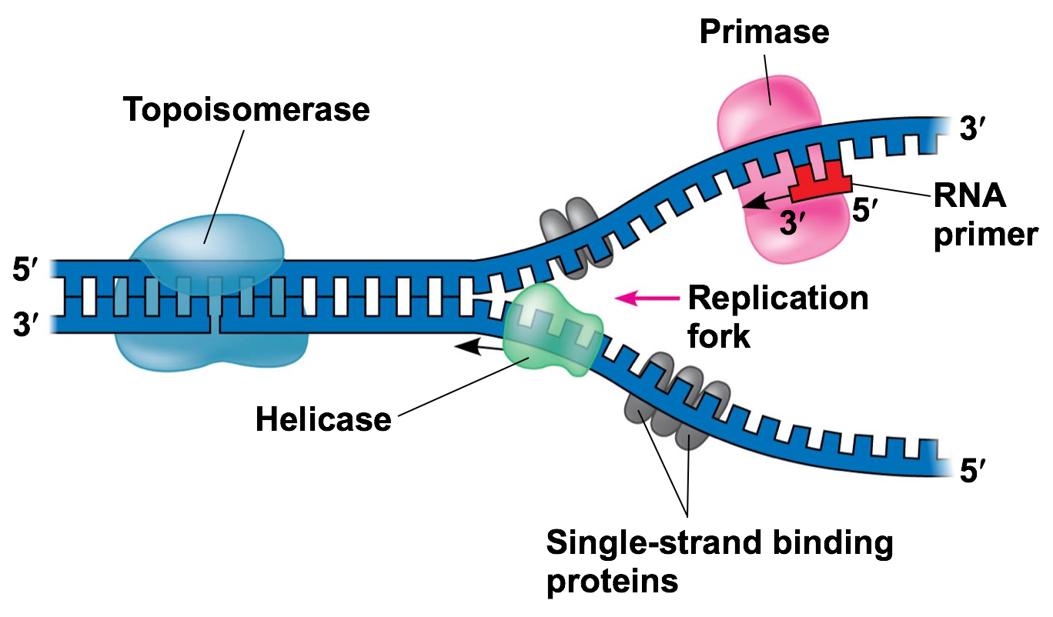

Slide 19
Step 2: Adding Nucleotides
-RNA primase adds an RNA primer (sequence of 5-10 RNA nucleotides) to start the process
-DNA polymerase III adds new nucleotides to the 3’ end, elongating the new DNA strand in a 5’ → 3’ direction

Slide 20
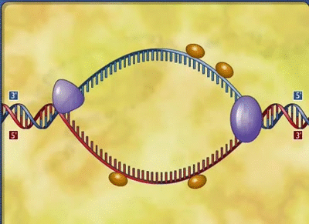

Slide 21
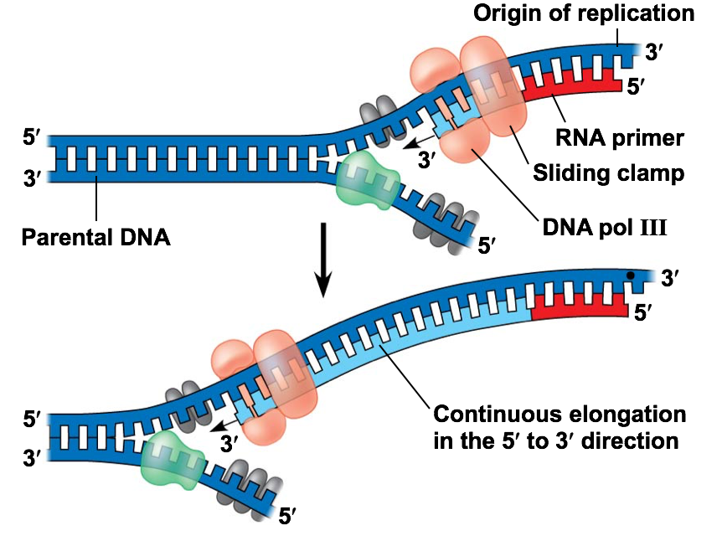

Slide 22
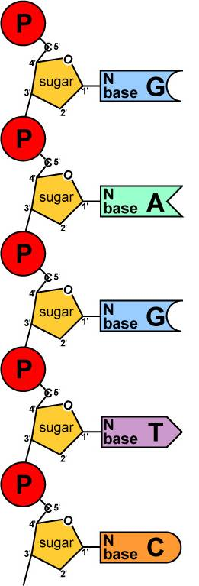
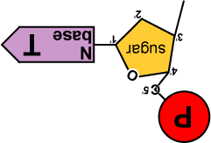
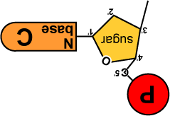
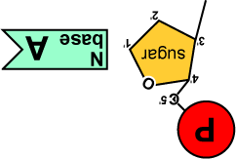
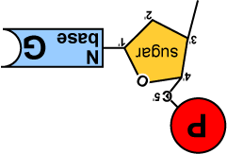
DNA
Polymerase III
Foglia
Notes:
Ask which way will it be built?

Slide 23
What type of reaction?
Anabolic or Catabolic?
Exergonic or Endergonic?

Slide 24
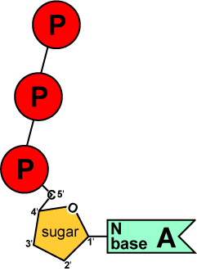
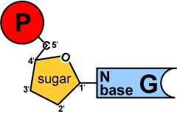
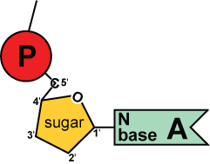
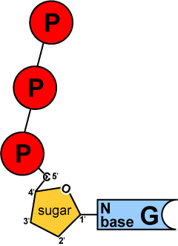
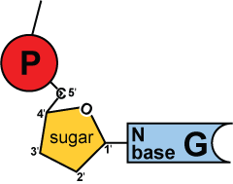
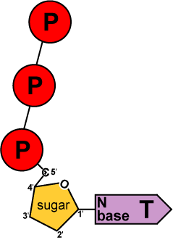
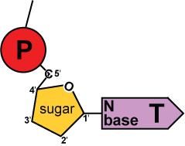
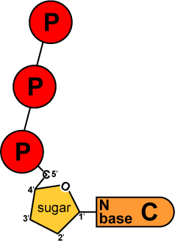
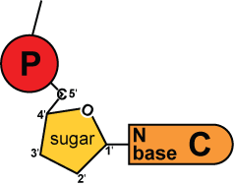
Where is the energy coming from?
5′
3′
energy
DNA
Polymerase III
Nucleotides arrive as nucleosides with 3 phosphate groups!
*Removal of phosphates provides energy!
DNA
Polymerase III
energy
DNA
Polymerase III
energy
DNA
Polymerase III
energy
3′
5′

Slide 25
The Problem!!!

Slide 26
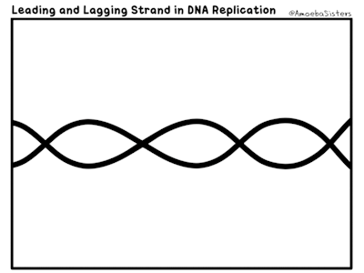

Slide 27
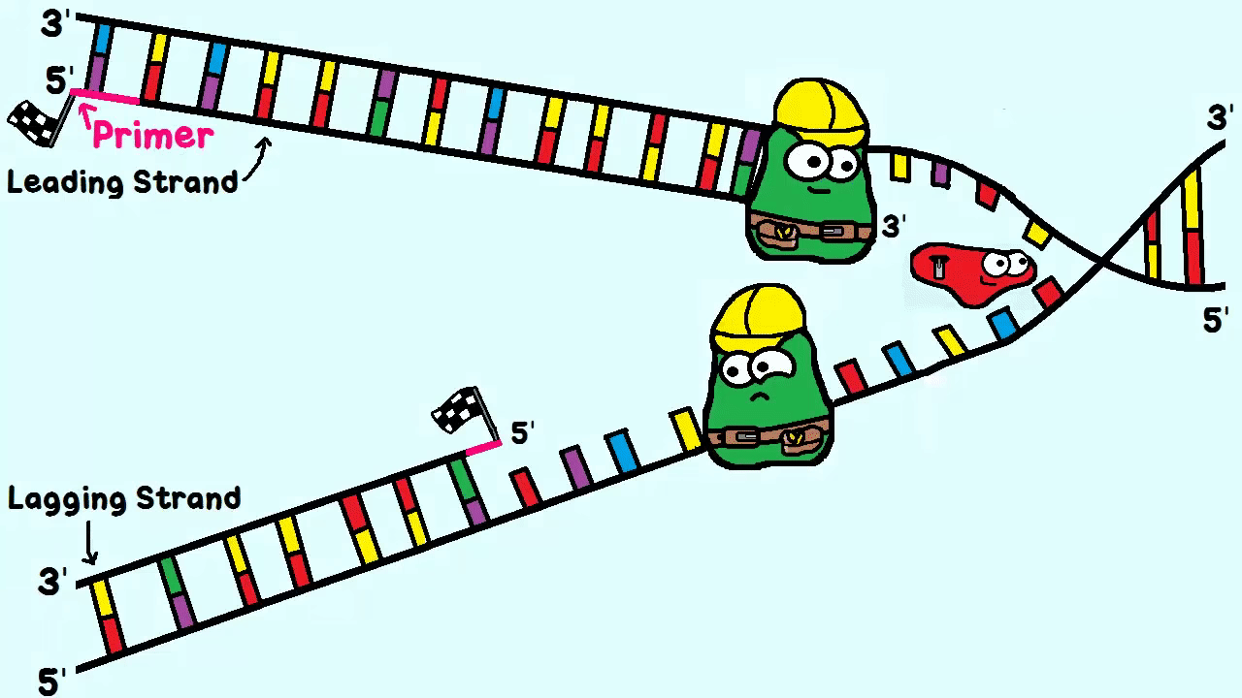

Slide 29
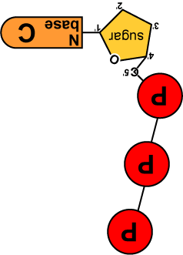
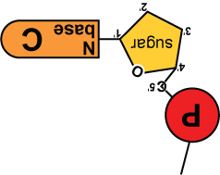
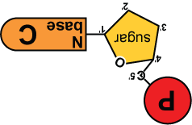
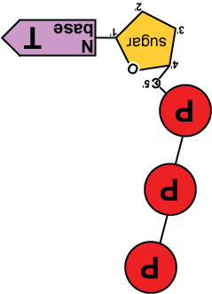
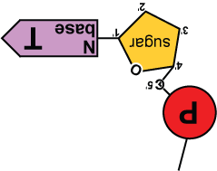
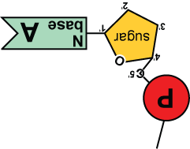
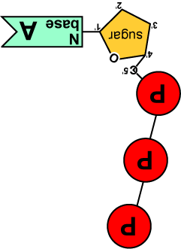
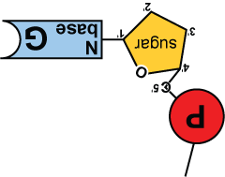
5′
3′
5′
need “primer” bases to add on to
3′
energy
no energy to bond
✗
energy
energy
energy
energy
ligase
energy
energy
3′
5′
3′
5′

Slide 30
Leading Strand vs. Lagging Strand
Leading strand- Needs only one primer and DNA polymerase III continuously adds nucleotides 5’ → 3’ direction

Slide 31
Leading Strand vs. Lagging Strand
Lagging strand- The strand that goes in the 3’ → 5’ direction so DNA polymerase III does not work
*Many primers are needed and nucleotides are added in short segments (Okazaki fragments) in 5’ → 3’ direction

Slide 32
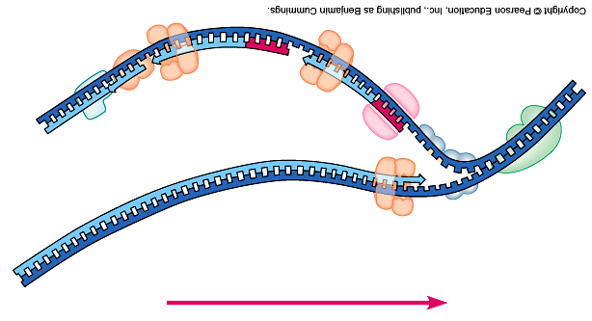
Replication fork
DNA polymerase III
lagging strand
DNA polymerase I
3’
Okazaki fragments
primase
5’
5’
ligase
3’
5’
SSB
3’
helicase
DNA polymerase III
5’
leading strand
3’
direction of replication
Foglia
SSB = single-stranded binding proteins

Slide 33
5′
3′
5′
need “primer” bases to add on to
3′
energy
no energy to bond
✗
energy
energy
energy
energy
ligase
energy
energy
3′
5′
3′
5′

Slide 34
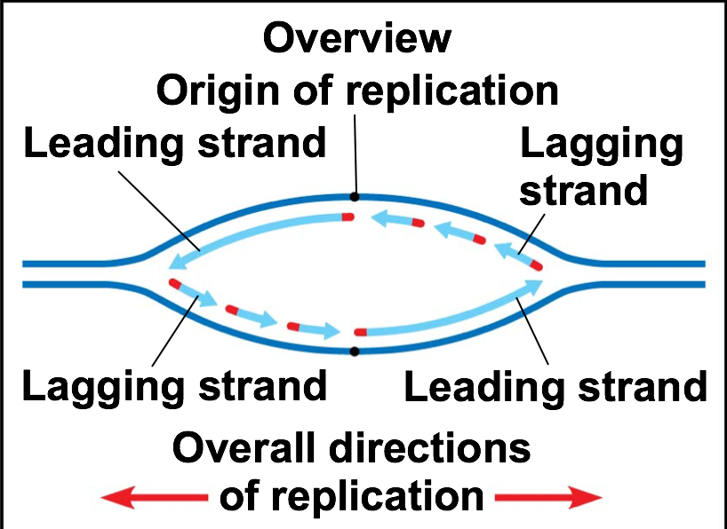

Slide 35
Steps for Elongation of the lagging strands
RNA primase adds RNA primer
DNA Polymerase III adds nucleotides in 5’ to 3’ direction
DNA Poly III detaches when it reaches next primer
DNA Polymerase I replaces the RNA primer with DNA nucleotides
DNA ligase joins the Okazaki fragments

Slide 36
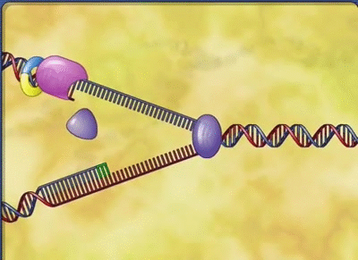

Slide 37
Proofreading and Repairing
-DNA polymerase enzymes have proofreading mechanism… only 1 in 10 billion errors
-Mismatch repair: other enzymes review DNA, cuts out and replaces incorrect nucleotides
-Nucleotide excision repair- damaged DNA is cut out and replaced
Ex: Thymine dimers ---Xeroderma pigmentosum

Slide 38
Mutations
Can lead to evolution:
The proteins may work better or cause the organism to look different

Slide 39
Replicating the telomeres
Telomeres are repeat segments of TTAGGG at the ends of DNA molecules
Telomeres get shorter every time DNA is replicated
Telomerase enzymes lengthen ends but only in germ cells, cancer cells and stem cells

