Slide 1
Translation
Reading the instructions and building a protein!

Slide 2
How many proteins?
How many different types of proteins does it take to make a human?
Estimated…2-6
million different types

Slide 3
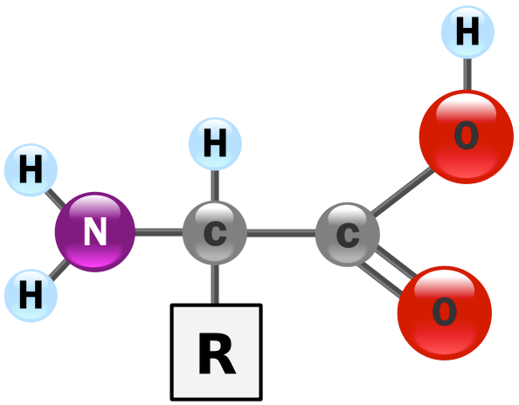
How do you build a protein?
To build a protein you connect together _________
There are _______________
_________
The amino acids are identical
but different
What does the above statement mean?
amino acids
20 different amino
acids

Slide 4
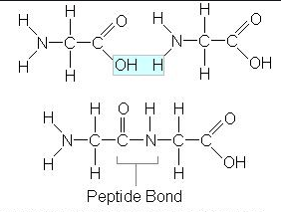
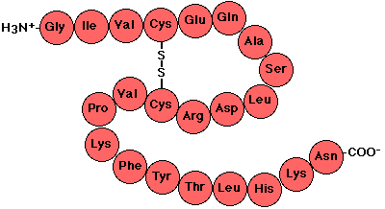

Slide 5
Cow Milk
Protein
Cell Death Fighting Protein
Cell Membrane Protein Receptor
Blood Vessel Protein
Green Florescent Protein
Growth Hormone Protein
Notes:
Protein receptor for cell death, green florescent protein, protein to help fight cell death, protein found in milk, blood vessel protein, Growth protein

Slide 6
Myosin Muscle Protein
Collagen Protein
Hemoglobin Protein
Insulin Protein

Slide 7
Translation
Step 2 of Protein Synthesis
***Read the instructions in the mRNA and connect together amino acids to build a protein

Slide 8
Translation on paper
*Must always transcribe before you can translate
Key term: codon- every 3 bases in mRNA
1 codon codes for 1 amino acid
DNA: TACTCTGGATTCAGCCAAGCTATC
mRNA:
Amino :
Acids of
protein
AUGAGACCUAAGACGGUUCGAUAG
Met
Arg
Pro
Asn
Ser
Val
Arg

Slide 9
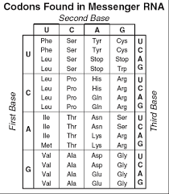

Slide 10
Significance of Translation?
Builds protein to exact specifications of DNA instructions.
*exact size and shape
What determines size and shape?
The number and sequence of amino
acids

Slide 11
Where does it take place?
On a ribosome in the cytoplasm
Ribosomes provide a location for all necessary parts for building a protein to assemble

Slide 12
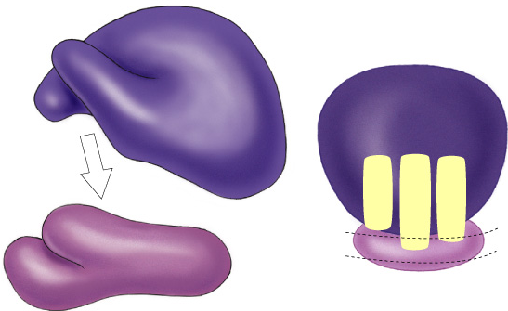
The ribosome up close
Made of 2/3 rRNA and 1/3 proteins
Key features:
- 2 subunits, large and small
*small is first to bind to mRNA
- 3 binding sites- A, P, E
*A- holds next tRNA in line to drop off its
amino acid
*P- Site where tRNA connects its amino acid
to the growing polypeptide chain
*E- exit site once the tRNA has dropped off
its amino acid

Slide 13
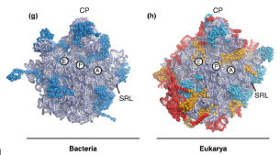
Prokaryote vs. Eukaryote Ribosomes
Eukaryote ribosomes are bigger because they have more rRNA strands to build it.
Eukaryotes can be bound to rough ER.

Slide 14
t-RNA up Close
Made of RNA folded into a “clover leaf” shape
(~80 nucleotides)
tRNA physically bring amino acids to the ribosome and drop them off
Key features
- anticodon in the middle loop matches to codon to ensure correct amino acid is dropped off
- amino acid attached to its 3’ end (always the same one)

Slide 15
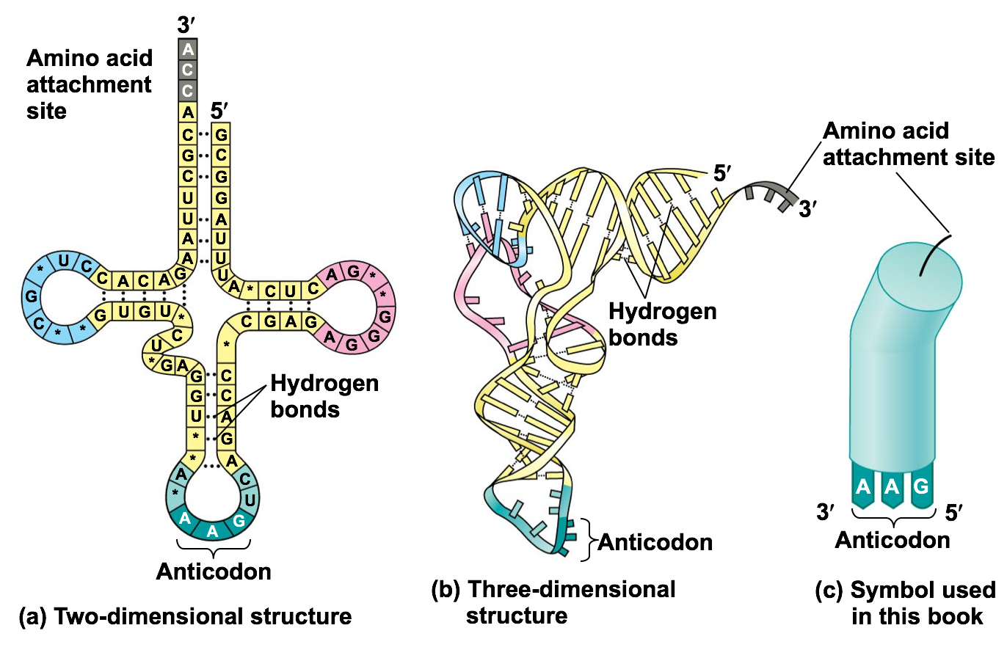

Slide 16
Loading tRNA
Aminoacyl tRNA synthetase (20 different ones)
Enzyme which bonds specific amino acid to tRNA
Each tRNA only carries one specific amino acid
Bonding amino acid to tRNA requires energy
ATP → AMP

Slide 17
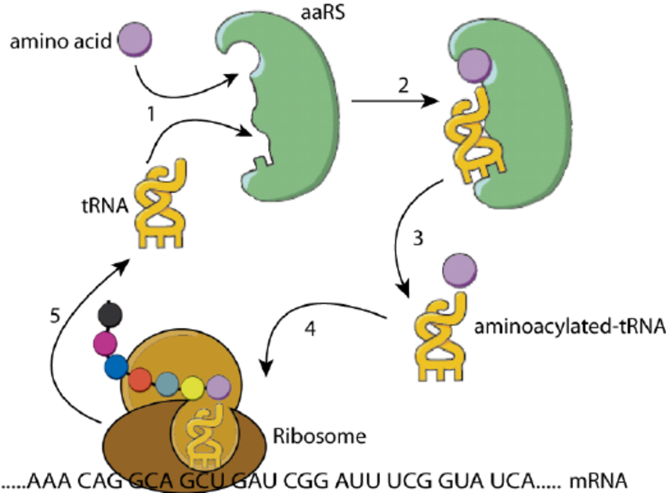

Slide 18
Factors
Factor- An additional protein needed to initiate/carry out one of the steps

Slide 19
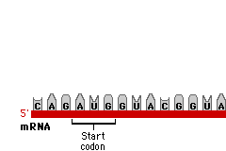
3 steps of Translation
Initiation
-Formation of the initiation complex:
1) mRNA, 2)small ribosomal subunit, 3)1st tRNA w/ Met, 4) large ribosomal subunit, 5) initiation factors
-GTP for energy to bind molecules together
-Eukaryotes bind their 5’ cap first

Slide 20
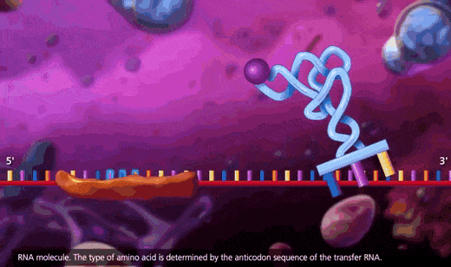
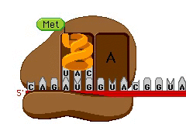
3 steps of Translation
Elongation
-Adding amino acids based on codon sequence (GTP energy used)
-Uses elongation factors to help assist
-tRNA’s deliver the amino acids by matching their anticodon to the correct codon in the mRNA
-Builds proteins by adding amino acid to the carboxyl terminus end of the previous amino acid

Slide 21
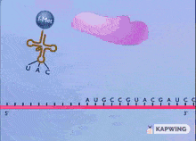
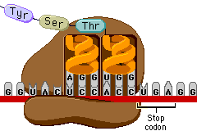
3 steps of Translation
Termination
-Need stop codon, release factor, H₂0, GTP
-Termination begins when a stop codon is reached (UAG, UAA, UGA)
-Release factor binds instead of tRNA. It uses hydrolysis w/GTP energy to break the bonds and releases the polypeptide

Slide 22
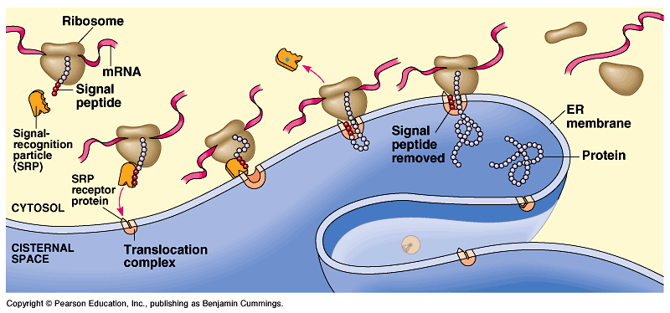
How do proteins know where to go?
Signal peptide- ~20 amino acids at start of protein that act as address label
Possible destinations:
-secreted from cell
-nucleus
-mitochondria
-chloroplast
-cell membrane
-cytoplasm

Slide 23
Translation in Prokaryotes
Transcription & translation are simultaneous in bacteria
*DNA is in cytoplasm
*no mRNA editing/processing
*ribosomes read mRNA as it is being transcribed

