Slide 1
Translation
Reading the instructions and building a protein!

Slide 2
Translation on paper
Must always transcribe before you can translate
1 codon codes for 1 amino acid
DNA: TACTCTGGATTCAGCCAAGCTATC
mRNA:
Amino :
Acids of
protein
AUGAGACCUAAGACGGUUCGAUAG
Met
Arg
Pro
Asn
Ser
Val
Arg

Slide 3
Significance of Translation?
Builds protein to exact specifications of DNA instructions.
*exact size and shape
What determines size and shape?
The number and sequence of amino
acids

Slide 4
Where does it take place?
On a ribosome in the cytoplasm
Ribosomes provide a location for all necessary parts for building a protein to assemble

Slide 5
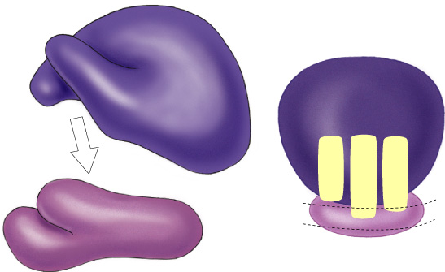
The ribosome up close
Made of rRNA and proteins
Key features:
- 2 subunits, large and small
*small is first to bind to mRNA

Slide 6
t-RNA up Close
Made of RNA folded into a “clover leaf” shape
***tRNA physically bring amino acids to the ribosome and drop them off
Key features
- Anticodon in the middle loop matches to codon to ensure correct amino acid is dropped off
Each tRNA only carries a specific amino acid

Slide 7
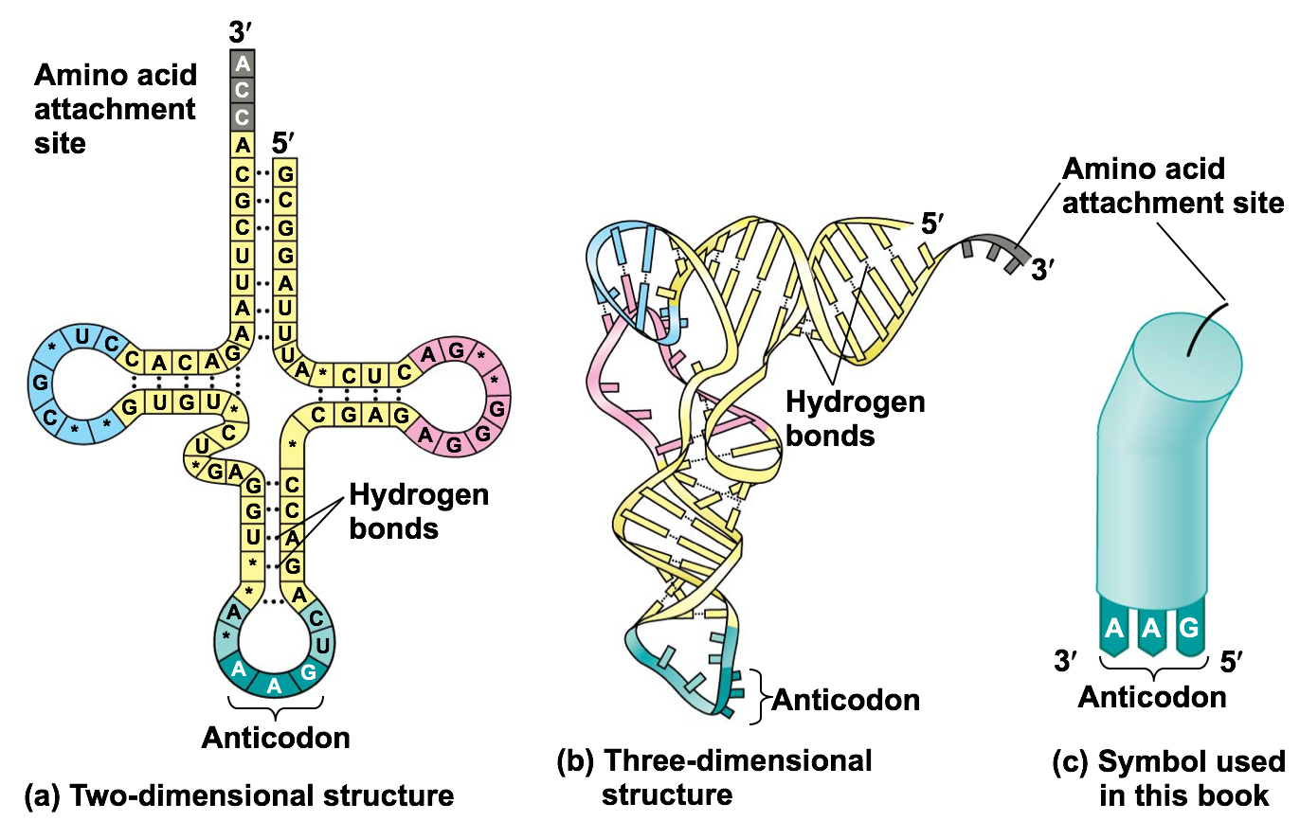

Slide 8
3 steps of Translation
Initiation
brings together mRNA by binding to 5’ cap, ribosome subunits, initiator tRNA
Elongation
adding amino acids based on codon sequence (GTP energy used)
Termination
Stop codon reached

Slide 9
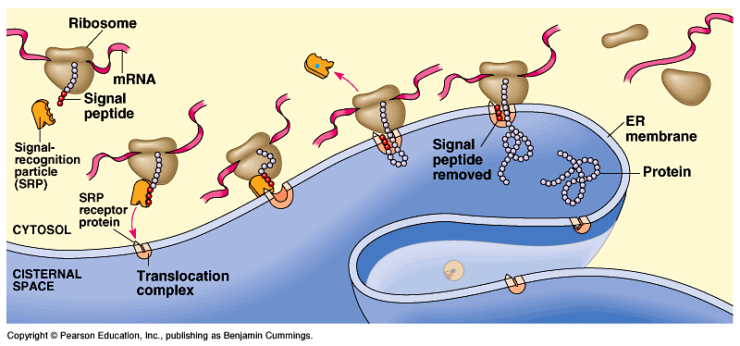
How do proteins know where to go?
Signal peptide- ~20 amino acids at start of protein that act as address label
Possible destinations:
-secreted from cell
-nucleus
-mitochondria
-chloroplast
-cell membrane
-cytoplasm

Slide 10
Translation in Prokaryotes
Transcription & translation are simultaneous in bacteria
*DNA is in cytoplasm
*no mRNA editing/processing
*ribosomes read mRNA as it is being transcribed

