Slide 1
The Calvin Cycle
Life from Air

Slide 2
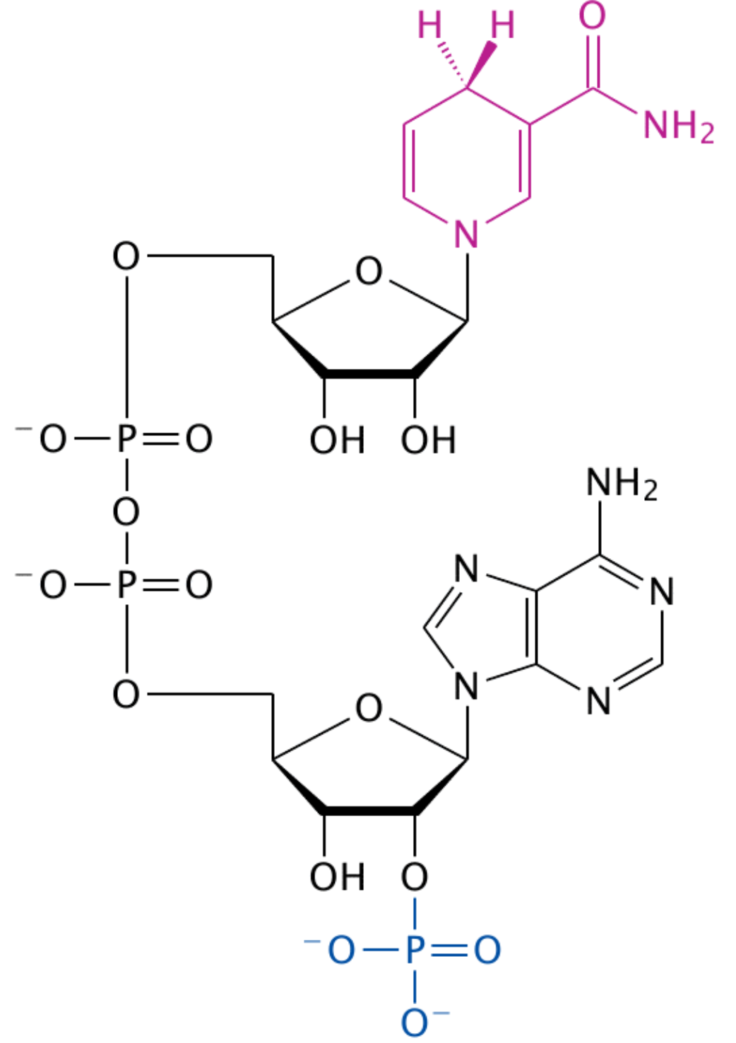
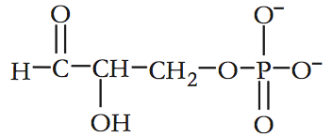
Purpose?
Use the chemical energy of ATP and NADPH to Reduce CO₂ to the sugar G3P…and eventually glucose!

Slide 3
CO₂ → C₆H₁₂O₆
-CO₂ has very little energy (fully oxidized)
-C₆H₁₂O₆ contains a lot of chemical
energy!!! (highly reduced)
-Synthesis from CO₂ to C₆H₁₂O₆ is an endergonic metabolic pathway with many small steps that adds energy
Notes:
Metabolic pathway means many enzymes with many products.

Slide 4
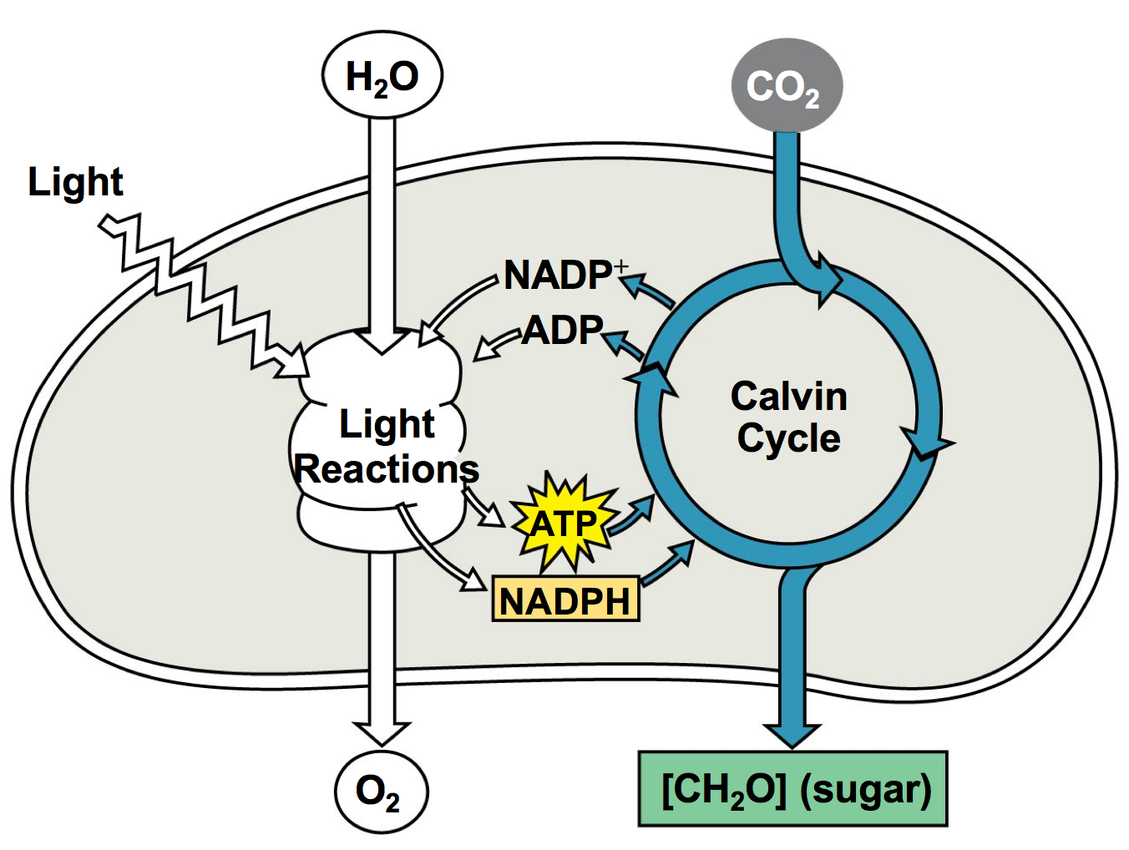
3 Phases
3 phases take place in the stroma
Phase 1: Carbon Fixation
Phase 2: Reduction
Phase 3: Regeneration of RuBP (CO₂ acceptor)

Slide 5
Carbon Fixation
(3) CO₂ are added to (3) RuBP using rubisco enzyme, then become PGA
CO₂

Slide 6
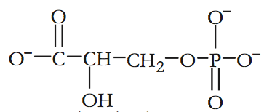
Reduction
6 ATP and 6 NADPH are used to reduce PGA to G3P

Slide 7
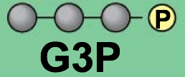
Regeneration (back to RuBP)
(1) G3P exits the cycle while the other (5) G3P + (3) more ATP are used to regenerate (3) RuBP again

Slide 8
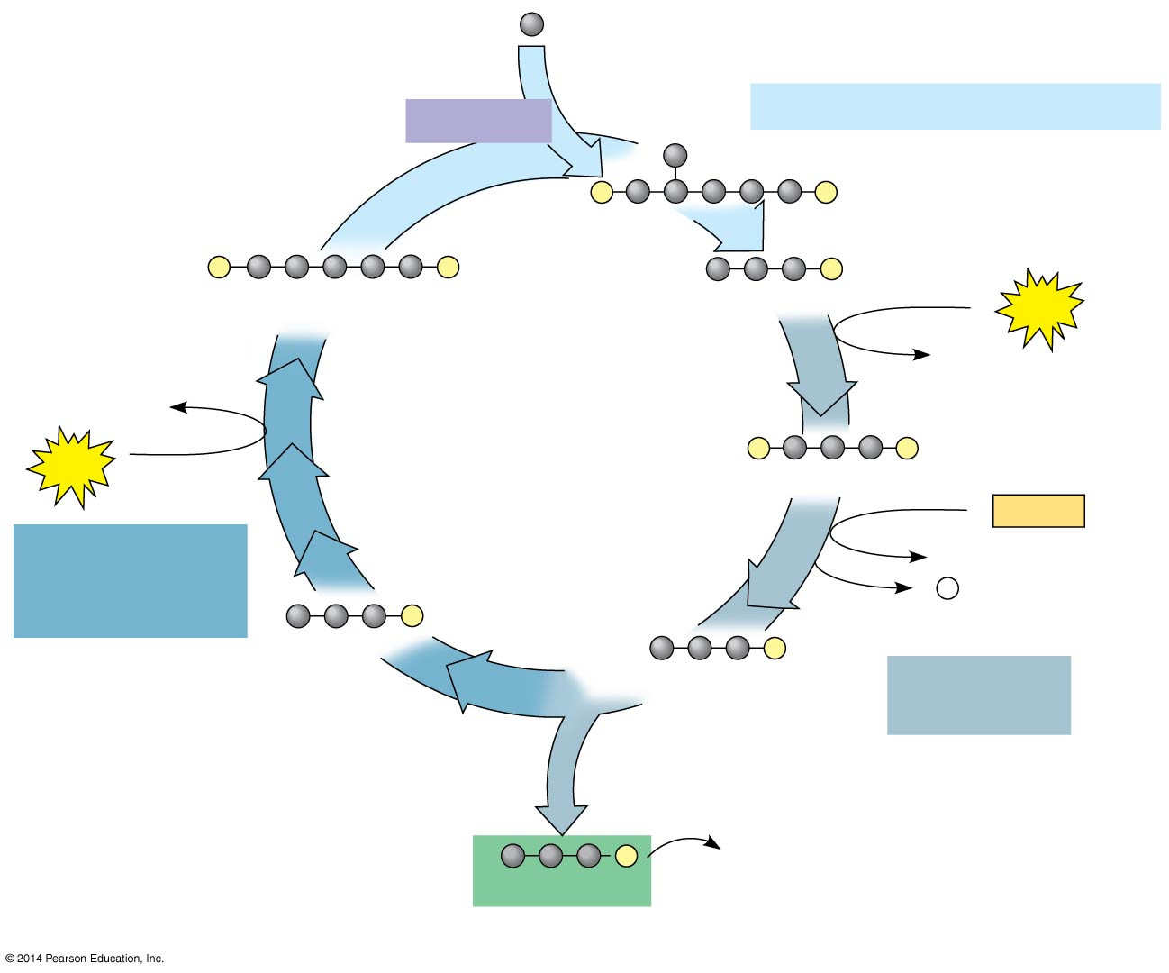
Input 3
as 3 CO₂
Rubisco
Phase 1: Carbon fixation
3
P
P
3
P
P
6
P
RuBP
3-Phosphoglycerate
6
ATP
6 ADP
3 ADP
Calvin
Cycle
3
ATP
6
P
P
1,3-Bisphosphoglycerate
6
NADPH
Phase 3:
Regeneration
of RuBP
6 NADP⁺
6 P _{i}
5
P
G3P
6
P
G3P
Phase 2:
Reduction
1
P
Glucose and
other organic
compounds
G3P
Output
Notes:
8
Figure 8.17-3 The Calvin cycle (step 3)

Slide 9
The Numbers
What goes in?
3 CO₂
3 RuBP
9 ATP
6 NADPH
What comes out?
1 G3P (3 carbon sugar)
9 ADP + P_{i}
6 NADP⁺
3 RuBP
What would it take to make glucose?
6CO₂ + 6 H₂O → C₆H₁₂O₆ + 6O₂

Slide 10
What happens to the G3P?

Slide 11
What happens to the G3P?

Slide 12
Summary of photosynthesis
6CO₂
+
6H₂O
+
light
energy
→
C₆H₁₂O₆
+
6O₂
Where did the CO₂ come from?
Where did the CO₂ go?
Where did the H₂O come from?
Where did the H₂O go?
Where did the energy come from?
What’s the energy used for?
What will the C₆H₁₂O₆ be used for?
Where did the O₂ come from?
Where will the O₂ go?
What else is involved…not listed in this equation?
Foglia
Notes:
Where did the CO₂ come from? air
Where did the CO₂ go? carbohydrate (G3P)
Where did the H₂O come from? soil (xylem)
Where did the H₂O go? split to donate e- & H+
Where did the energy come from? sun
What’s the energy used for? to make ATP in light reactions
What will the C₆H₁₂O₆ be used for? the work of plant life
Where did the O₂ come from? splitting of H₂O
Where will the O₂ go? air or respiration
What else is involved…not listed in this equation?
ATP, ADP, NADP, NADPH

