Slide 1
Cell Communication
Protein receptor Types and Transduction Pathways

Slide 2
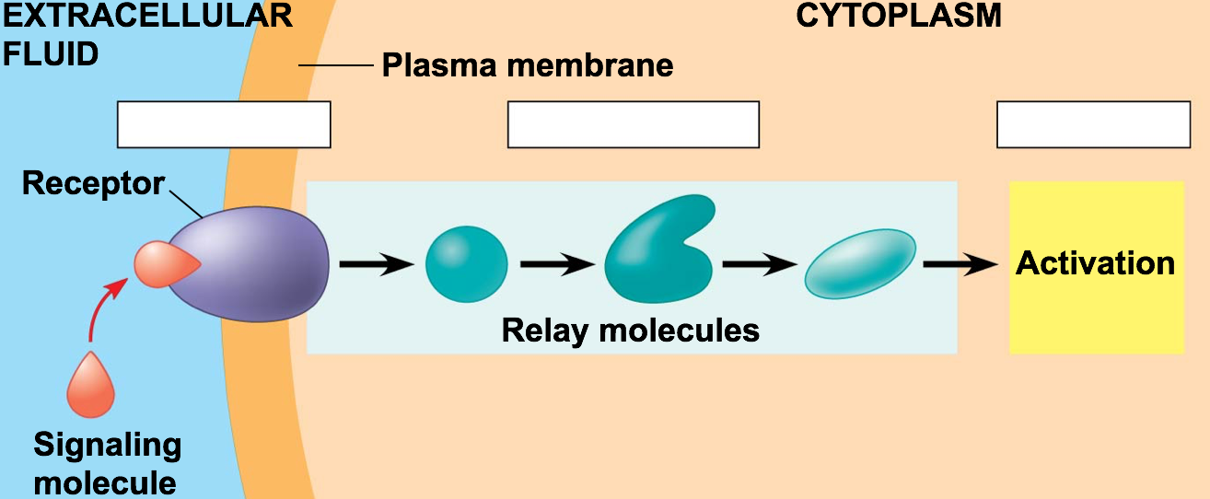
3 Stages of Cell Communication
Reception
Transduction
Response
Modifications and Changes!!!

Slide 3
Environment and Change
Change in the cells/organisms environment will cause a (temporary) change in the cell
Example:
Epinephrine (adrenaline)
-Stress causes release from adrenal glands
-Epinephrine targets liver and muscle cells
- Liver and muscle activate enzyme that breaks apart glycogen
- Glucose is released into the blood to provide energy for the
body

Slide 4
3 Stages of Cell Communication
Reception
Transduction
Response
Modifications and Changes!!!

Slide 5
3 Major types of Cell Membrane Protein Receptors
1) G protein-coupled receptors
2) Ligand-gated ion channels
3) Tyrosine Kinases

Slide 6
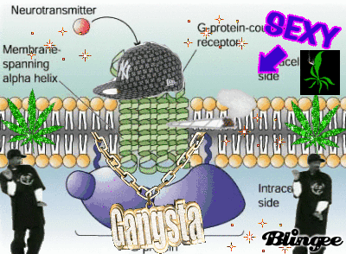
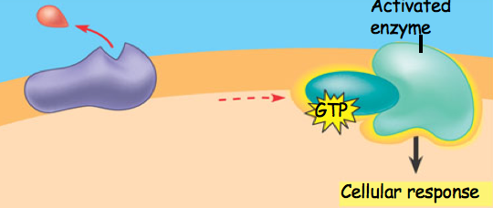
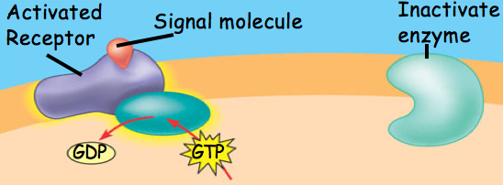
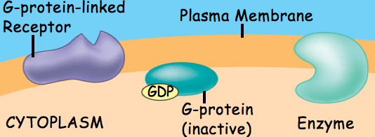
G-Protein Coupled Receptor
Used in: embryonic development, taste
smell
Diseases can interfere in G-protein function:
Cholera, Pertussis, Botulism
60% of medicines affect G-protein pathways

Slide 7
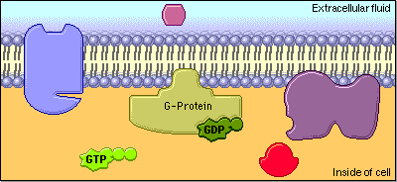

Slide 8
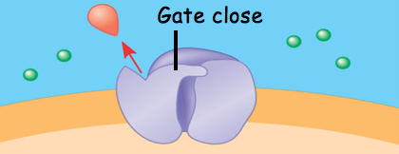
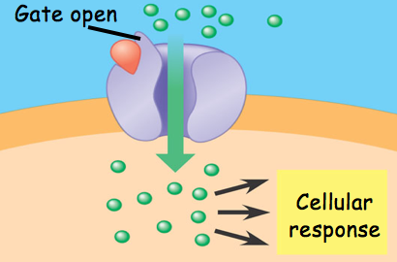
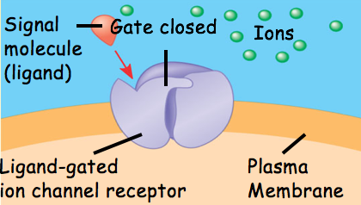
Ligand-Gated Ion Channel
Used in many diverse processes, Nervous system

Slide 9
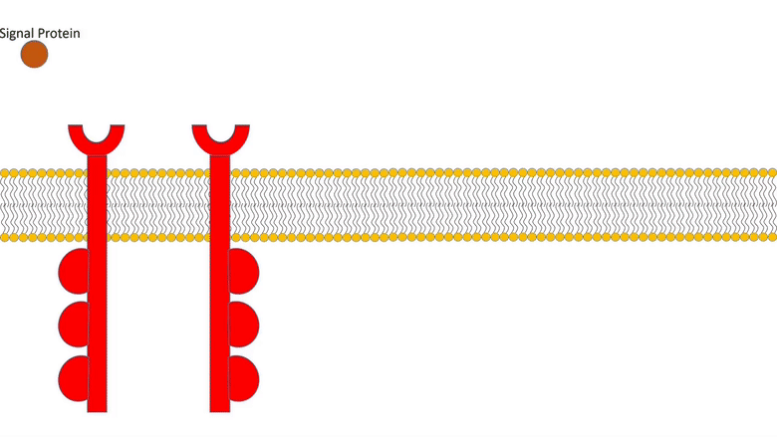
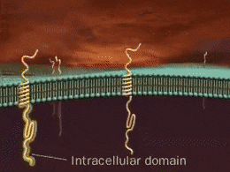
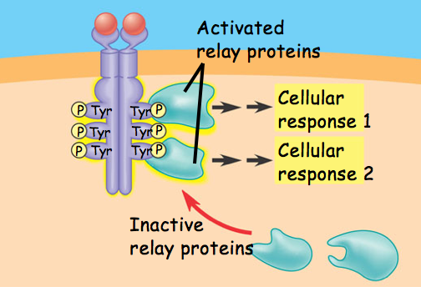
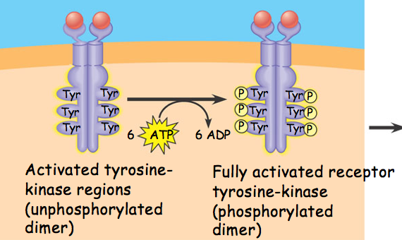
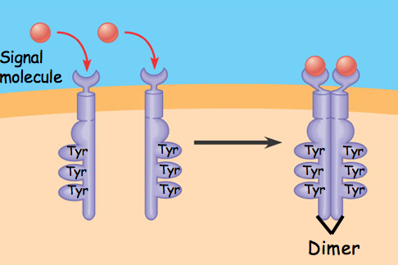
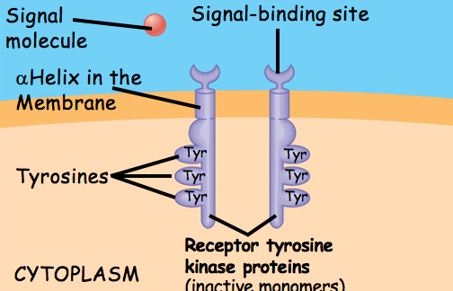
Tyrosine Kinase Receptors
Involved in: metabolism, cell cycle
Linked to: Cancers, diabetes, bone
disorders, inflammation

Slide 10
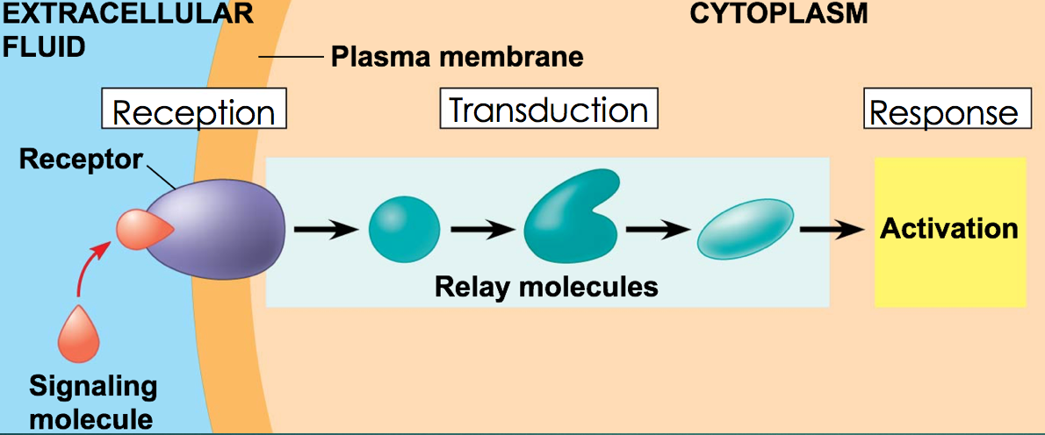
Signal Transduction Pathways
Signal Transduction Pathway= “Domino effect” in which a molecule is modified and activated, which modifies/activates another molecule…
Relay Molecules: Usually large proteins that are modified to become active
Example: Protein Kinases- molecules that modify/activate the next molecule by phosphorylating it
Secondary messengers: small molecules, such as cyclic AMP or Ca⁺, that can be used to activate relay molecules in a pathway

Slide 11
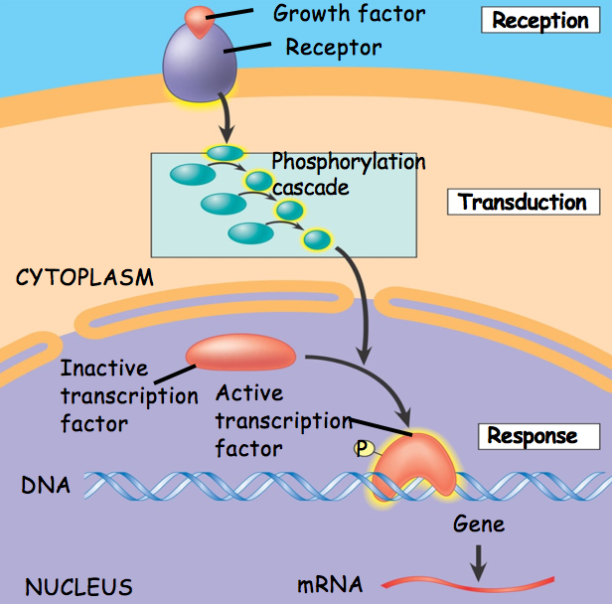
Example 1: Phosphorylation Cascade

Slide 12
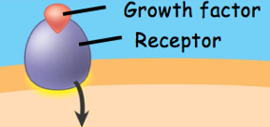
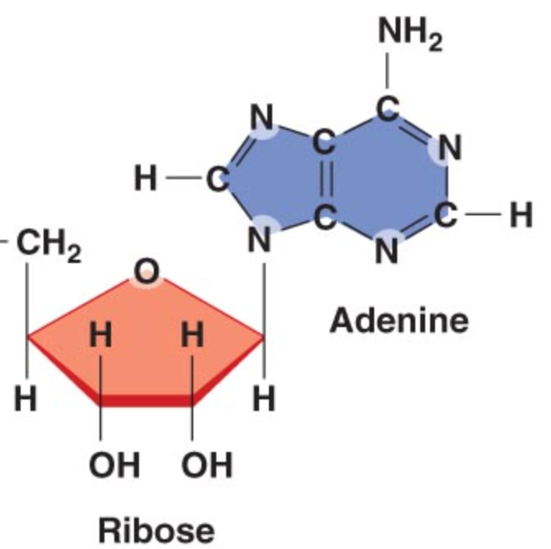
Example 1: Phosphorylation Cascade
P
P
P
P
P
P
P
P

Slide 13
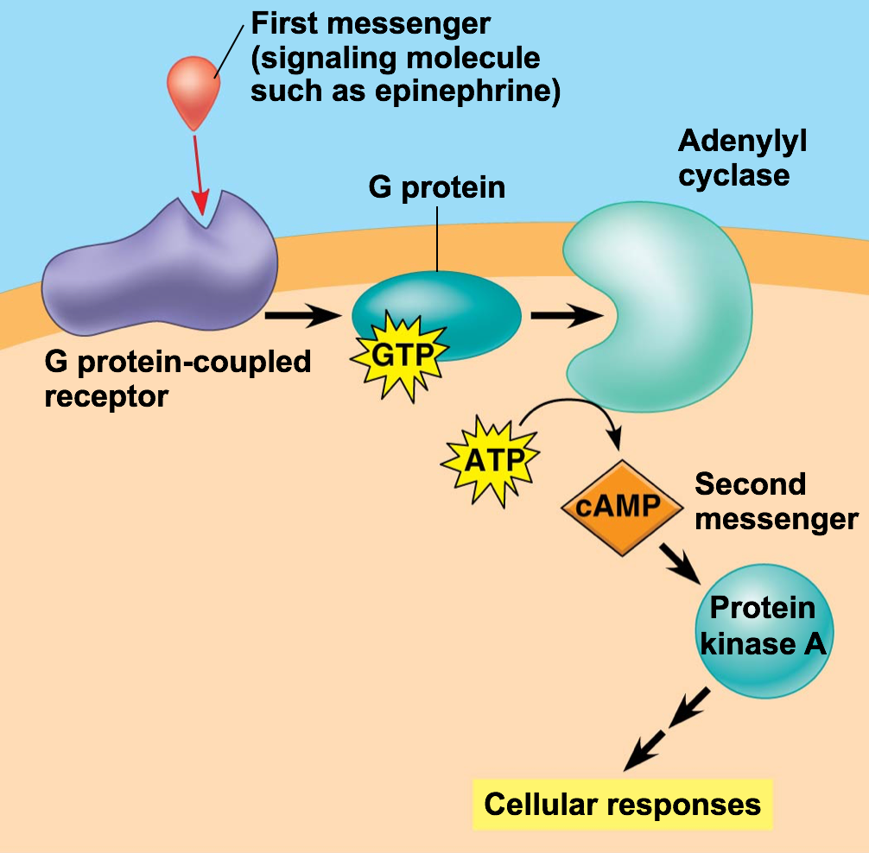
Example 2: Secondary Messengers

Slide 14
Big Idea
A series of changes during a signal transduction pathway leads to an overall change (usually temporary) in the cell!
I feel different…

