Slide 1
CHONP and Proteins
S
Building Block of Life

Slide 2
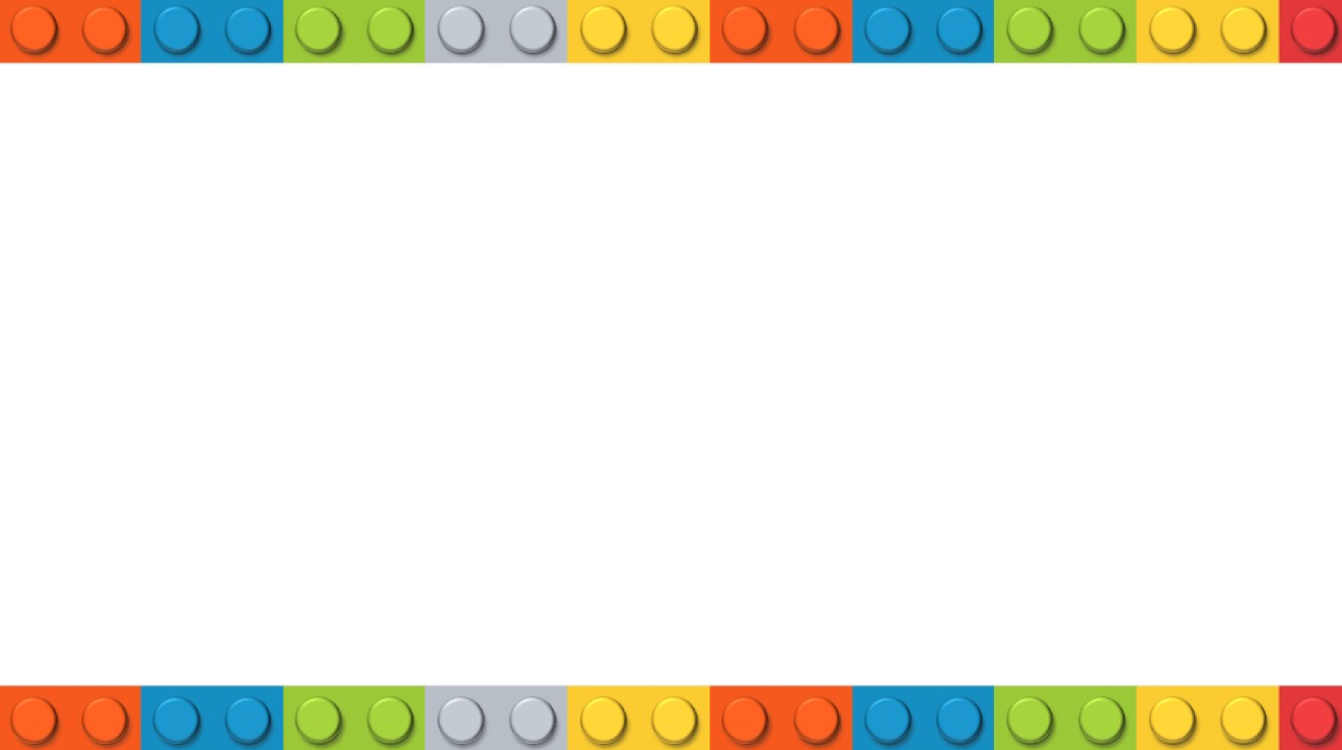
What is CHONP ?
S
Acronym for the most common elements (atoms) found in living things
C= Carbon
N= Nitrogen
H= Hydrogen
P= Phosphorous
O= Oxygen
= Sulfur
S

Slide 3
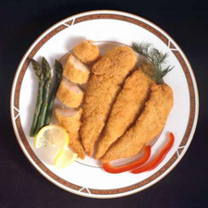
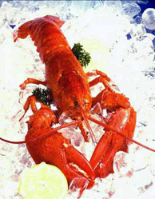
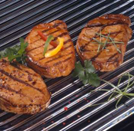
Proteins

Slide 4
Atoms
CHON
S

Slide 5
Monomer
Amino Acid

Slide 6
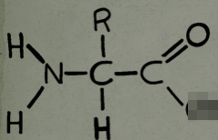
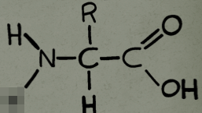
Polymer
Polypeptide
R
R
enzyme
Polypeptide bond
H₂O

Slide 7
Functions
Most structurally & functionally diverse macromolecule
Function: involved in almost everything that goes on in a living thing! (50% dry mass of cells)
1) enzymes (pepsin, DNA polymerase)
2) structure (keratin, collagen)
3) carriers & transport (hemoglobin, aquaporin)
4) cell communication
signals (insulin & other hormones)
receptors
5) defense (antibodies)
6) movement (actin & myosin)
7)storage (bean seed proteins)

Slide 8
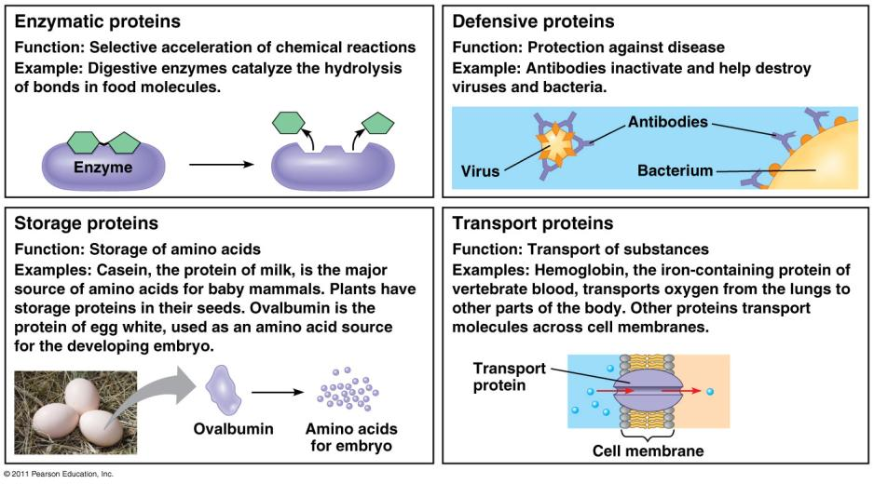

Slide 9
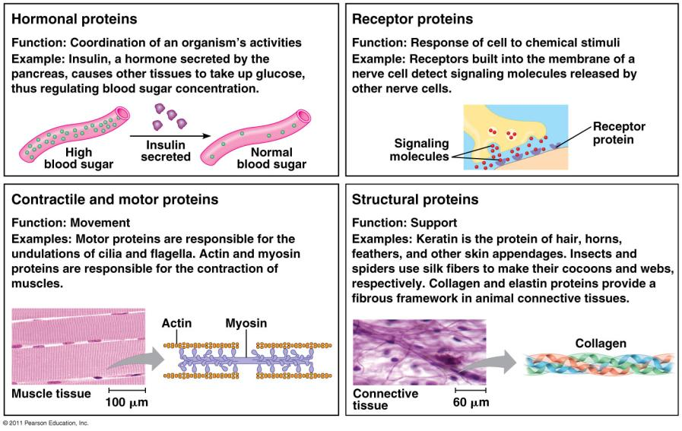

Slide 10
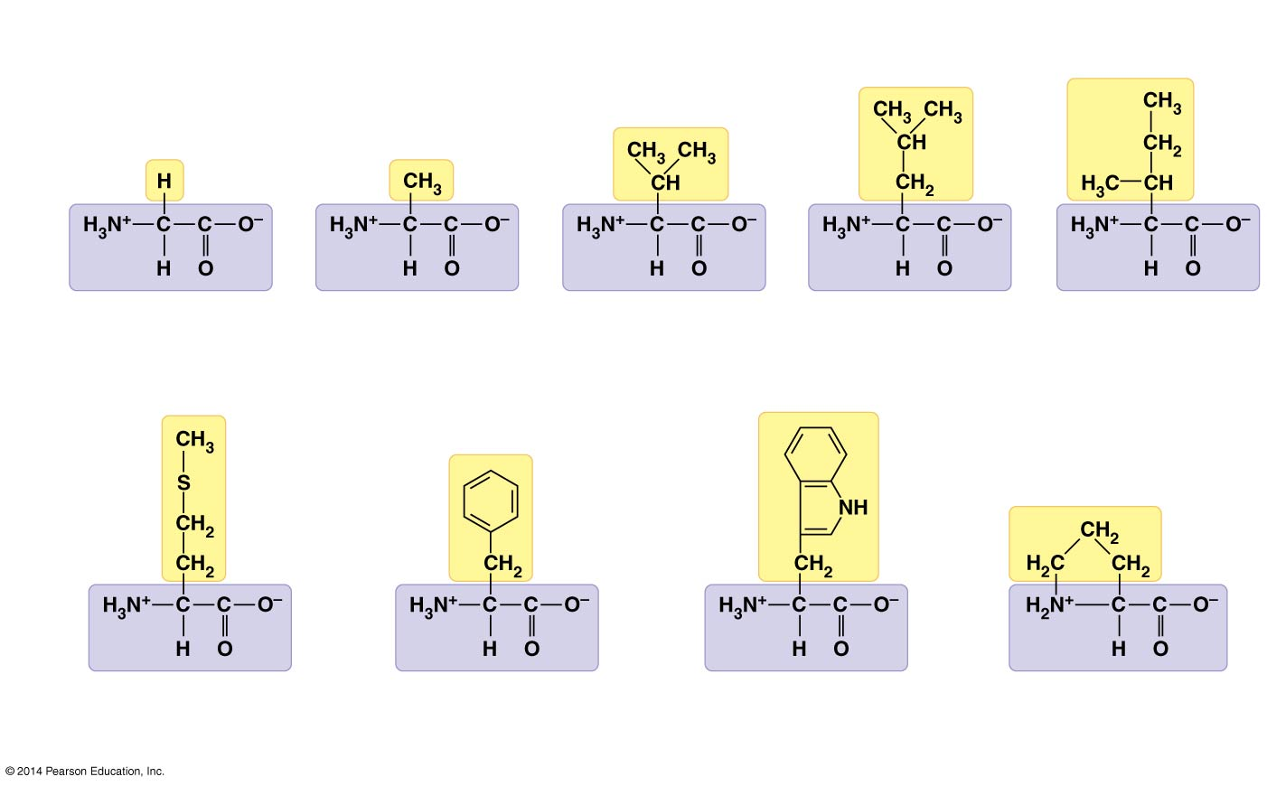
Side Chain Groupings
Nonpolar side chains; hydrophobic

Slide 11
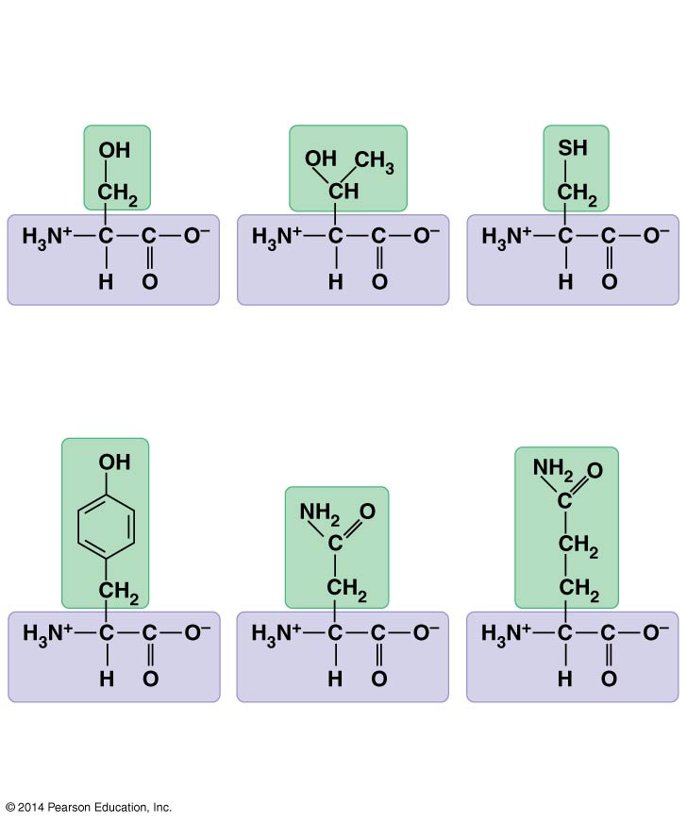
Side Chain Groupings
Polar side chains; hydrophilic
Serine
(Ser or S)
Threonine
(Thr or T)
Cysteine
(Cys or C)
Tyrosine
(Tyr or Y)
Asparagine
(Asn or N)
Glutamine
(Gln or Q)

Slide 12
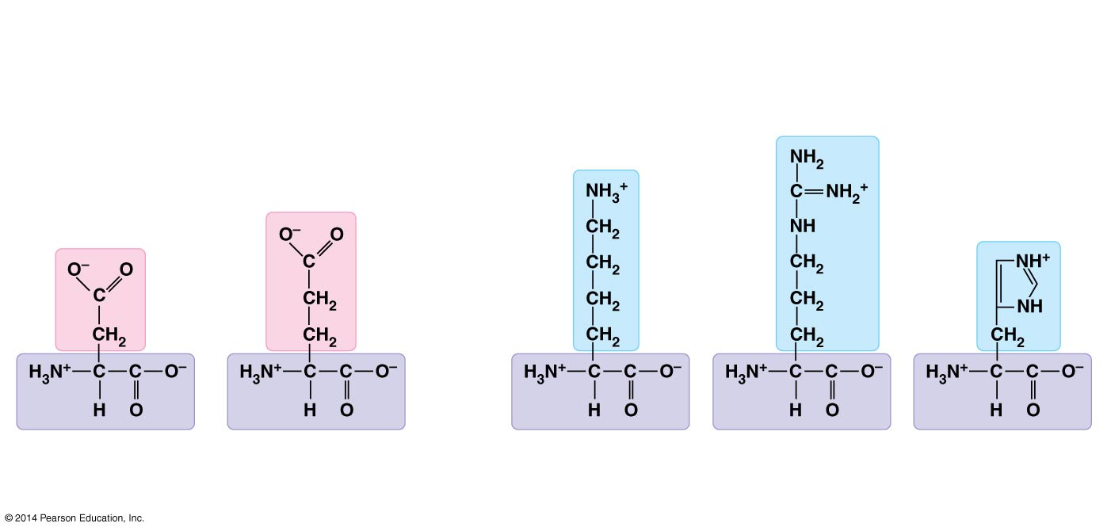
Side Chain Groupings
Electrically charged side chains; hydrophilic
Basic (positively charged)
Acidic (negatively charged)
Aspartic acid
(Asp or D)
Glutamic acid
(Glu or E)
Lysine
(Lys or K)
Arginine
(Arg or R)
Histidine
(His or H)

Slide 13
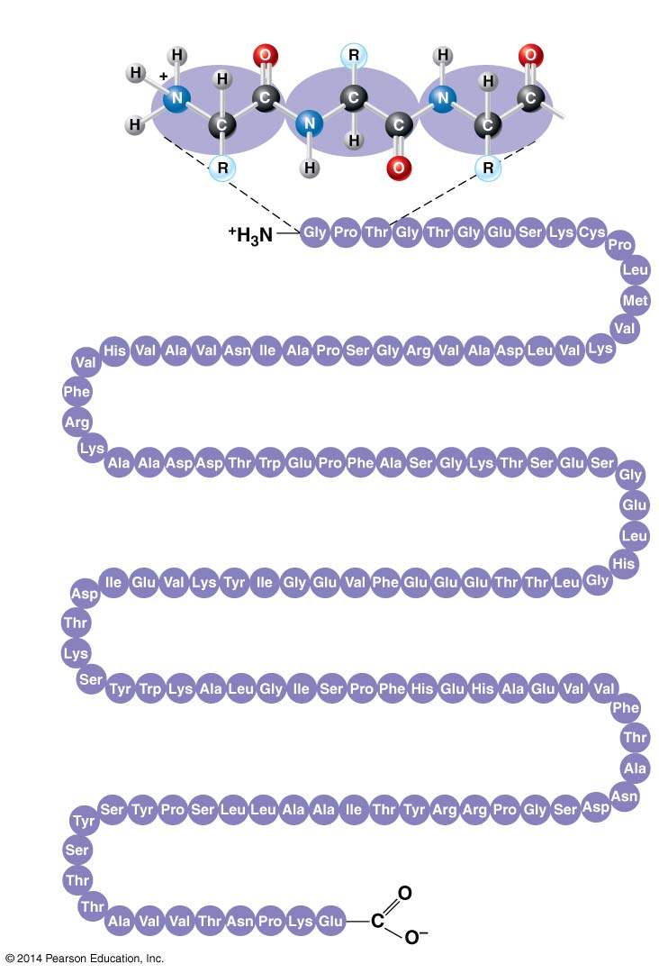
Primary Structure
Determined by:
Sequence (order) of amino acids in chain
*This order is determined by DNA
instructions
*Even just one amino acid change can
make a big difference

Slide 14
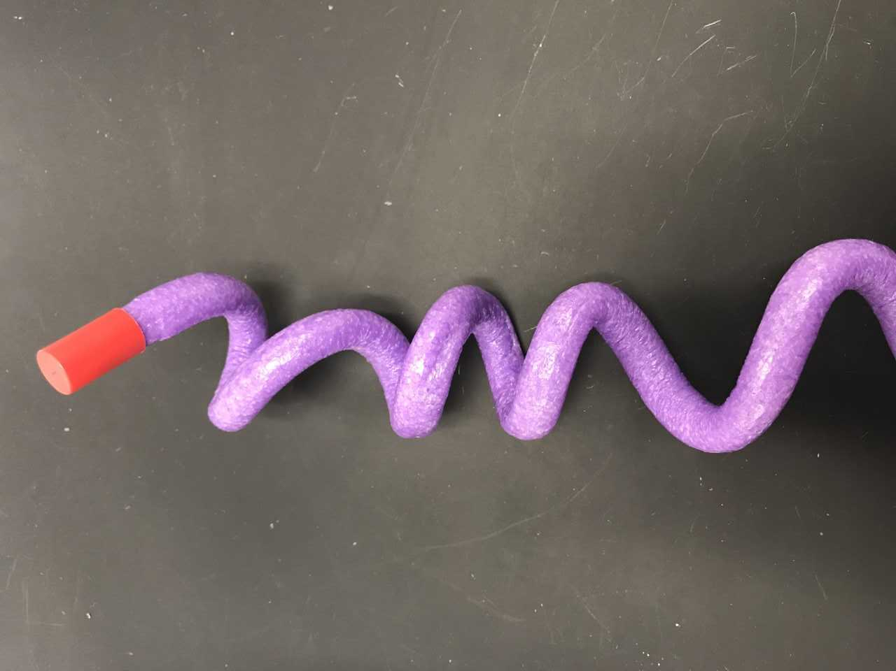
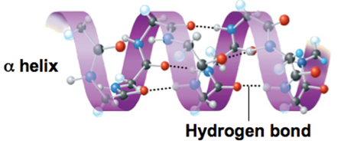
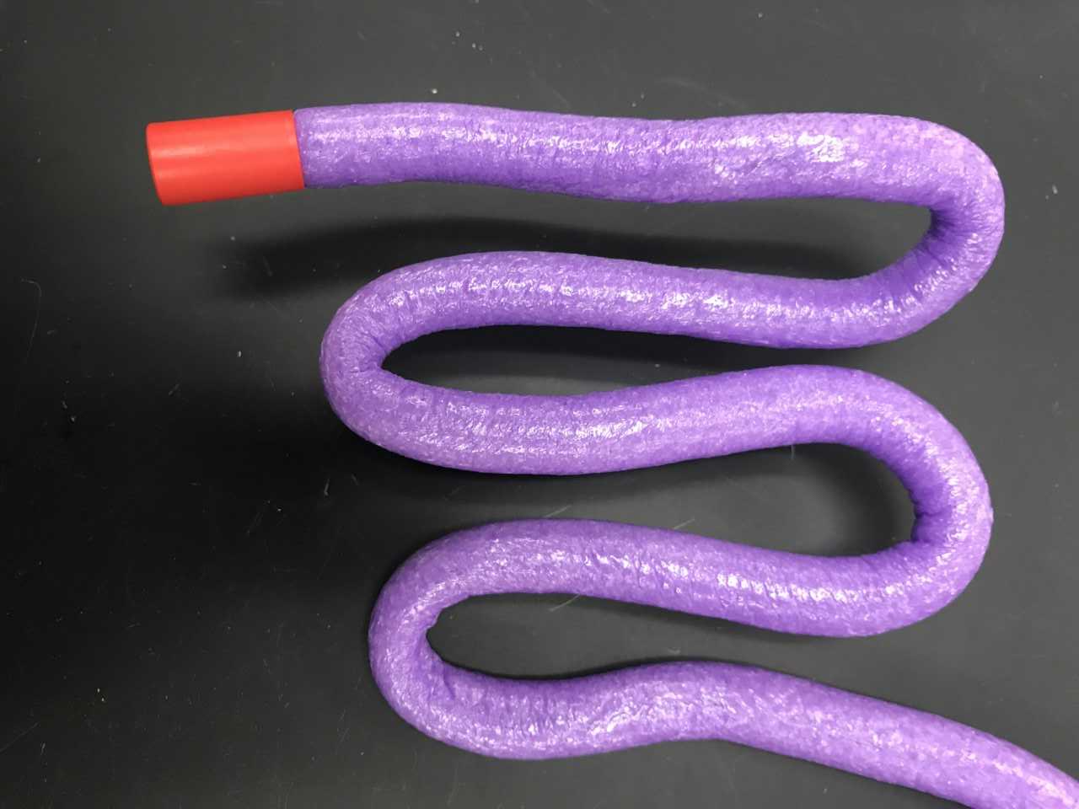
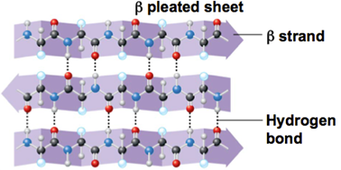
Secondary Structure
Coils and folds called Alpha Helix and Beta pleated sheets caused by hydrogen bonding between polypeptide backbones

Slide 15
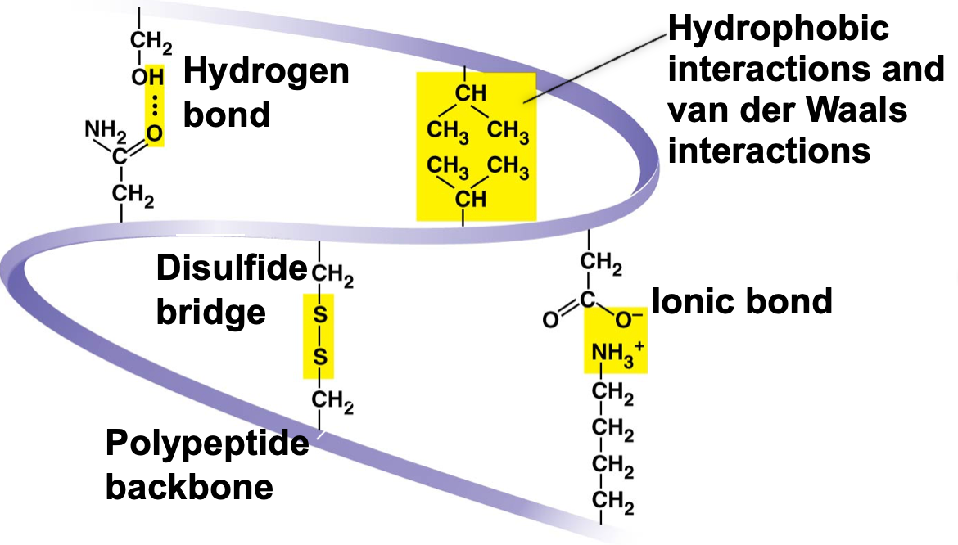
Tertiary Structure
Three dimensional shape caused by “weak” interactions between the side chains
1. Hydrogen bonds
2. Hydrophobic and Van der Waals
3. Disulfide bridges
4. Ionic Bonds

Slide 16
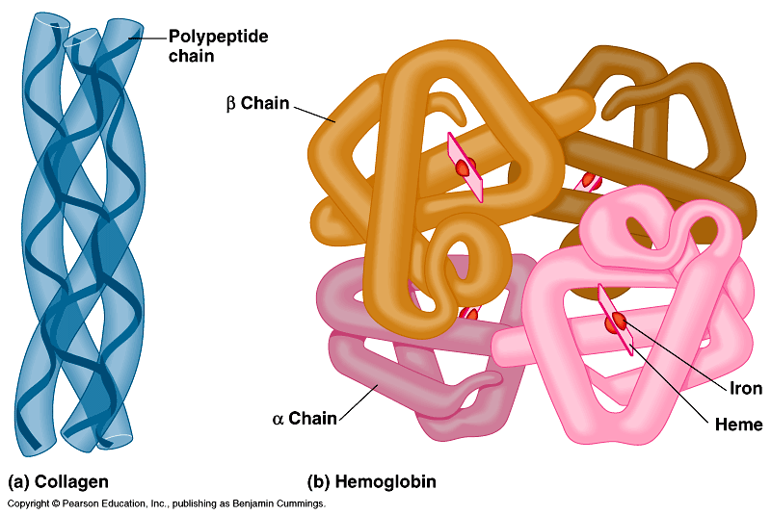
Quaternary Structure
The overall structure formed by two or more polypeptides
*This is when protein becomes functional
*Caused by hydrophobic interactions
hemoglobin
collagen = skin & tendons

Slide 17
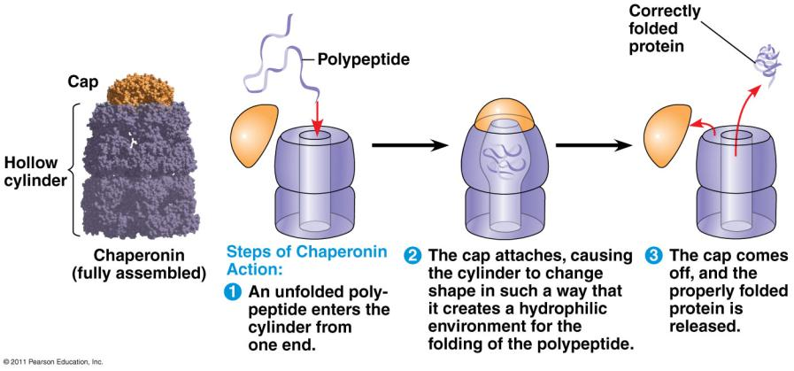
Chaperonins assist in proper folding of proteins by creating a hydrophilic environment.

Slide 18
Protein Denaturation
Denaturation is the unfolding of a protein due to
conditions that disrupt H bonds, ionic bonds, disulfide bridges such as
*Temperature
*pH
*salinity
Result in changes in secondary and
tertiary structures
Wrong shape = no function

