Slide 1
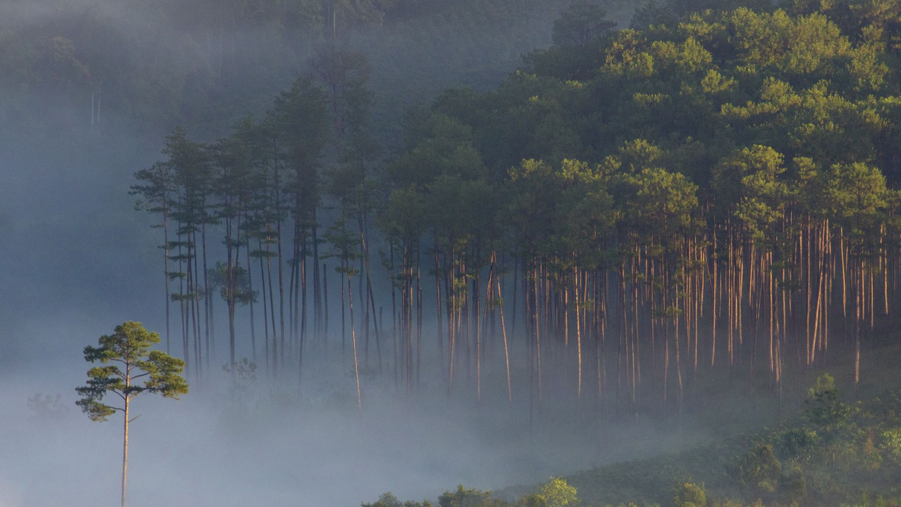
Community Ecology: Niche Symbiosis Predator/Prey

Slide 2
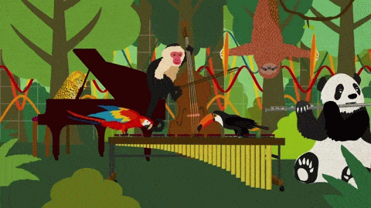
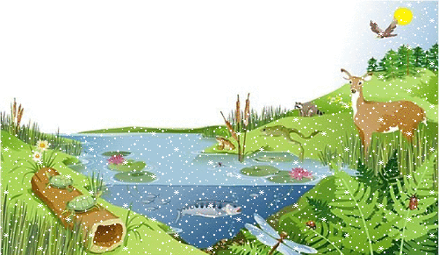
Community vs. Ecosystem
Community -All the living organisms in an area (plants, animals, bacteria)
All the populations in an area that interact
Ecosystem -All the living and nonliving in an area

Slide 3
Niche
An organism’s niche is its ecological role
habitat = address vs. niche = job
Ex: what it eats, what it lives in, time of day when active, behavior, etc…
Notes:
Compare to high school niches (Hollywood style)

Slide 4
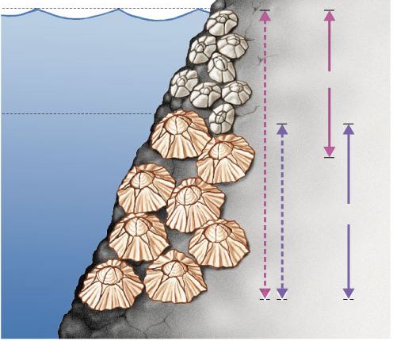
Competitive Exclusion Principle
No two similar species can occupy the same niche at the same time.
Why?
High tide
Competition!!!
Species 1
Low tide
Chthamalus sp.
Species 2
Fundamental
niches
Realized
niches
Semibalanus sp.

Slide 5
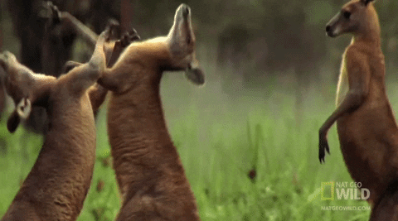
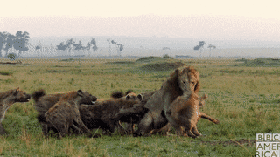

Slide 6
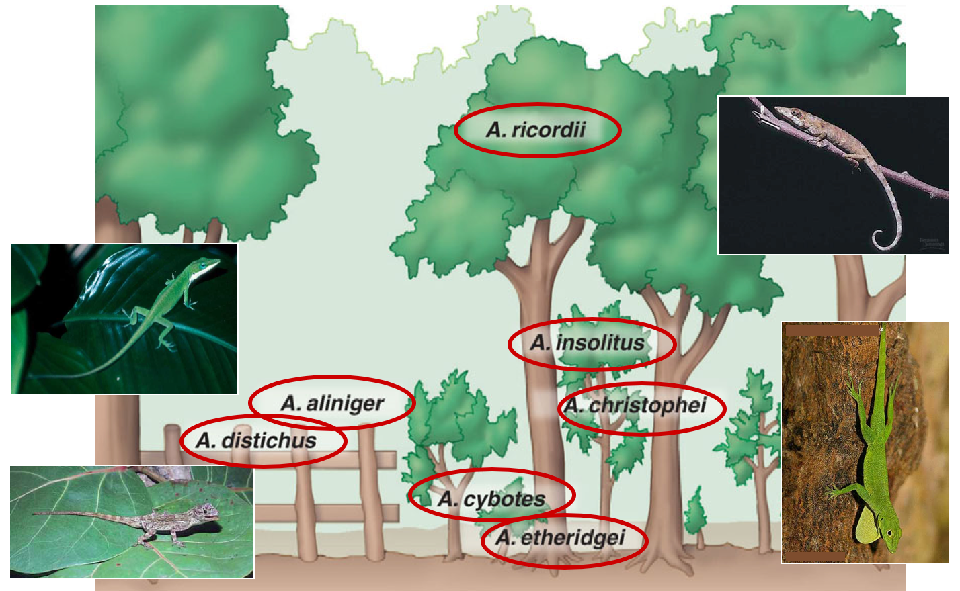
Resource Partitioning
Reduce Competition through microhabitats
Notes:
Resource partitioning among Dominican Republic lizards. Seven species of Anolis lizards live in close proximity, and all feed on insects and other small arthropods. However, competition for food is reduced because each lizard species has a different perch, thus occupying a distinct niche.

Slide 7
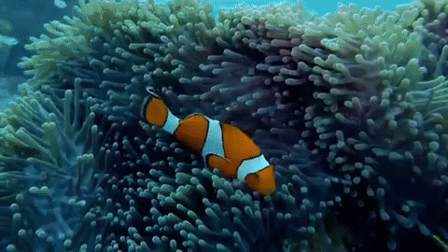
Symbiosis
Symbiosis- a close relationship between two organisms of two different species

Slide 8
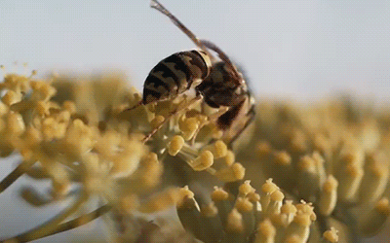
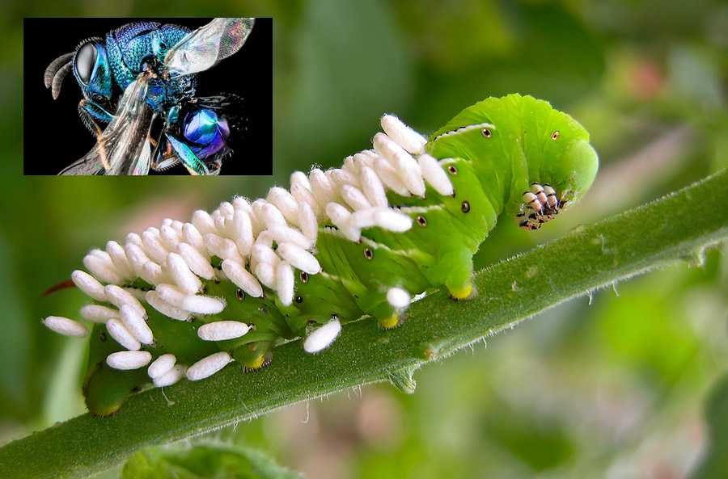
Types of Symbiosis
Mutualism: Both benefit (+/+)
Parasitism: One benefits the other is harmed (+/-)

Slide 9
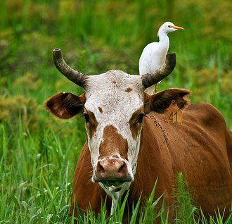
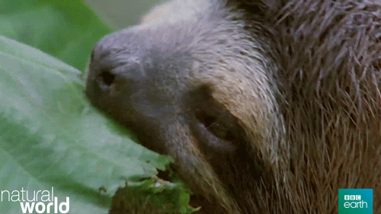
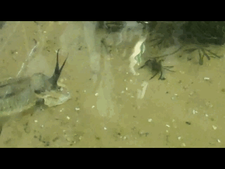
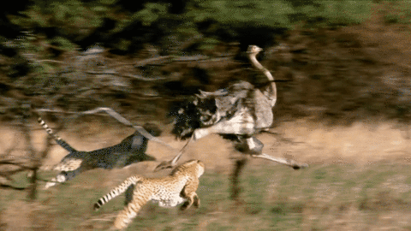
Types of Symbiosis
Commensalism: One benefits, the other
gets no benefit (+/0)
Herbivory: Organisms eating plants (+/-)
Predation: Organisms eat animals (+/-)
Notes:
Cow egret and cows

Slide 10
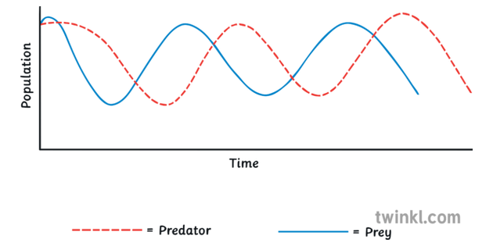
Predator/Prey Relationship
Key factors:
1) Population control
2) Drive evolution…survival of the fittest
Affects: coloration, mimicry, behavior

Slide 11
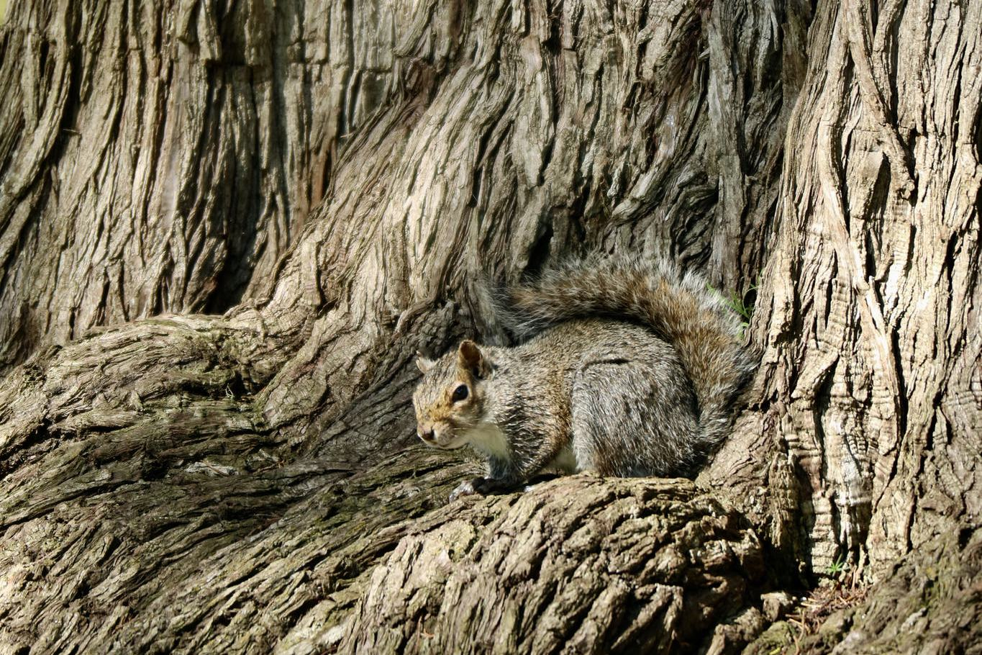
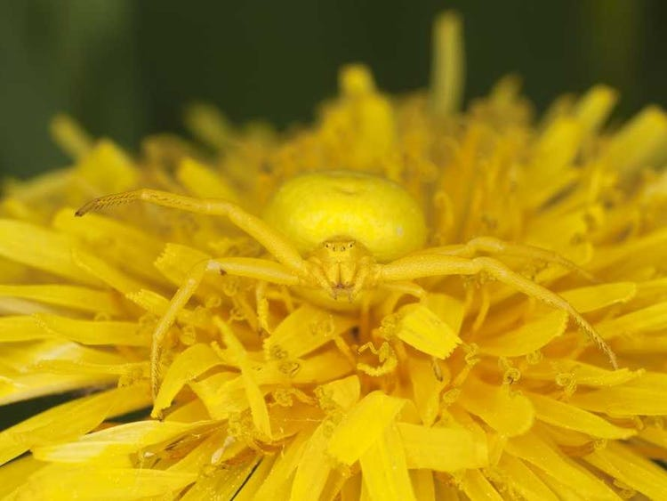
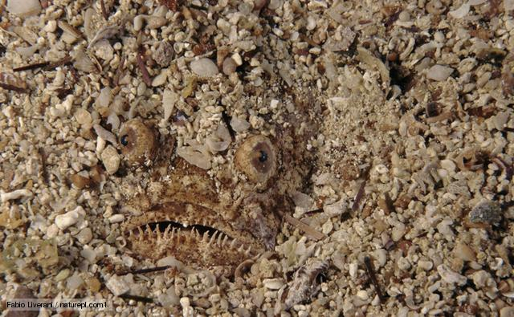
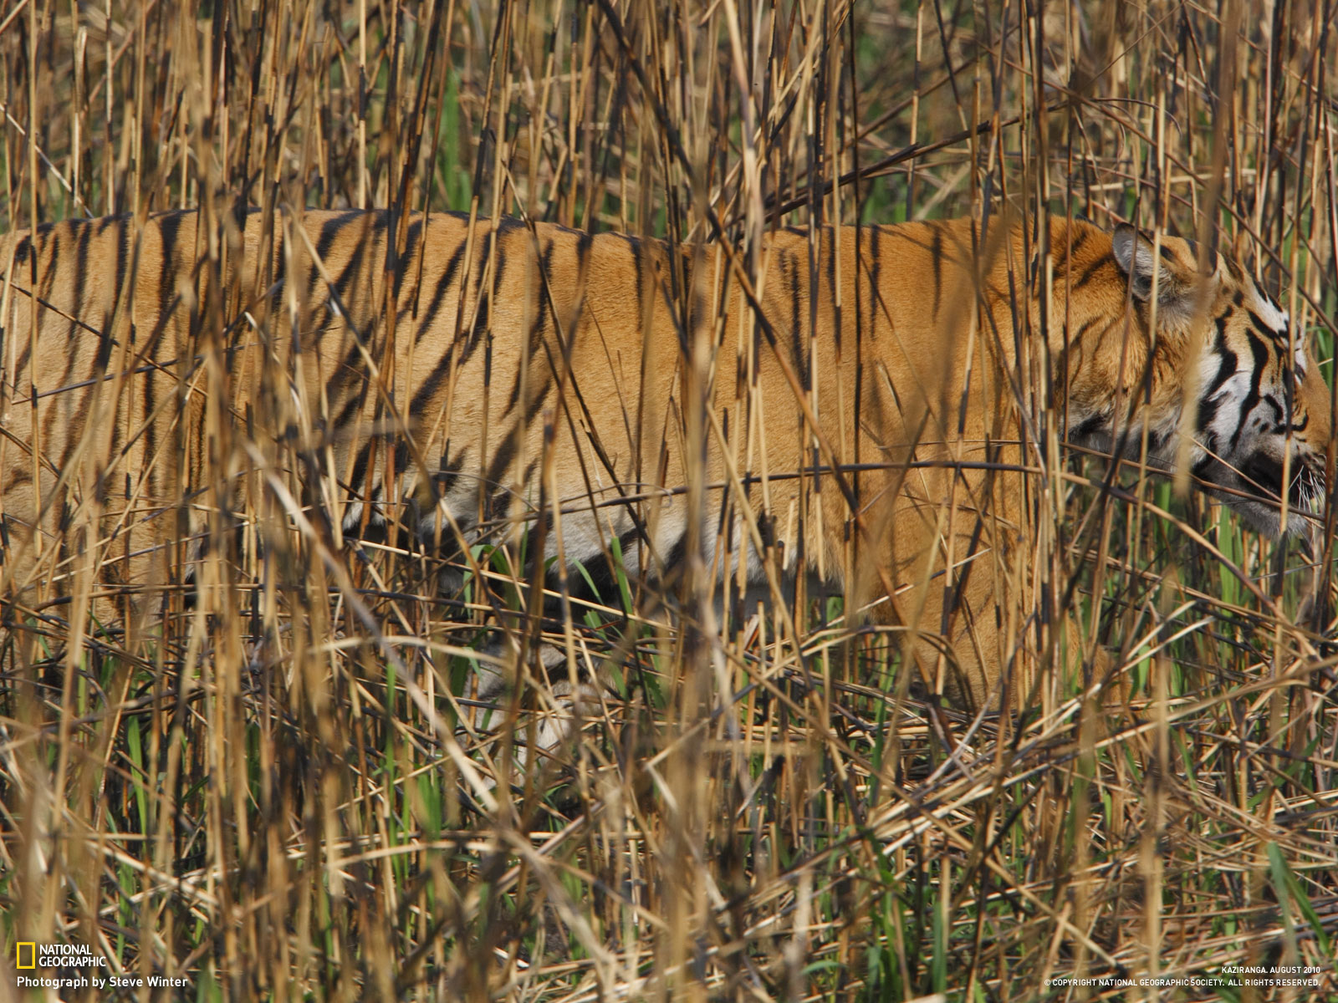

Slide 12
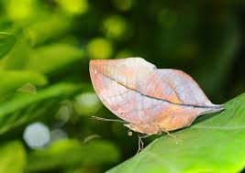
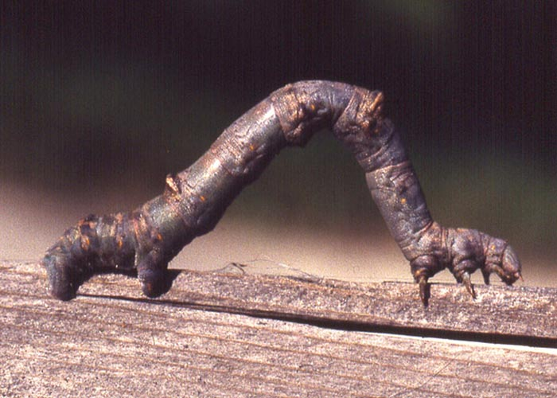
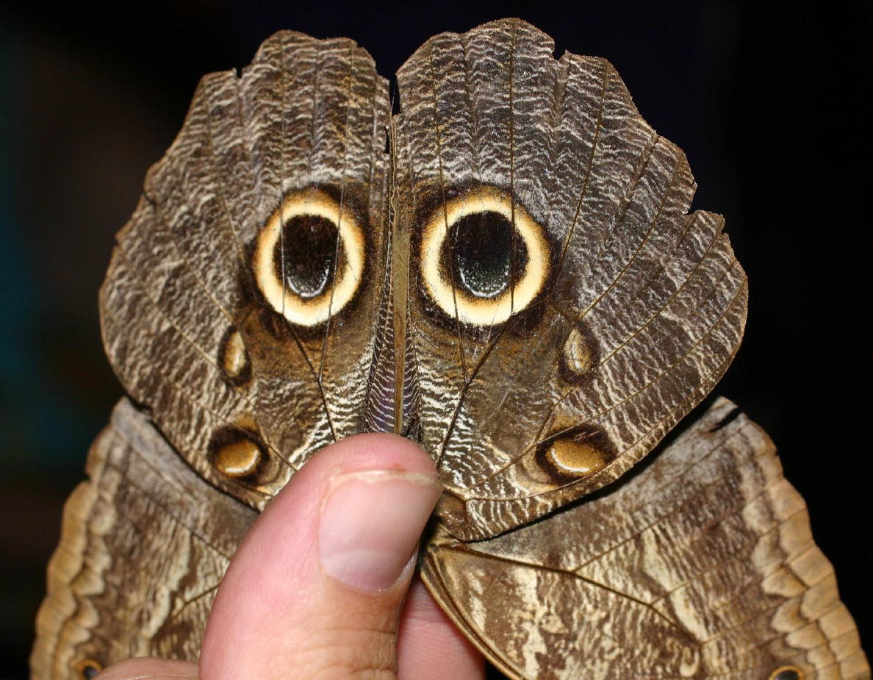
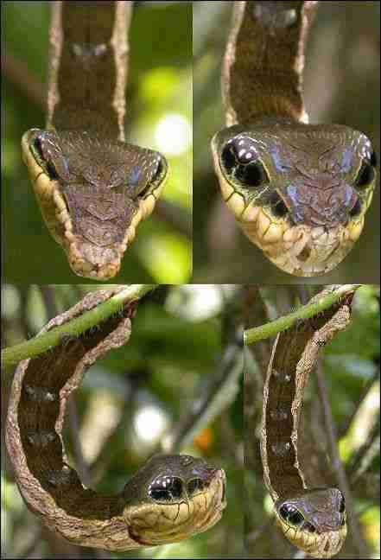
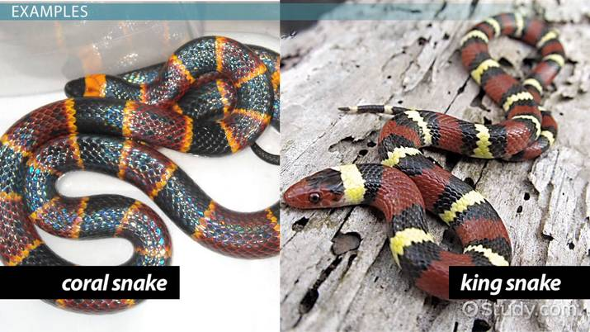
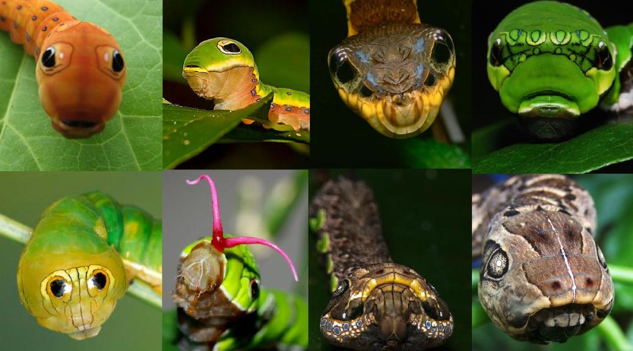

Slide 13
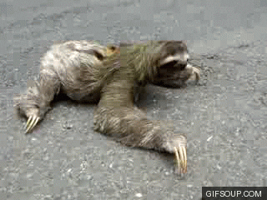

Slide 14
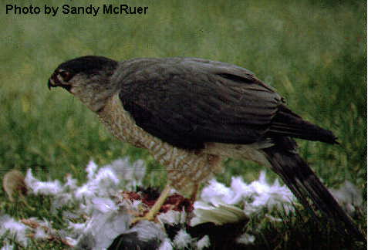
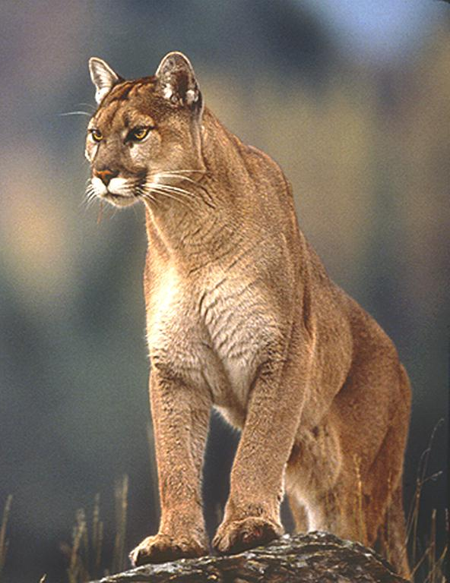
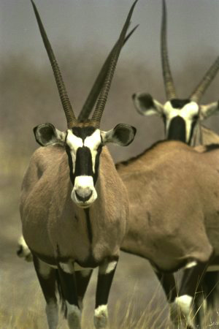
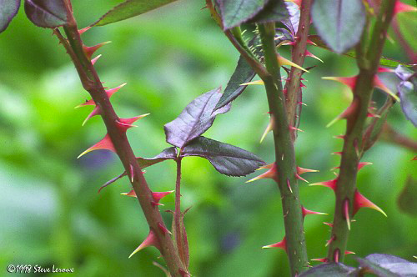
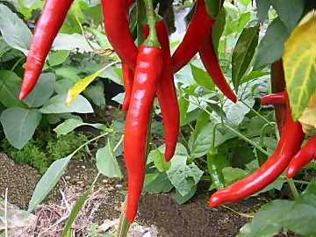
Predation drives evolution
Predators adaptations
- locate & subdue prey
Prey adaptations
-elude & defend
Predation provides a strong selection pressure on both prey & predator
horns, speed, coloration
spines, thorns, toxins
Notes:
Predation provides a strong selective pressure on prey populations. Any feature that would decrease the probability of capture should be strongly favored.

Slide 15
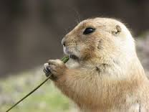
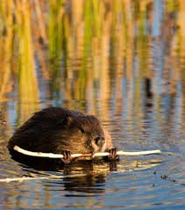
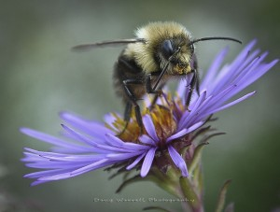
Keystone species
Species with an influential ecological role (niche)
Key characteristics:
-A species that has a large effect on its environment relative to its abundance
-A consumer organism (herbivore or carnivore)
-Low biomass in numbers

Slide 16
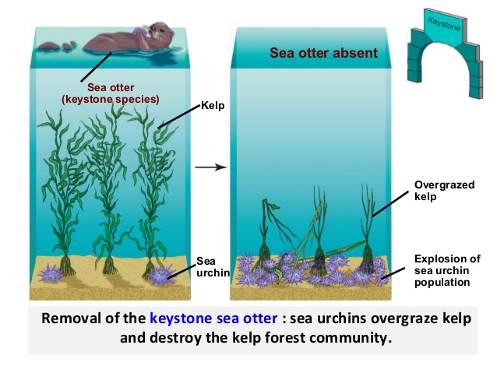
Sea Otters of the North Pacific
Notes:
Structure of a community may be controlled bottom-up by nutrients or top-down by predators

Slide 17
Trophic Cascade
Removal of keystone species results in breakdown of food chain balance and ecosystem interactions (can affect abiotic factors too)

