Slide 1
Cellular Respiration
Stages 2-4

Slide 2
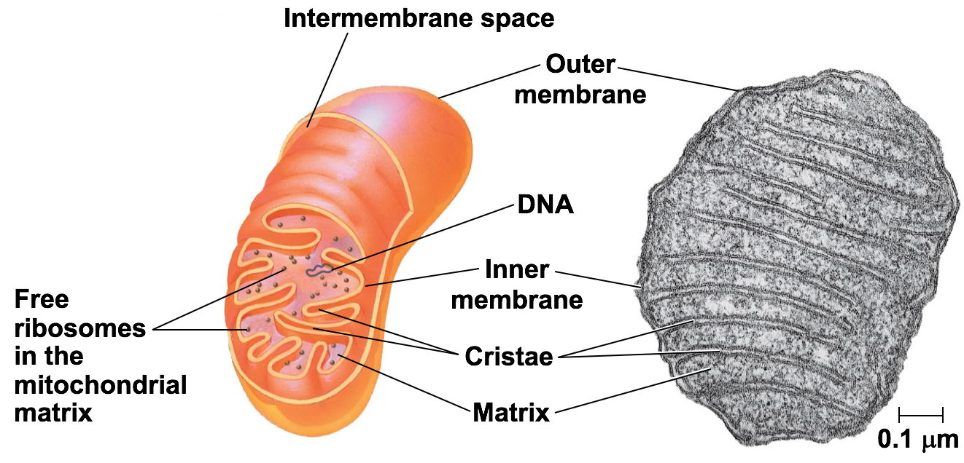
Where does is happen?
Stages 2-4 occur in the mitochondria
*Mitotondrial Matrix
*Inner membrane
Notes:
Ask what it looks like. What else has those things

Slide 3
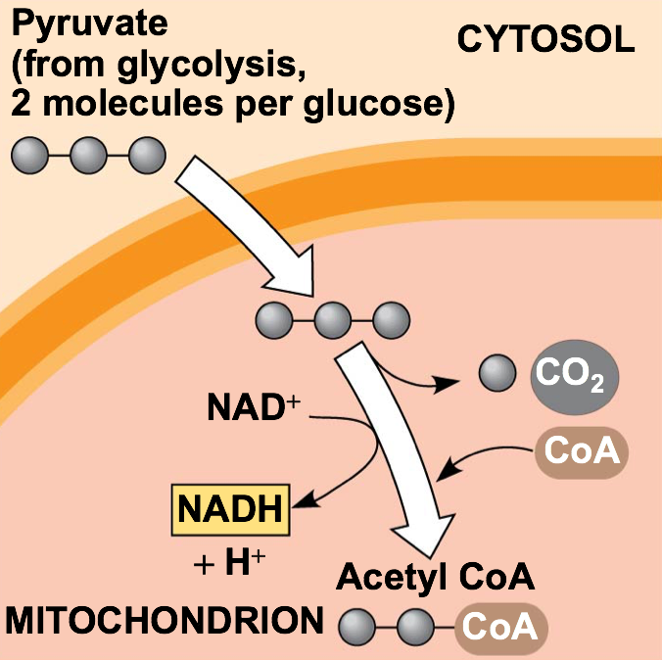
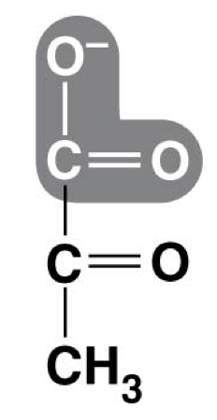
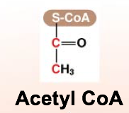
Pyruvate Oxidation
Converts Pyruvate (3C) to acetyl CoA (2C) in 3 steps
Each pyruvate produces:
*1 CO₂
*1 NADH
*1 acetyl CoA
*Acetyl CoA goes to stage 3
Notes:
Gets in through membrane protein

Slide 4
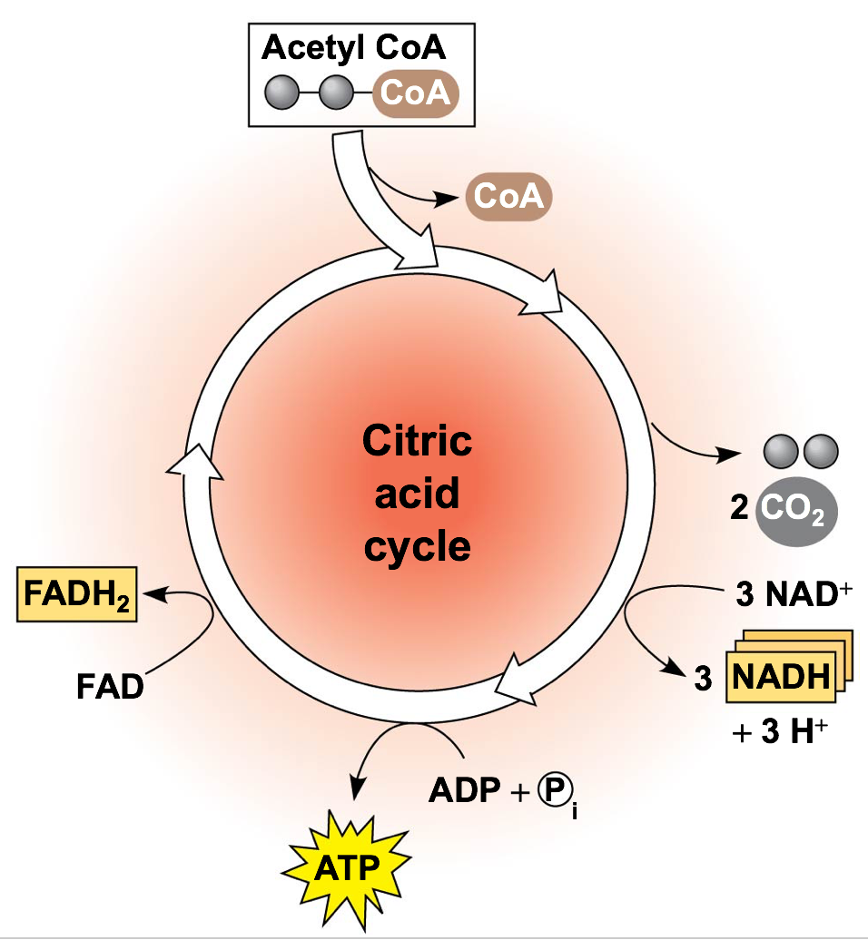
Krebs Cycle (Cirtic Acid Cycle)
8 step cycle that gets the remaining energy out of acetyl CoA and puts it into Electron Carriers
Each pyruvate produces:
*2 CO₂
*3 NADH
*1 FADH₂
*1 ATP

Slide 5
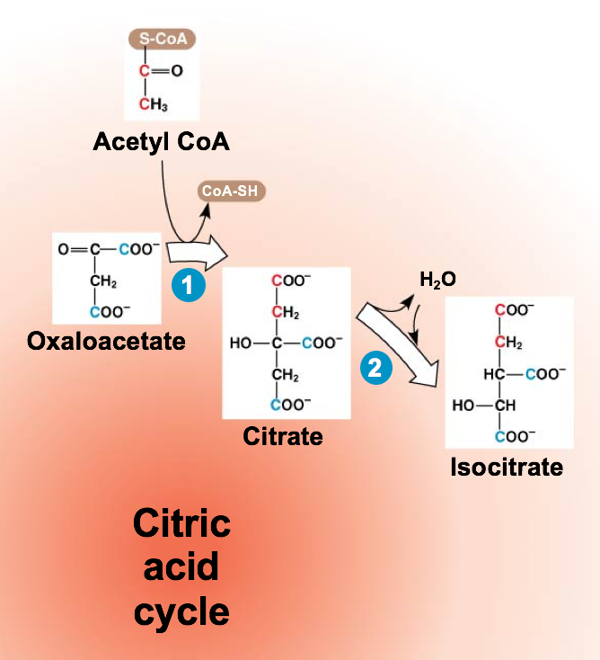
Krebs Cycle Key Points
1st step breaks off the acetyl group of acetyl CoA and puts it onto oxaloacetate to form Citrate
Notes:
Why is citrate important?

Slide 6
Krebs Cycle Key Points
Next 7 steps include several Redox reaction that produce 3 NADH, 1 FADH₂ and decompose citrate back to oxaloacetate (for each pyruvate)

Slide 7
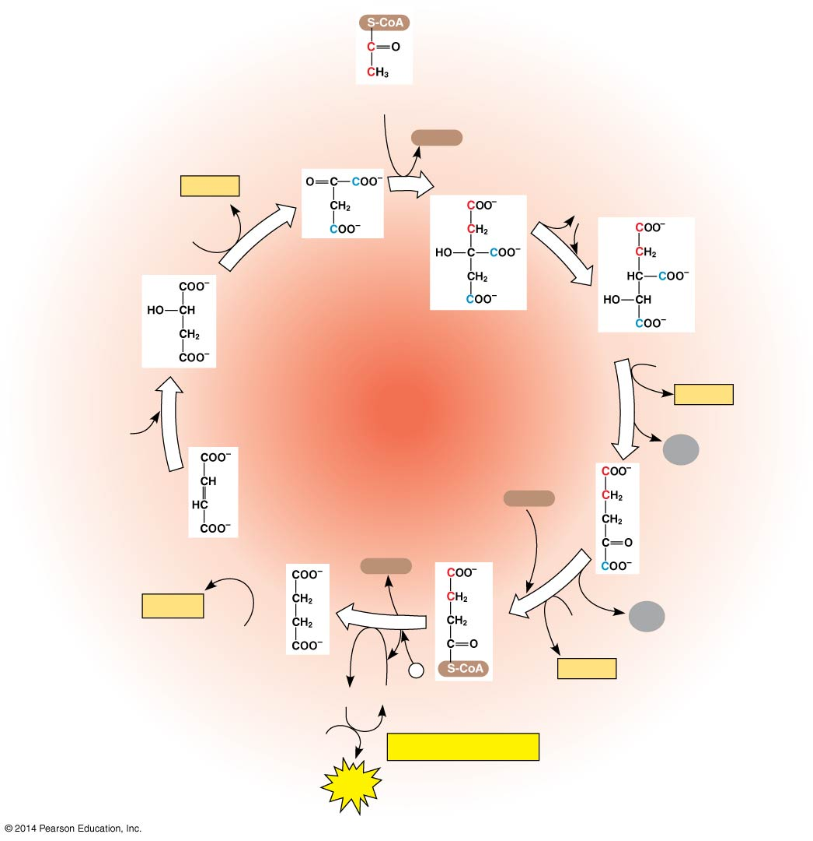
Figure 7.11-6
Acetyl CoA
CoA-SH
NADH
1
+ H⁺
H₂O
NAD⁺
Oxaloacetate
8
2
Malate
Citrate
Isocitrate
Citric
acid
cycle
NAD⁺
3
NADH
7
+ H⁺
H₂O
CO₂
Fumarate
CoA-SH
α-Ketoglutarate
6
4
CoA-SH
FADH₂
5
NAD⁺
CO₂
FAD
Succinate
P
NADH
_{i}
GTP
GDP
Succinyl
CoA
+ H⁺
ADP
ATP formation
ATP
Notes:
7
Figure 7.11-6 A closer look at the citric acid cycle (step 8)

Slide 8
Oxidative Phosphorylation
2 parts to this:
1)ETC: Series of redox reactions that use electron carrier proteins to slowly release the energy from NADH and FADH_{2…} Also moves H⁺ out of cell
2)Chemiosmosis: Process that uses the movement of H+ through ATP synthase to phosphorylate ADP→ATP

Slide 9
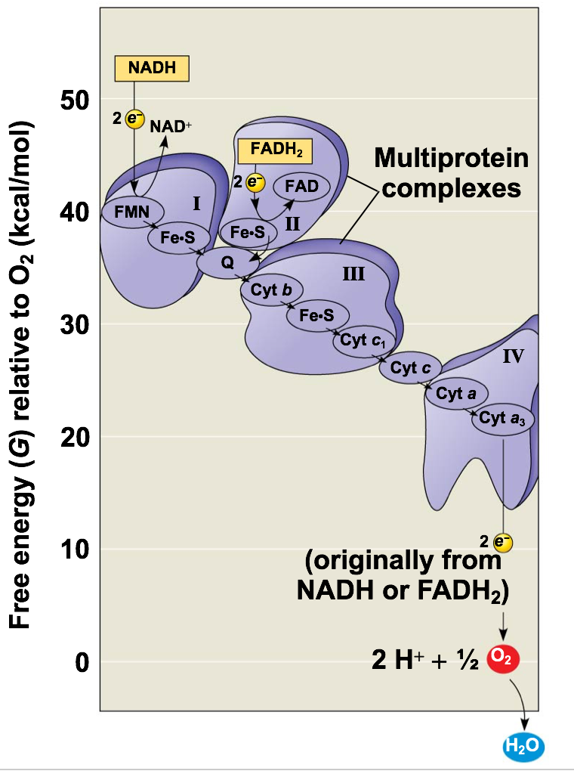
Electron Transport Chain (ETC)
*Removes the electrons from NADH and FADH₂ passes them down to O₂ to make H₂O
*Creates an H⁺ gradient by pumping H⁺ out of the matrix into the intermembrane space

Slide 10
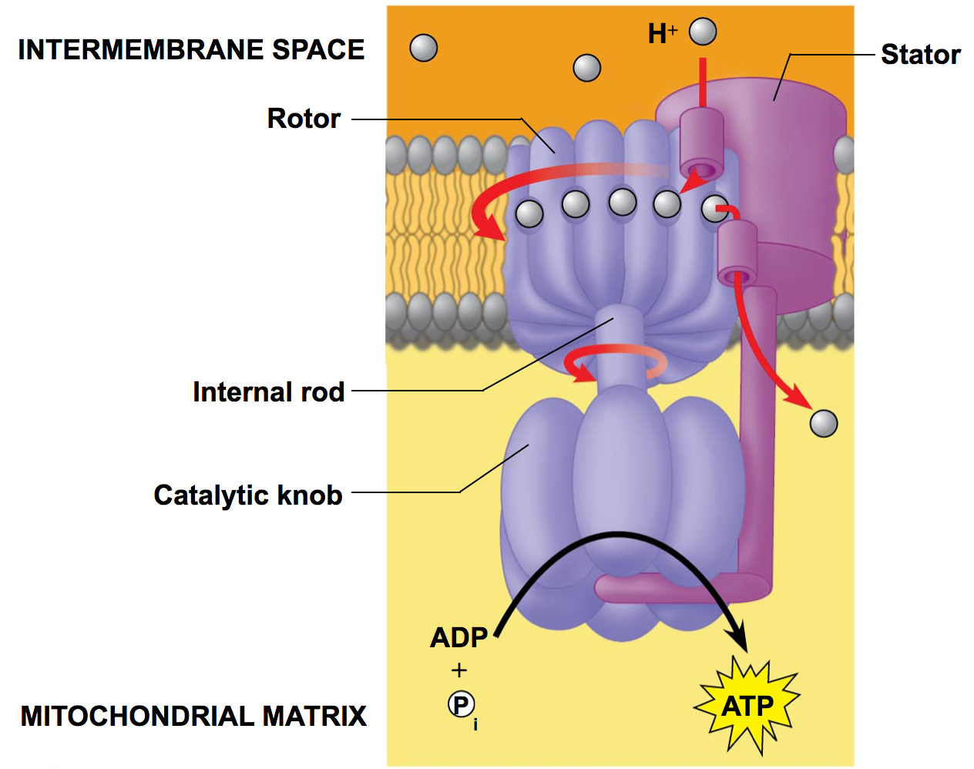
Chemiosmosis
The H⁺ wants to move back into the mitochondrial matrix—ATP Synthase only way in
Energy from movement is enough to add a Pi to ADP

Slide 11
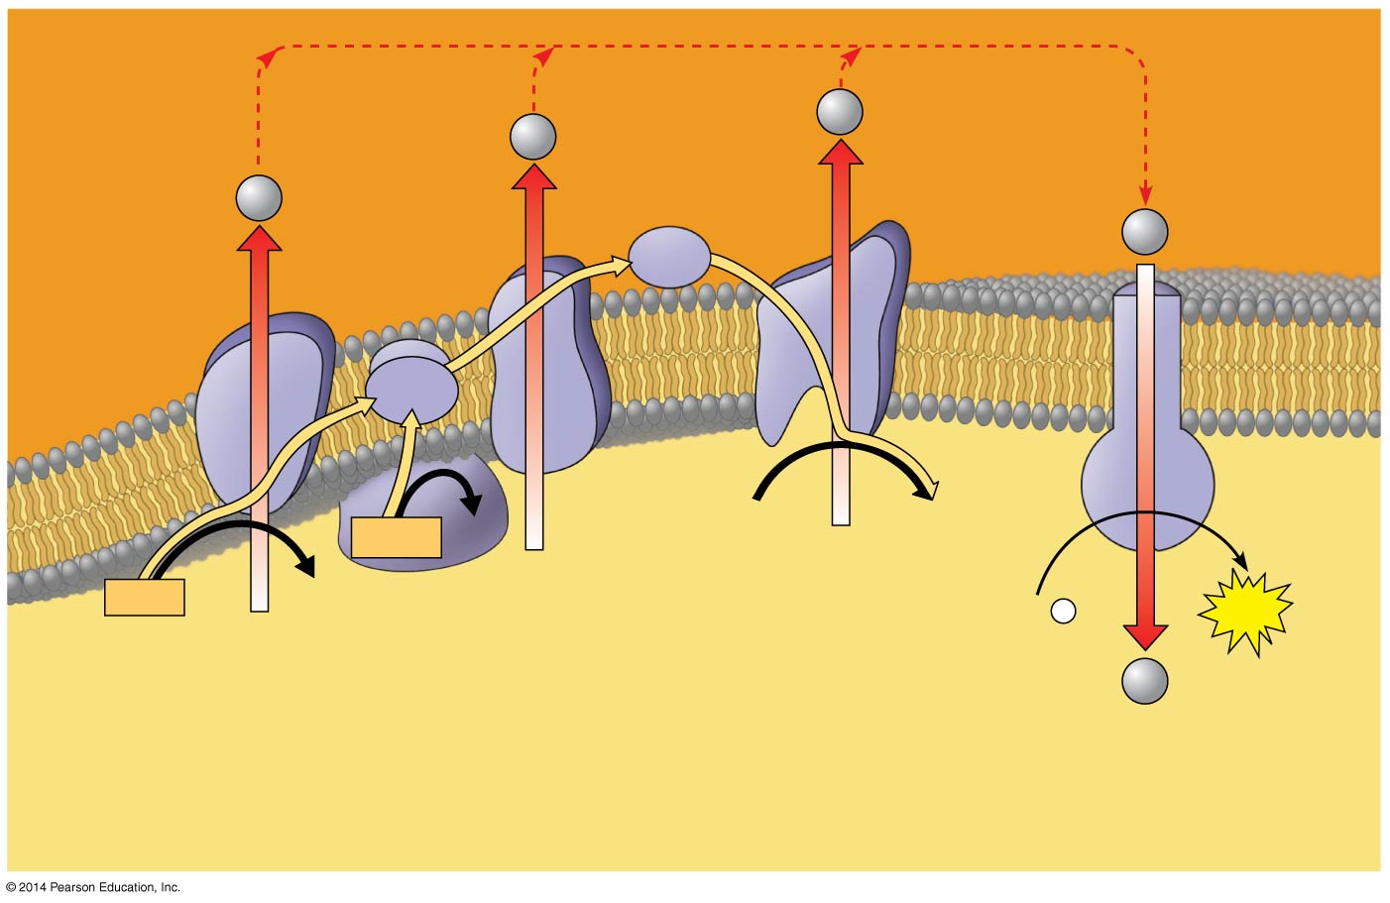
H⁺
H⁺
Protein
complex
of electron
carriers
H⁺
H⁺
Cyt c
Q
IV
I
III
ATP
synthase
II
2 H⁺ + ½ O₂
H₂O
FADH₂
FAD
NADH
NAD⁺
ADP +
P
ATP
(carrying electrons
from food)
_{i}
H⁺
1
Electron transport chain
2
Chemiosmosis
Oxidative phosphorylation
Notes:
11
Figure 7.14 Chemiosmosis couples the electron transport chain to ATP synthesis

Slide 12
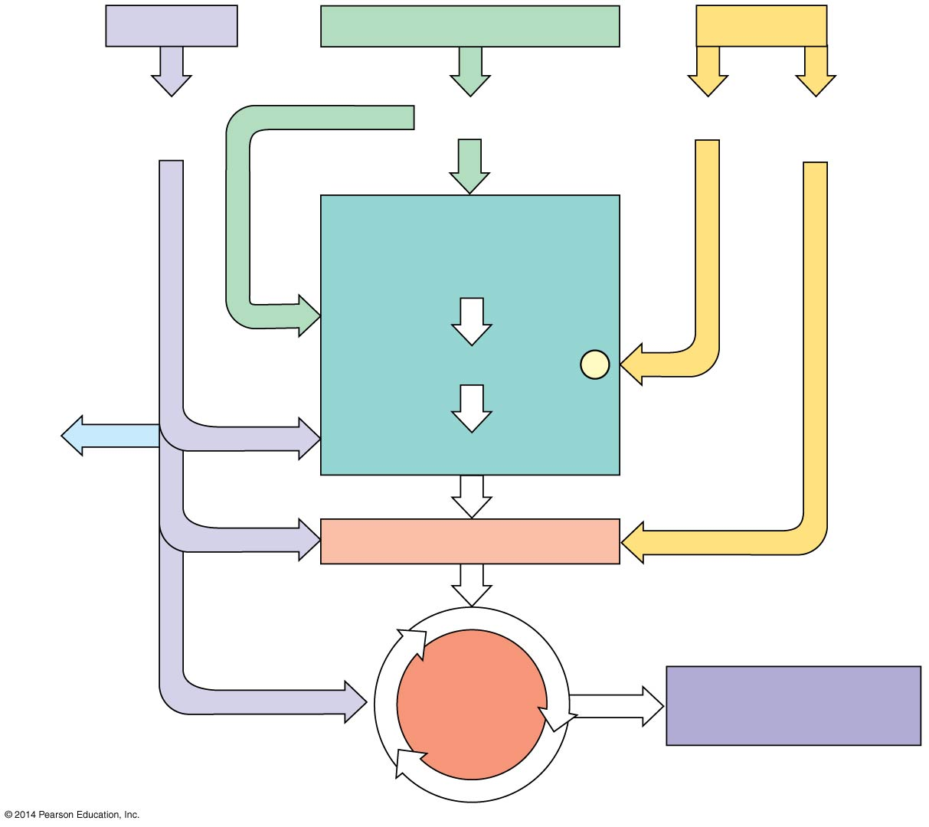
Figure 7.18-5
Proteins
Carbohydrates
Fats
Amino
acids
Sugars
Glycerol
Fatty
acids
Glycolysis
Glucose
Glyceraldehyde 3-
P
NH₃
Pyruvate
Acetyl CoA
Citric
acid
cycle
Oxidative
phosphorylation
Notes:
12
Figure 7.18-5 The catabolism of various molecules from food (step 5)

