Slide 1
DNA Experiments

Slide 2
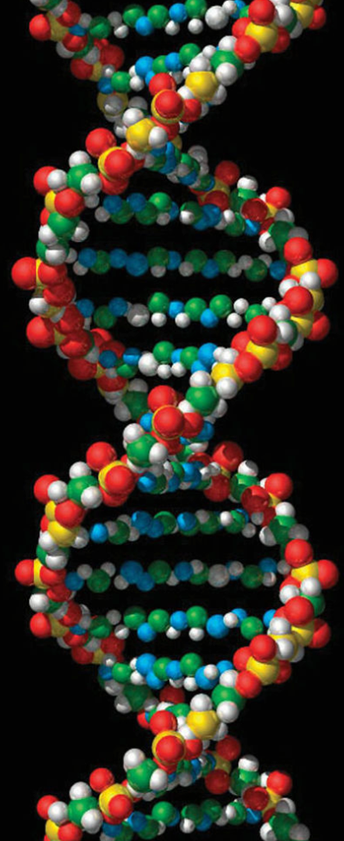
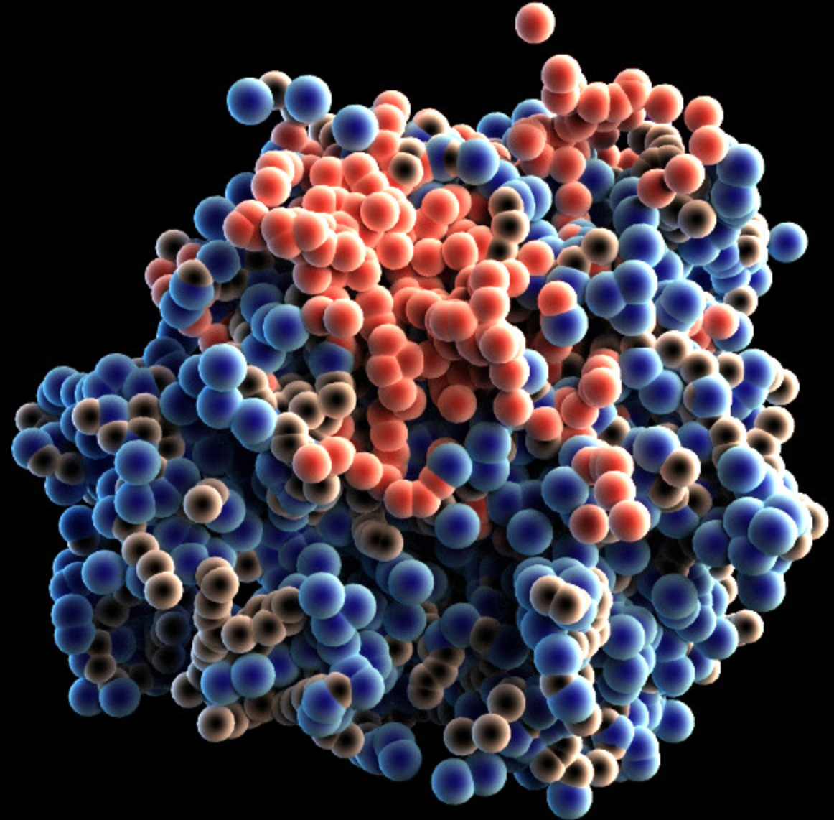
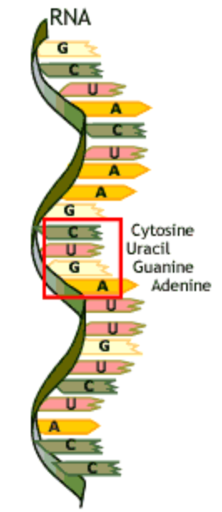
The Big Question…
What is the genetic material that gets passed on?
DNA?
Protein?
RNA?

Slide 3
The Experiments
- Griffiths Experiment (Mice & Bacteria)
- Hershey/Chase Experiment (Viruses & Bacteria)
Chargaff’s Experiment
Rosalind Franklins X-ray diffraction

Slide 4
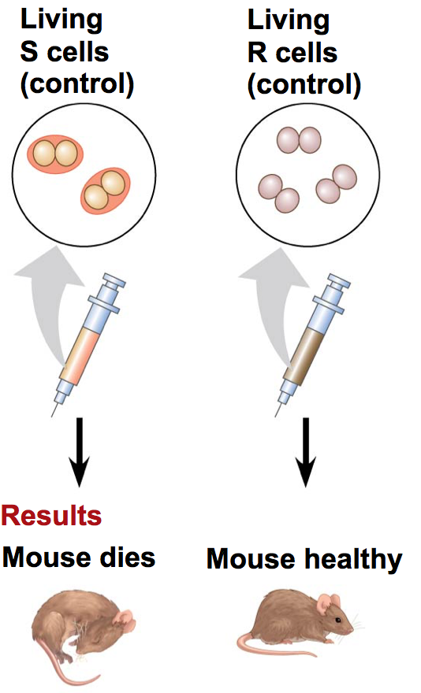
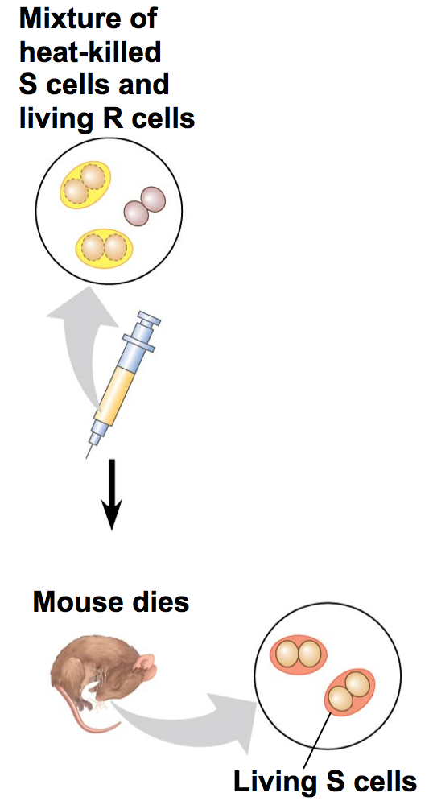
Griffiths Experiments
Can DNA transform bacteria?

Slide 5
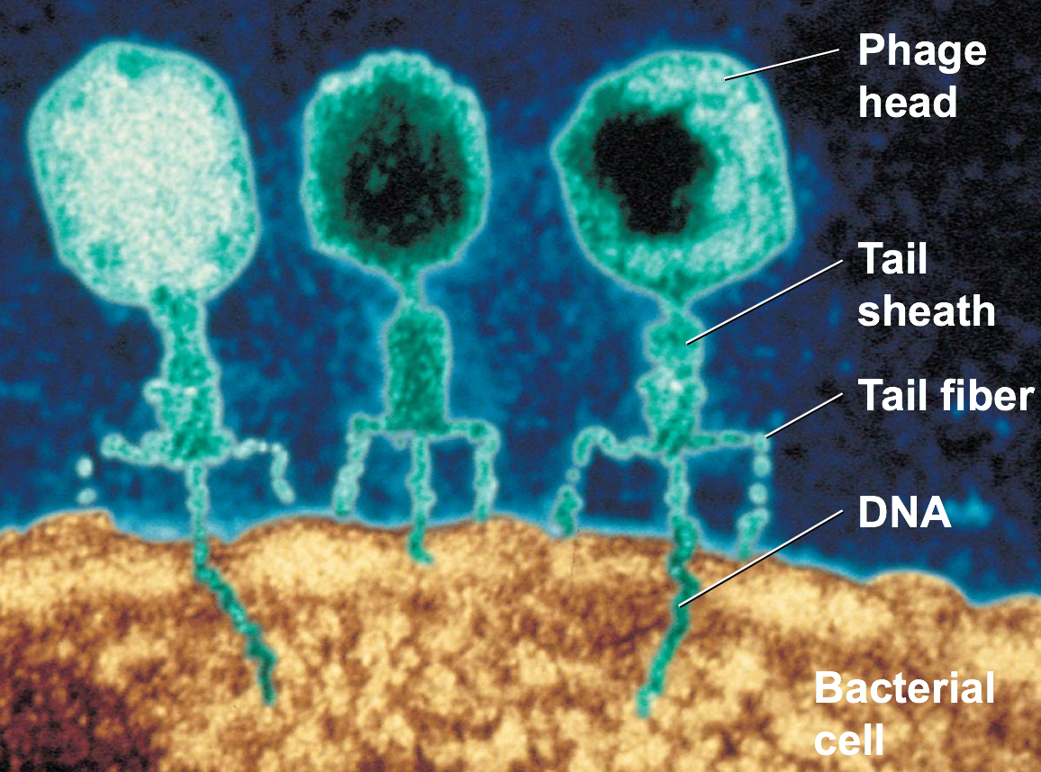
Hershey/Chase Experiment

Slide 6
Radiolabeling and Isotopic Markers
Techniques used to label protein and DNA so that their movements can be traced/followed

Slide 7
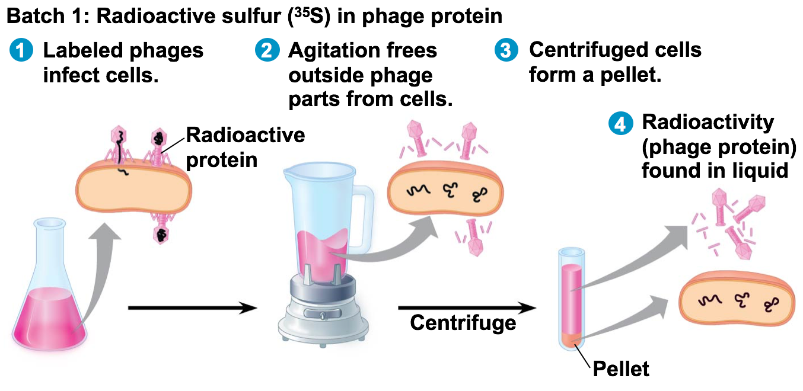

Slide 8
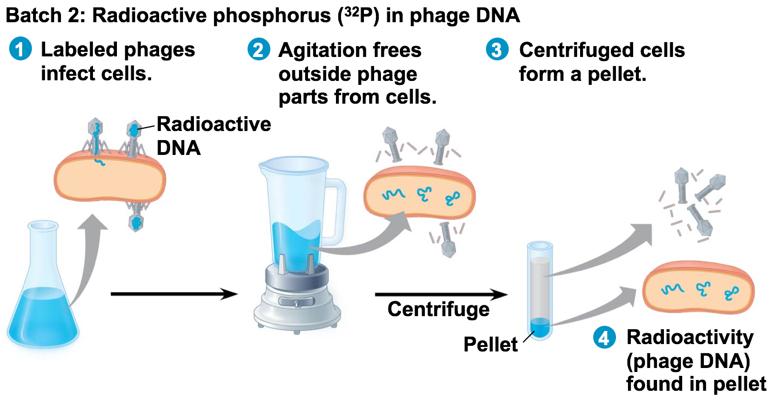

Slide 9
Chargaff’s Experiments
Analyzed ratios of bases...

Slide 10
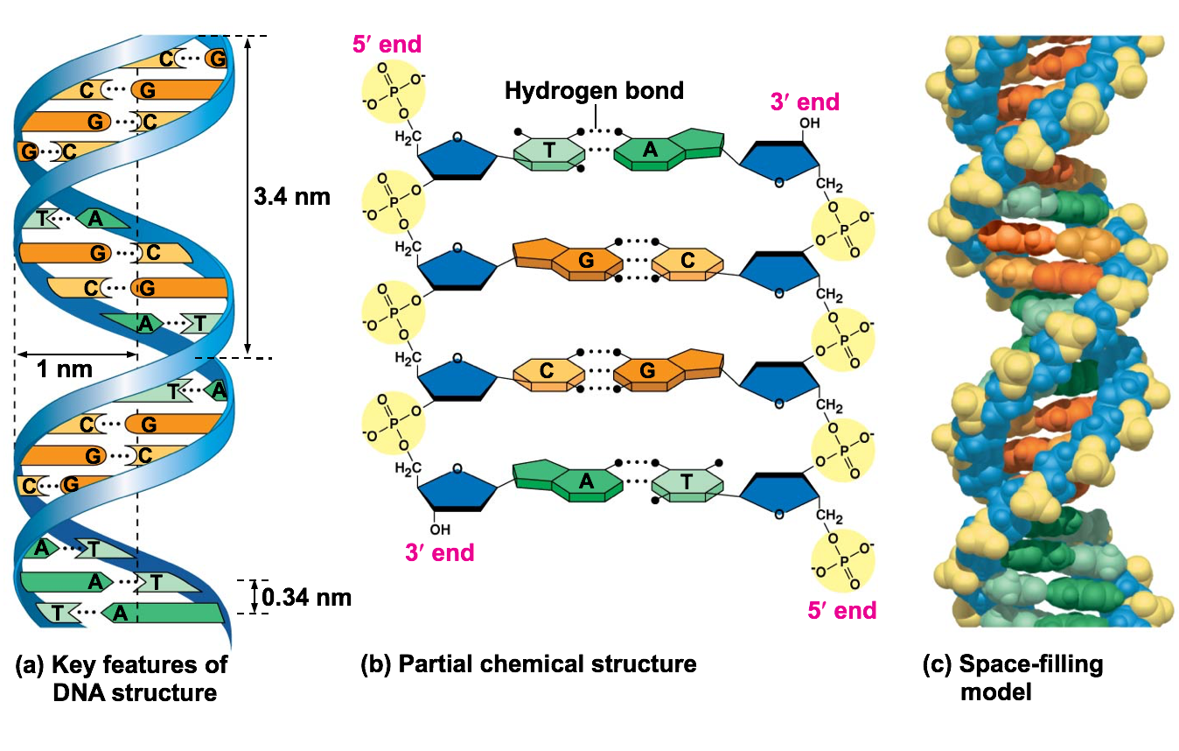
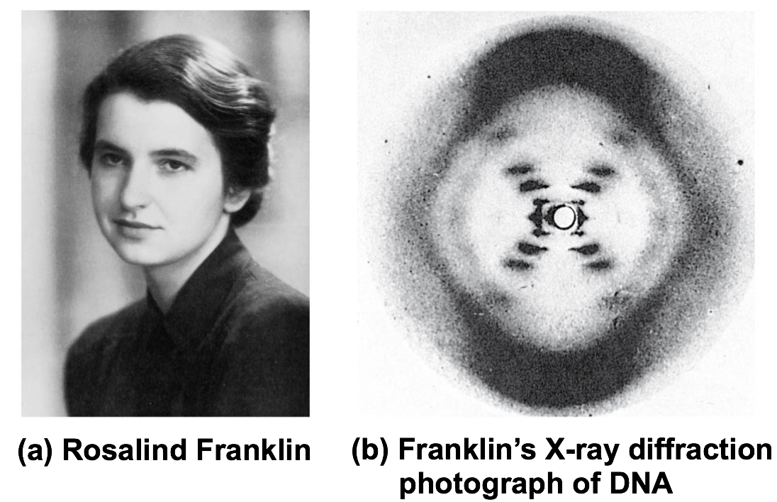
DNA Structure

Slide 11
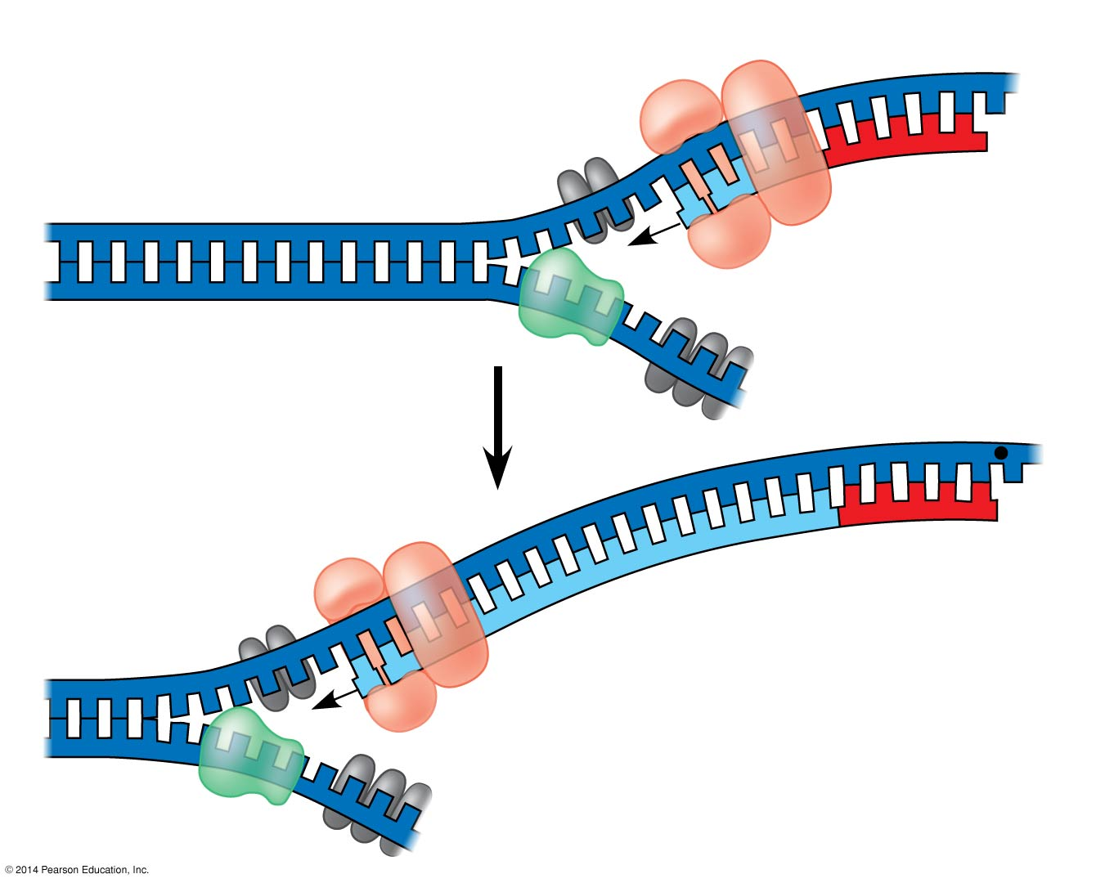

Slide 12
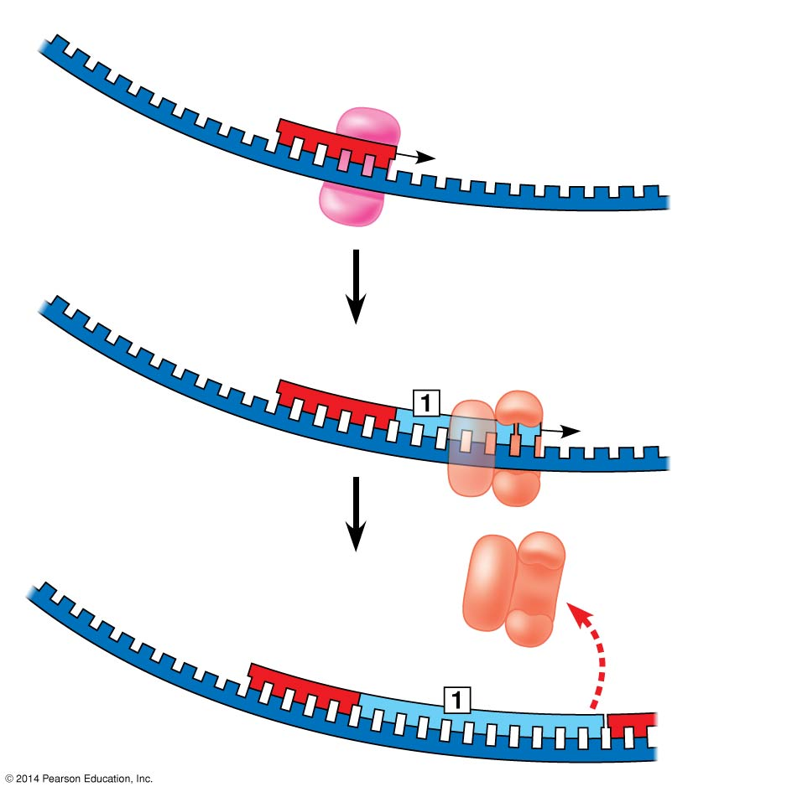

Slide 13
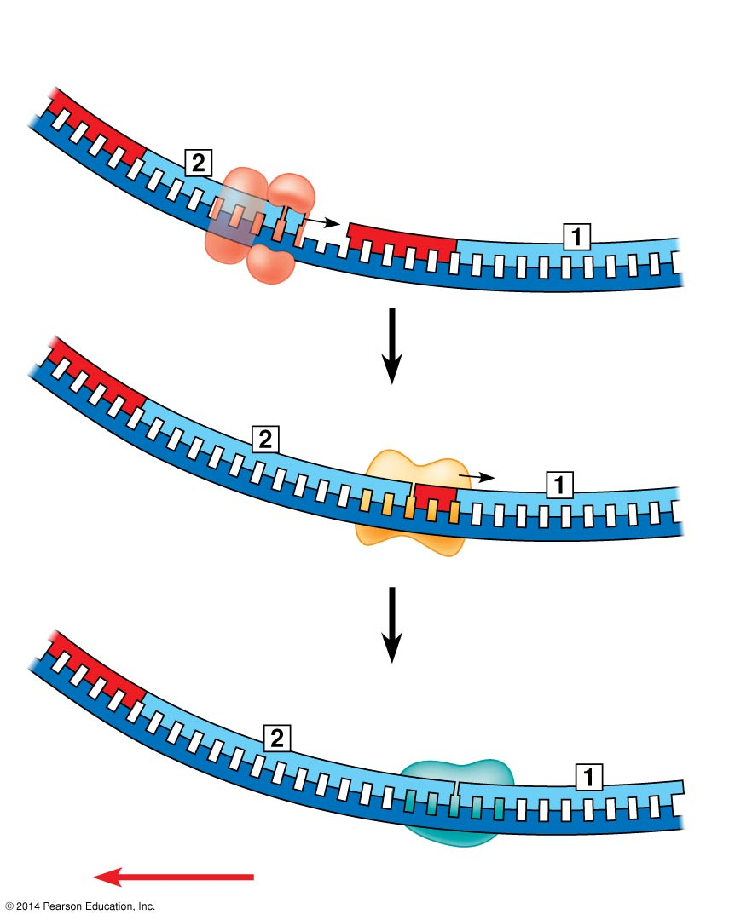

Slide 14
