Slide 1
Proteins!!!
More than just meat

Slide 2
How many proteins?
How many different types of proteins does it take to make a human?

Slide 3
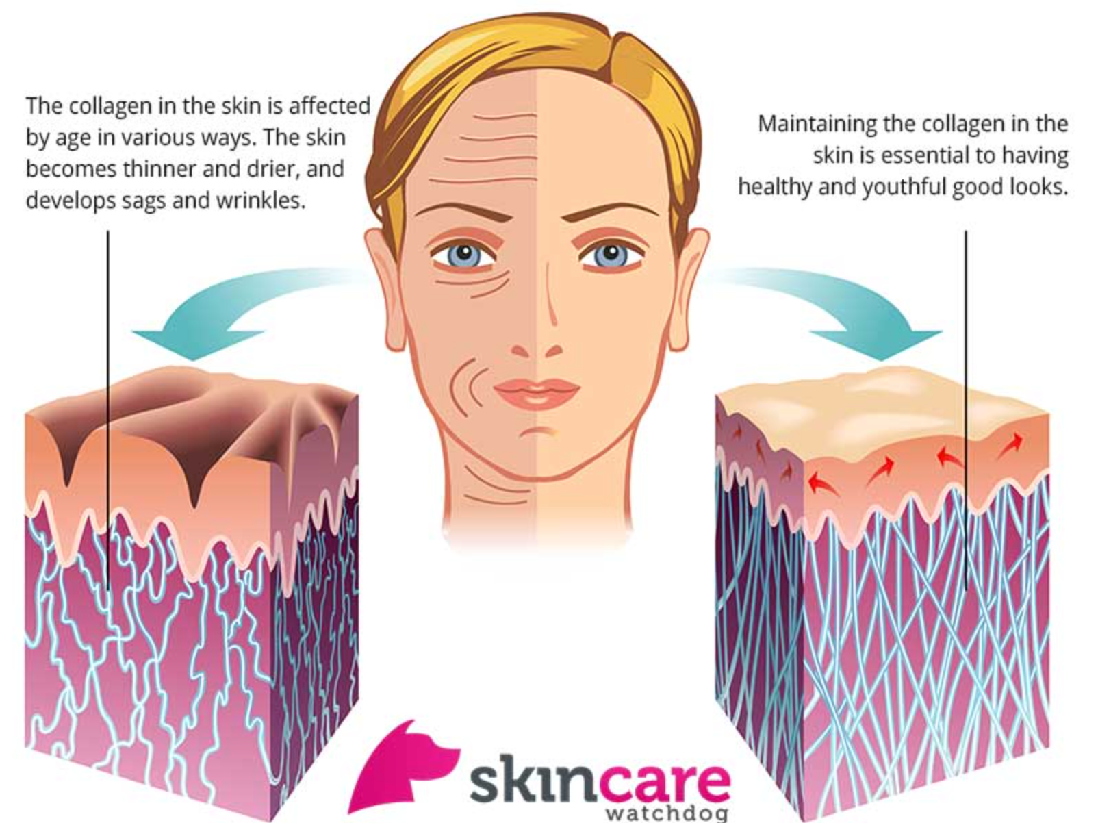
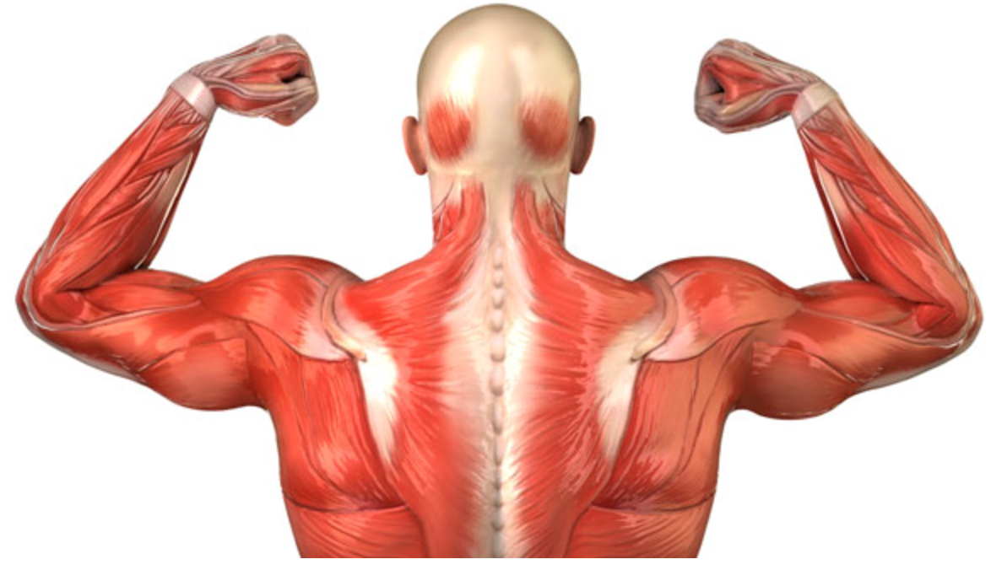
What do proteins do?
- Build body structures

Slide 4
What do proteins do?
-Provide transport through the cell membrane

Slide 5
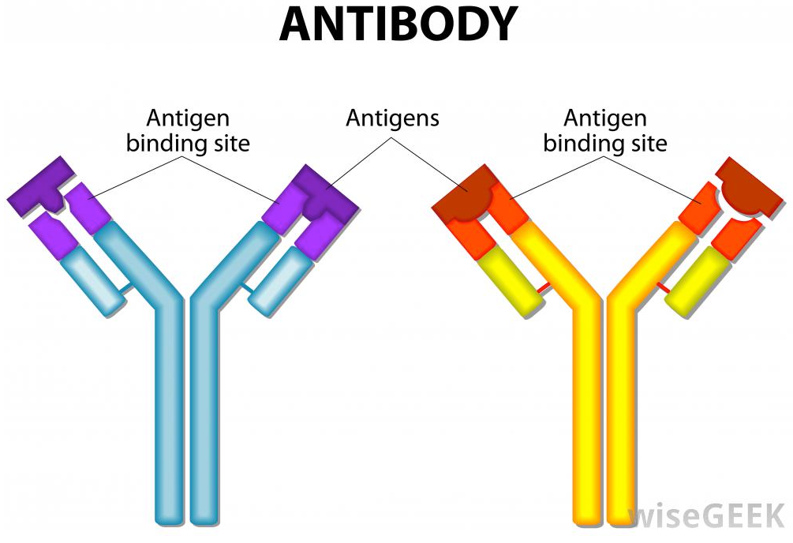
What do proteins do?
-Fight disease

Slide 6
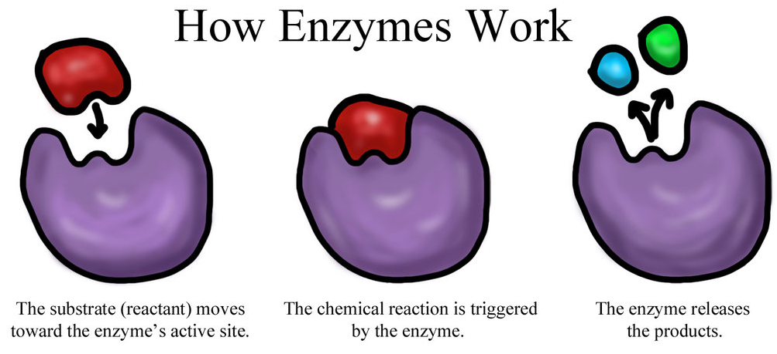
What do proteins do?
-Enzymes that speed up chemical reactions

Slide 7
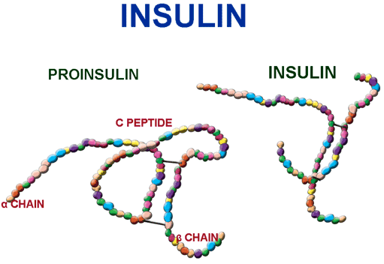
What do proteins do?
- Hormones that help regulate metabolism and work with the nervous system

Slide 8
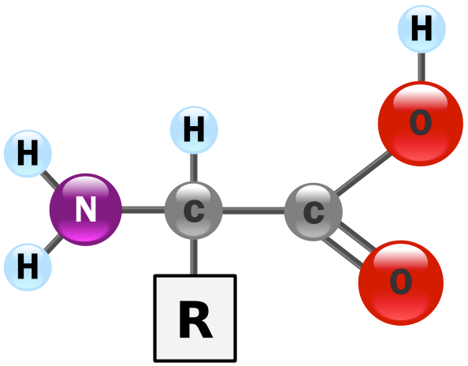
How do you build a protein?
To build a protein you connect together _____
There are 20 different amino acids
The amino acids are identical
but different
What does the above statement mean?

Slide 9
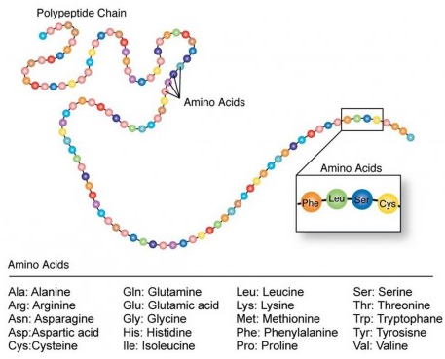
Protein Function and structure
The amino acids that are put together determine the different proteins
The number and sequences determines the shape and size of the protein
***Shape of the protein is the most important thing!!!
Wrong shape and the protein will not work!

