Slide 1
Enzyme Regulation and Activity

Slide 2
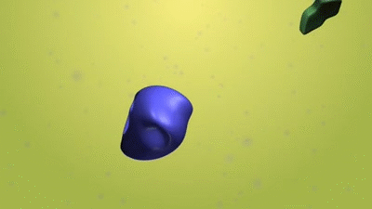
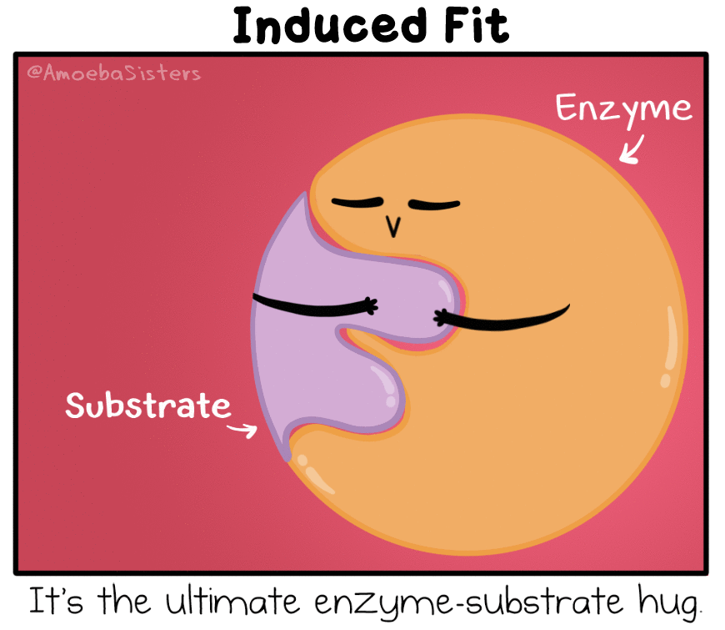
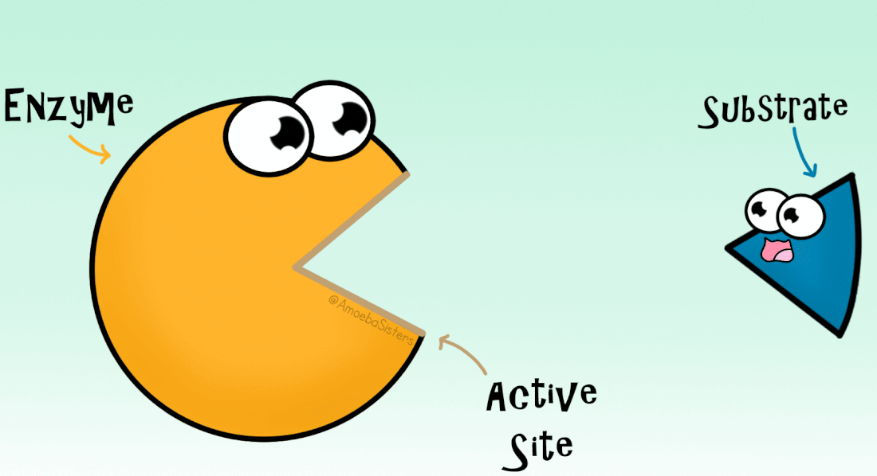

Slide 3
Enzyme regulation in Metabolism
Enzymes are controlled in two major ways
1) Turning genes on or off that make a
specific enzyme

Slide 4
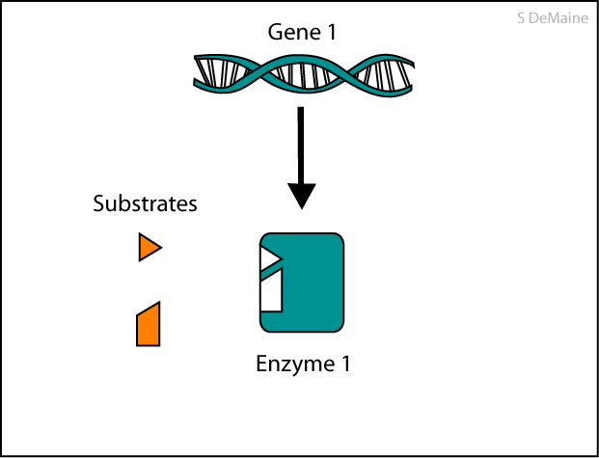

Slide 5
Enzyme regulation in Metabolism
Enzymes are controlled in two major ways
1) Turning genes on or off that make a
specific enzyme
2) Using other molecules to turn the
enzyme on or off
-Binding to active site or allosteric site

Slide 6
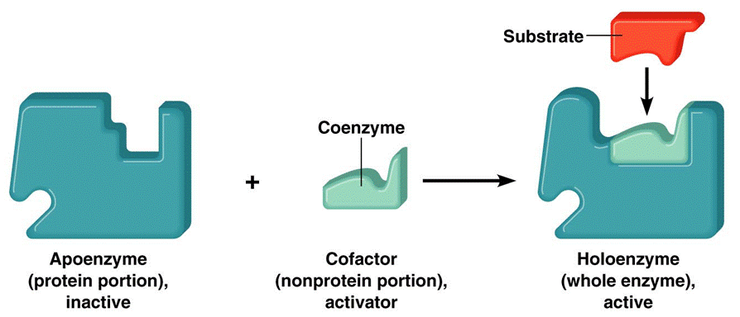
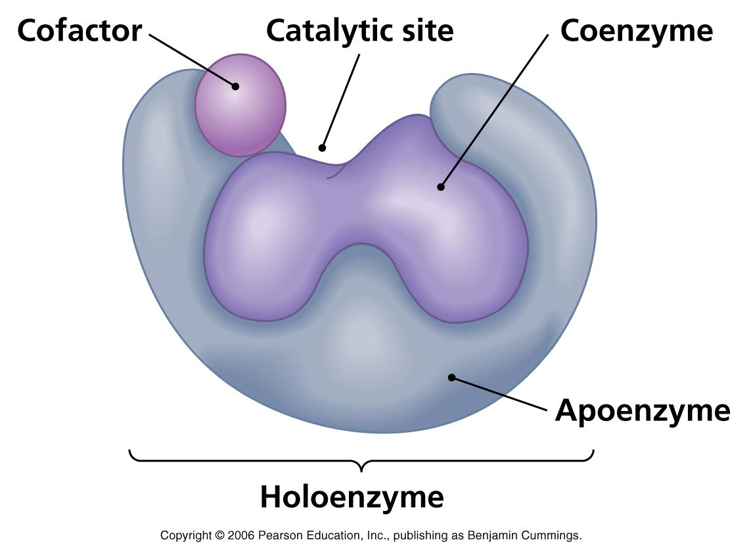
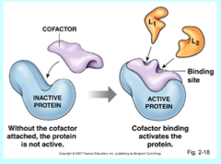
Activators
Cofactors are activators that bind to and enzyme and help it catalyze reactions
2 types:
-Inorganic cofactors: zinc, iron, copper
-Coenzymes- organic cofactors such as
vitamins

Slide 7
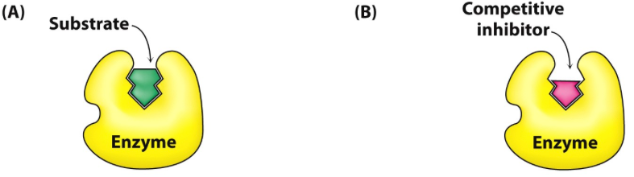
Enzyme inhibitors
Inhibitors slow down or stop enzymes from catalyzing reactions
-Competitive inhibitors- are similar in shape to substrate and compete with it to bind to the active site

Slide 8
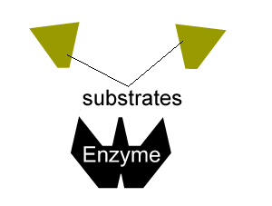
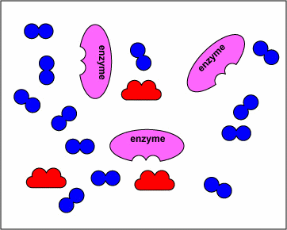

Slide 9
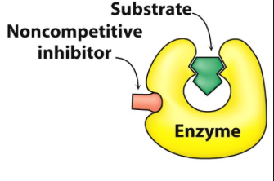
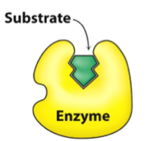
Enzyme inhibitors
Inhibitors slow down or stop enzymes from catalyzing reactions
-Noncompetitive inhibitors- bind to another part of the enzyme (allosteric site) causing it to change shape

Slide 10
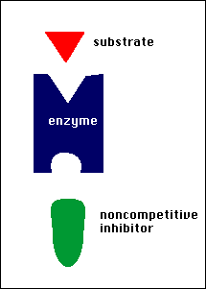
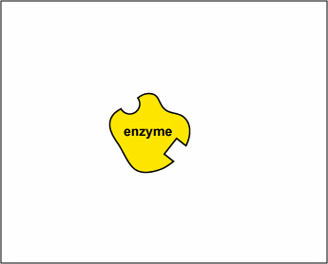

Slide 11
Irreversible Enzyme inhibitors
Irreversible inhibitors- permanently covalently bond to enzyme= permanent deactivation
-Toxins and poisons
Sarin Nerve Gas
Pesticides (DDT, parathion)
Antibiotics (penicillin)

Slide 12
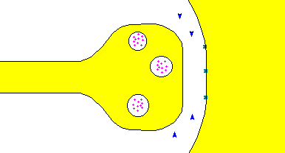
* Serin gas binds to the enzymes (little blue triangles above) that break apart the neurotransmitters
* Without the breakdown of neurotransmitters, the neuron cannot reset to send another signal and the
entire nervous system permanently shuts down!!!

Slide 13
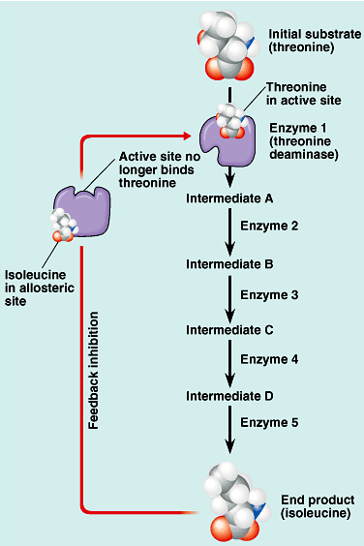
Feedback inhibition
Metabolic pathway is turned off when the end product acts as an inhibitor

Slide 14
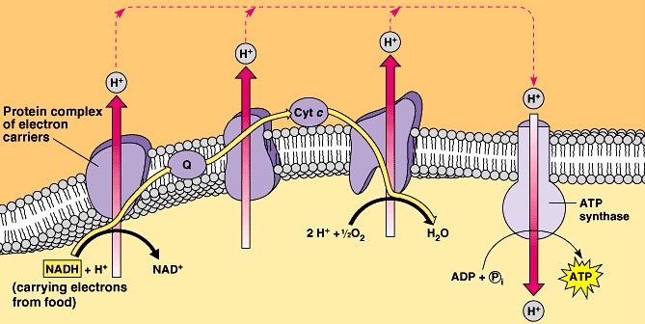
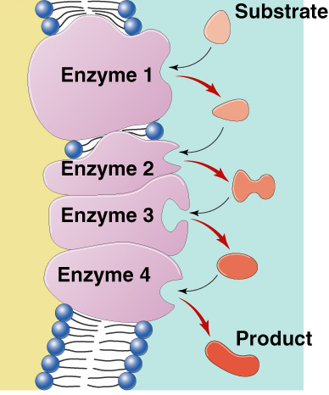
Enzyme organization
Enzymes are localized in specific parts of the cell to do their jobs
Enzyme complex

Slide 15
Other Factors affecting enzymes
Enzyme concentration
Substrate concentration
What affects the shape of an enzyme?
-Temperature
-pH
-Salinity

Slide 16
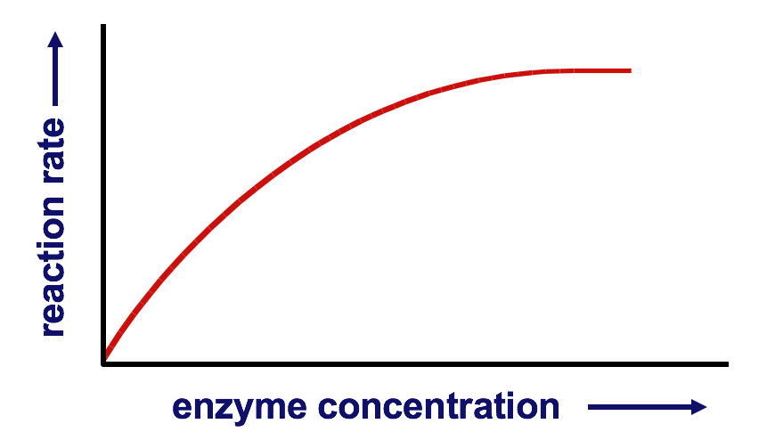
Enzyme Concentration
↑ enzyme = ↑ reaction rate
-more enzymes = more frequently collide with
substrate
-reaction rate levels off
*substrate becomes limiting factor
*not all enzyme molecules can find substrate
reaction rate
enzyme concentration
Notes:
Why is it a good adaptation to organize the cell in organelles?
Sequester enzymes with their substrates!

Slide 17
Substrate Concentration
Substrate concentration
↑ substrate = ↑ reaction rate
-more substrate = more frequently collide
with enzyme
reaction rate levels off…why?
reaction rate
substrate concentration
Notes:
Why is it a good adaptation to organize the cell in organelles?
Sequester enzymes with their substrates!

Slide 18
Temperature
reaction rate
37°
temperature

Slide 19
Temperature
Optimum Temperature:
-maximum collisions
-enzyme not denatured
What causes denaturing?
-in humans 35°- 40°C but different
optimal temps in other organisms.

Slide 20
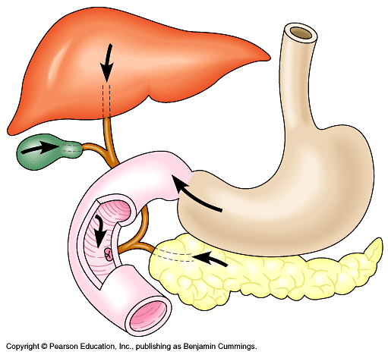
pH
pepsin
trypsin
pepsin
reaction rate
trypsin
0
1
2
3
4
5
6
7
8
9
10
11
12
13
14
pH

Slide 21
pH
Optimum pH- adds or remove H⁺
    -Denatures protein by:
    *disrupting weak bonds at
    secondary and tertiary level
    -In human pH 6-8
      *depends on localized conditions
      pepsin (stomach) = pH 2-3
      trypsin (small intestines) = pH 8
0
1
2
3
4
5
6
7
8
9
10
11

Slide 22
Salinity
reaction rate
salt concentration

Slide 23
Salinity
Salt concentration
    -adds or removes cations (+) & anions (–)
    -disrupts weak bonds at secondary and tertiary level of protein

