Slide 1
Eukaryote Gene Regulation

Slide 2
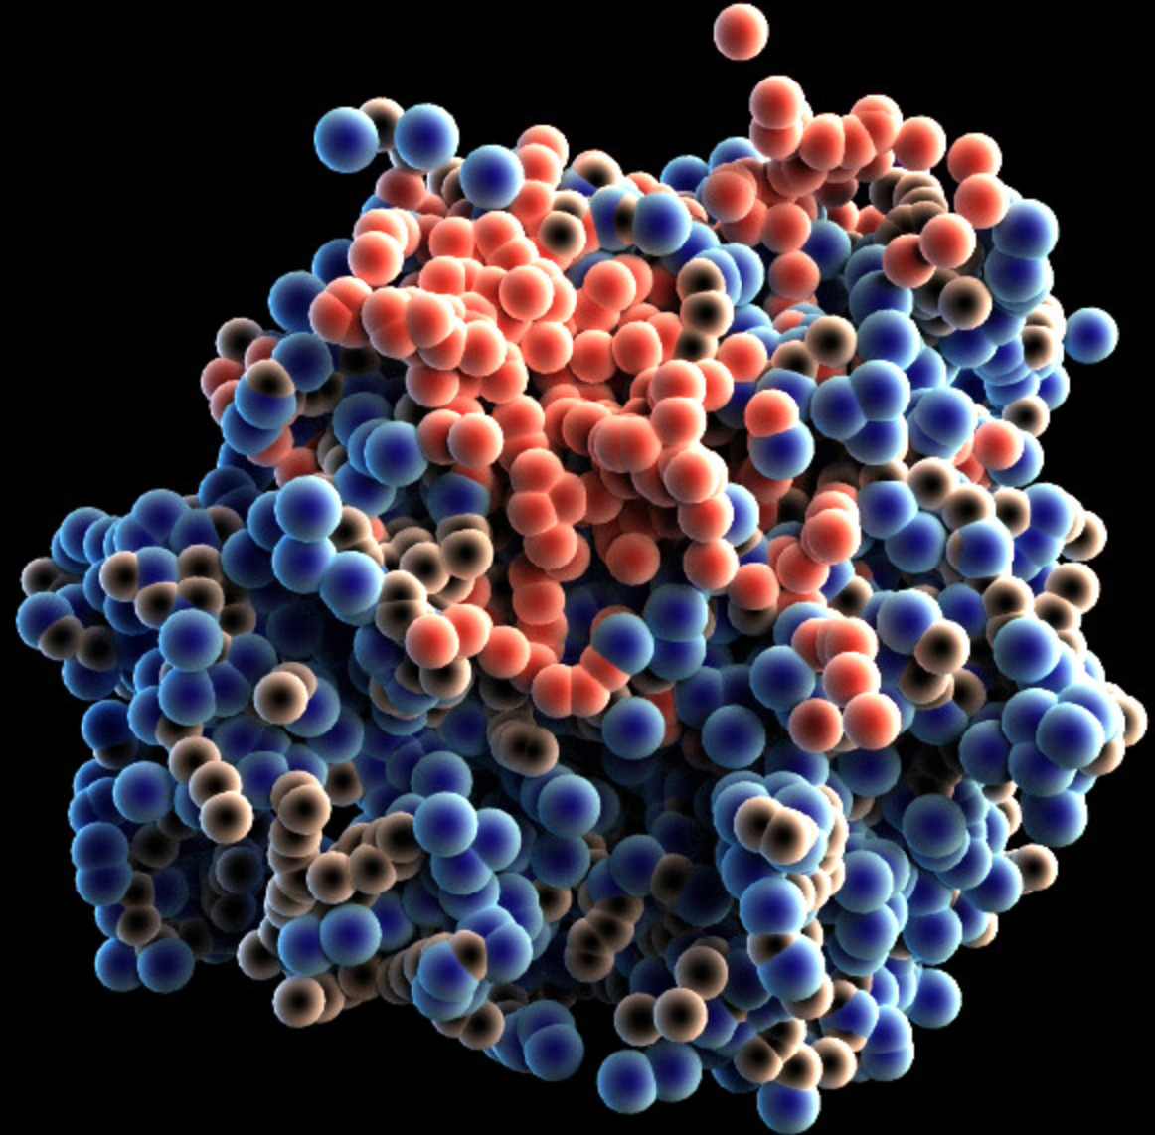
How do prokaryotes regulate genes?
Operons!!!
Repressor
(Protein that turns operator off)
Promoter
RNA Polymerase
GENE 1
GENE 2
Operator
(On/Off Switch)

Slide 3
Repressible Operons
trp operon
RNA Polymerase
trpE
trpD
trpC
trpB
trpA

Slide 4
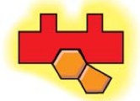
Repressible Operons
trp operon
RNA Polymerase
trpE
trpD
trpC
trpB
trpA

Slide 5
Inducible Operons
Operons that are usually off but are turned on when a certain molecule becomes present
Example: Lac Operon
RNA Polymerase
lacZ
lacY
lacA

Slide 6
Inducible Operons
Operons that are usually off but are turned on when a certain molecule becomes present
Example: Lac Operon
lacZ
lacY
lacA

Slide 7
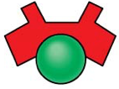
Inducible Operons
RNA Polymerase
lacZ
lacY
lacA

Slide 8
Why do eukaryotes regulate their genes?
Conserve energy
Conserve materials

Slide 9
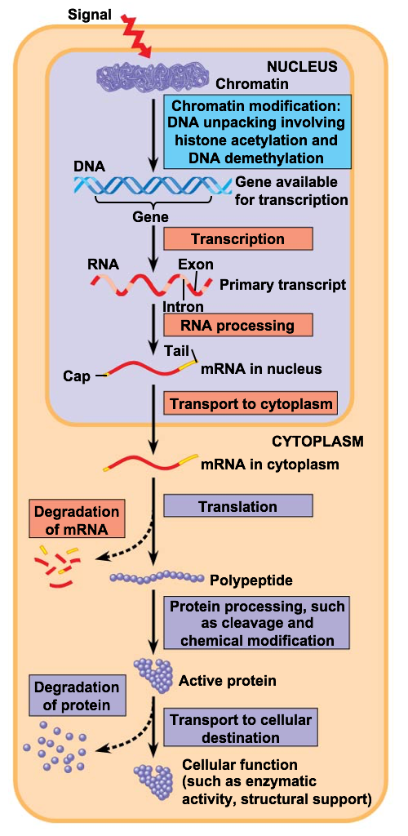
Levels of Eukaryote Gene Regulation
Three major ways eukaryote genes are regulated:
-At the chromatin level
-Transcription
-Post Transcription

Slide 10
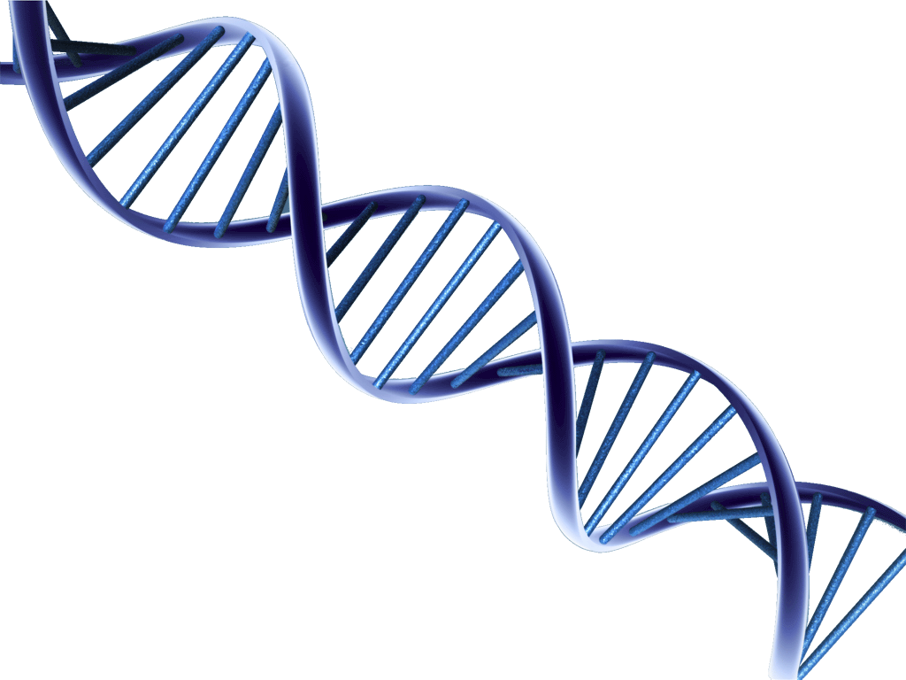
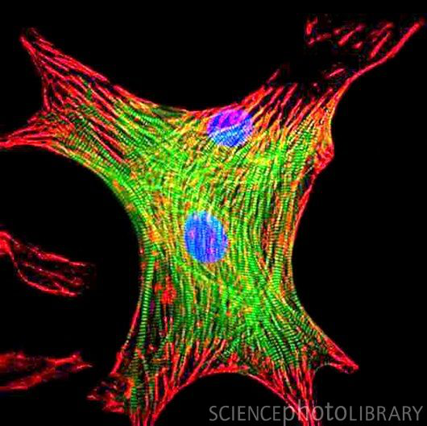
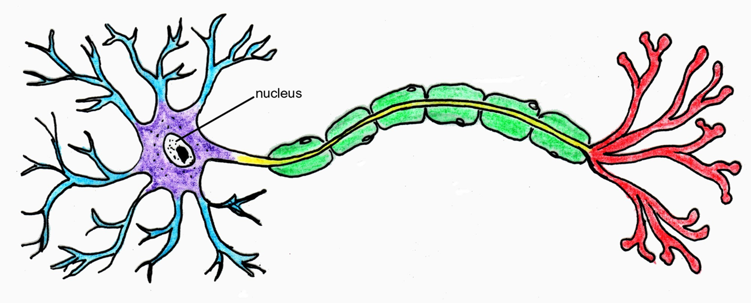
1) Differential Gene Expression (Differentiation)
***Every cell in an organisms body has the same copy of DNA instructions (genome) but…
Certain parts of the instructions are turned on or off (In humans only 20-40% of genes are expressed in each cell)
This makes cells look and behave different

Slide 11
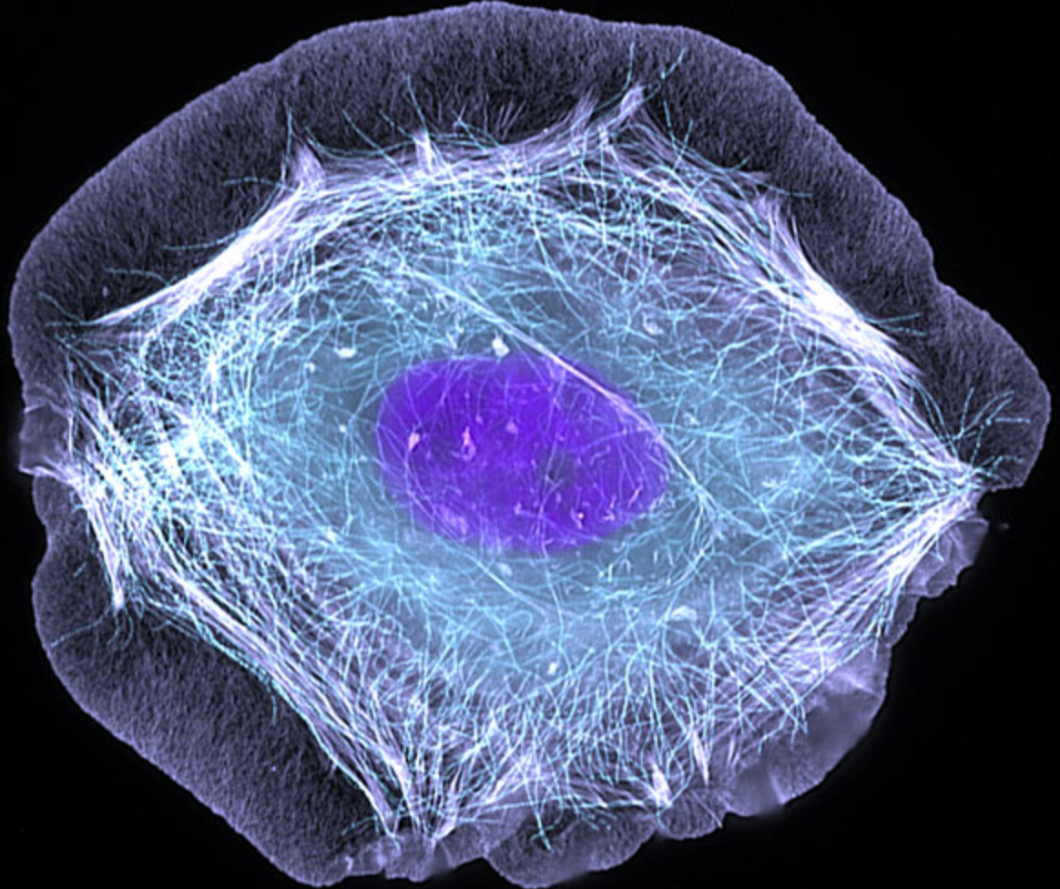
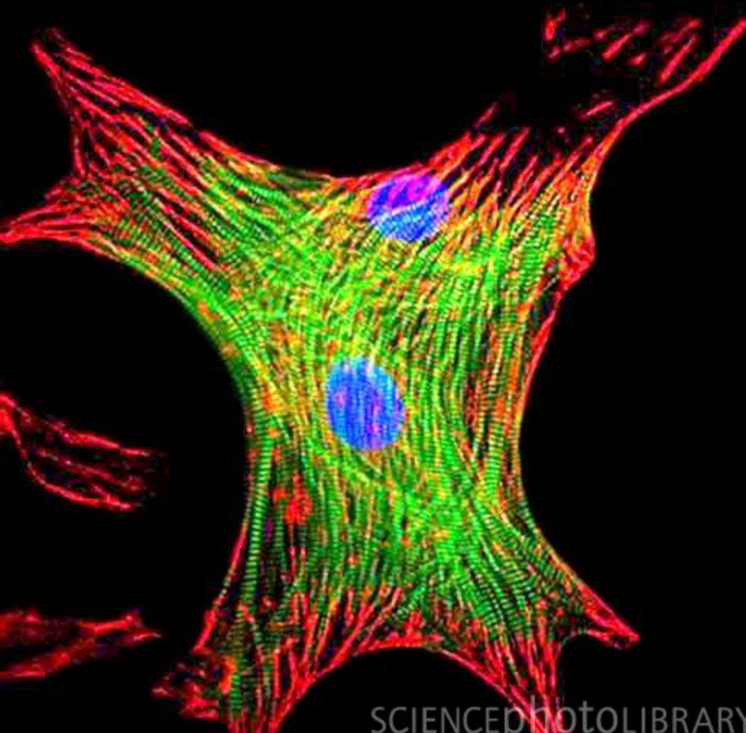
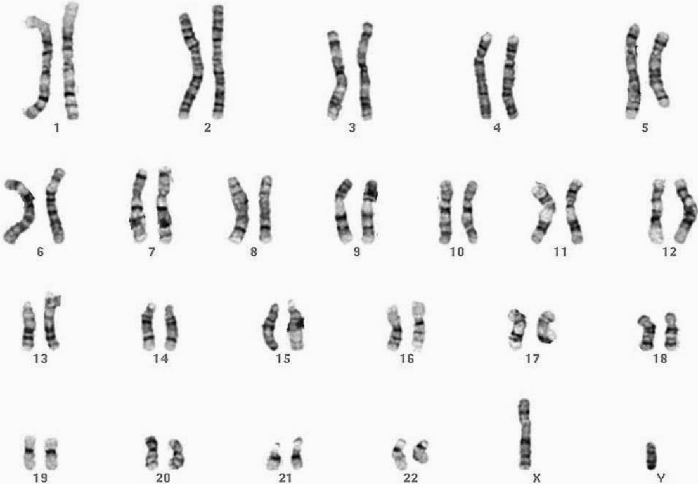
Cell Differentiation
Off
Off
Off
Off
Off
Off
Off
Off
Off
Off
Off
Off
Off
Off
Off
Off
Off
Off
Off
Off
Off
Off
Off

Slide 12
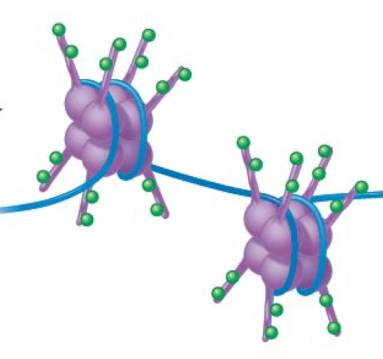
Chromatin Structure Affects Expression
-The genes location of its promotor relative to the nucleosome determines if it can be transcribed
Gene on = Euchromatin
Gene off = Heterochromatin

Slide 14
Histone Acetylation
-Addition of an acetyl (-COCH₃) to a histone tail amino acid decondenses heterochromatin
to euchromatin

Slide 15
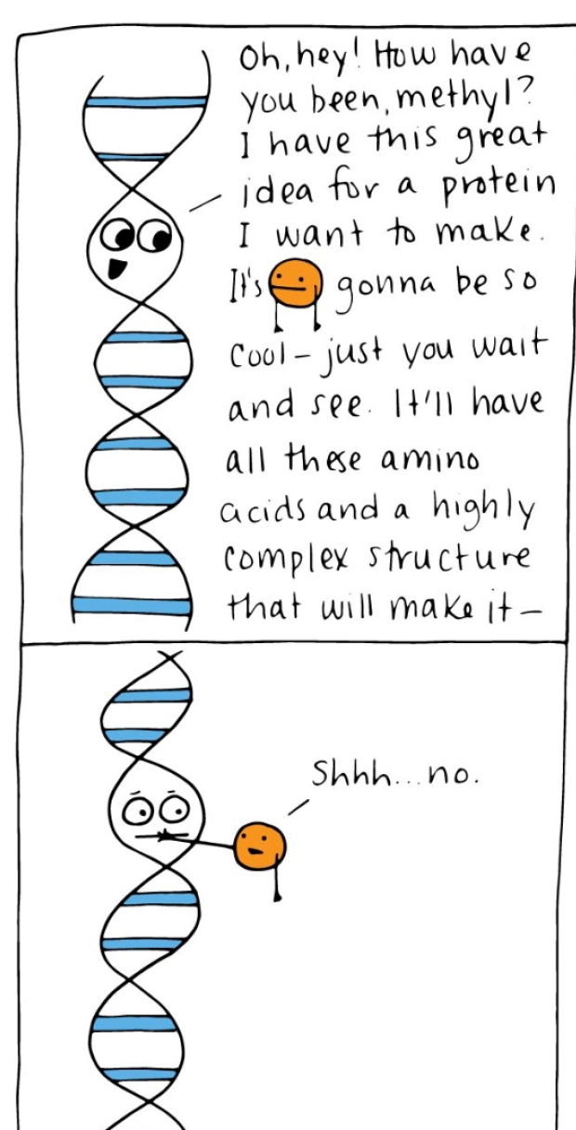
DNA Methylation
Addition of methyl group (-CH₃) to DNA bases (usually cytosine) causes condensing of DNA
- Few methyl groups means gene is transcribed less
-Heavy methylation means genes are not expressed
- Removal of methyl groups can resume expression

Slide 17
Epigenetic Inheritance
Methylation can be influenced by environmental factors!
-Lactose intolerance
Methylation patterns can be passed to future generations

Slide 18
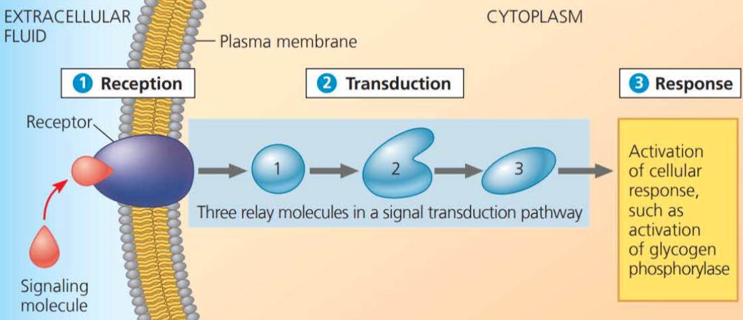
2)Transcription
In most organisms, gene expression is controlled at transcription by signals sent from the out side of the cell

Slide 19
Gene Regulation
BIG IDEA!!!
Cells continuously turn genes on or off in response to signals from internal and external environments
-Hormones
-Death of surrounding cells (growth factors)
-Eating
-Temperature Changes
- Cyclins/CDKS

Slide 20
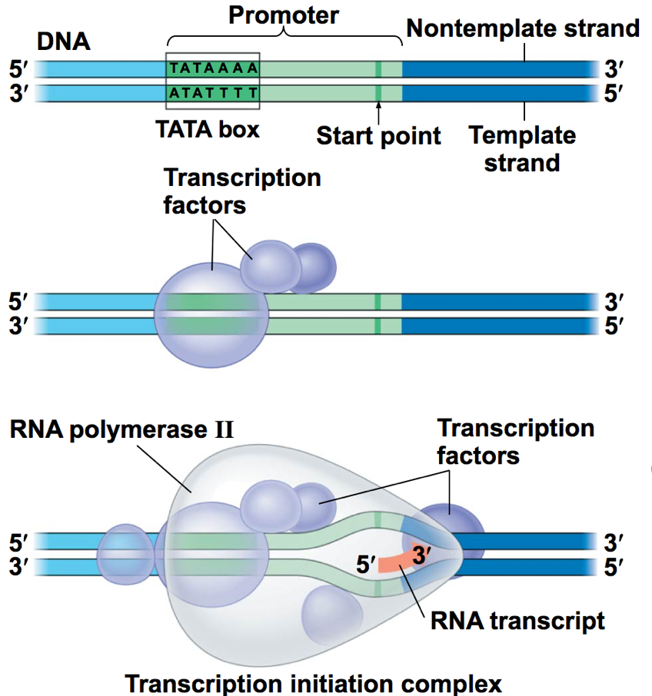
Basic regulation of Transcription Initiation
The binding of proteins (transcription factors) to the promotor region can either facilitate or inhibit the binding of RNA Polymerase

Slide 21
Components of Transcription
-Control Elements- DNA segments that are binding sites for transcription factors
*Enhancer- control elements upstream of the gene that must be bound for transcription to occur
-General Transcription Factors- proteins that must bind to control elements and the promoter in order for RNA Polymerase to bind
*May be activators or repressors
-Mediator proteins- Additional group of proteins that must be present to interact with the promoter.

Slide 22
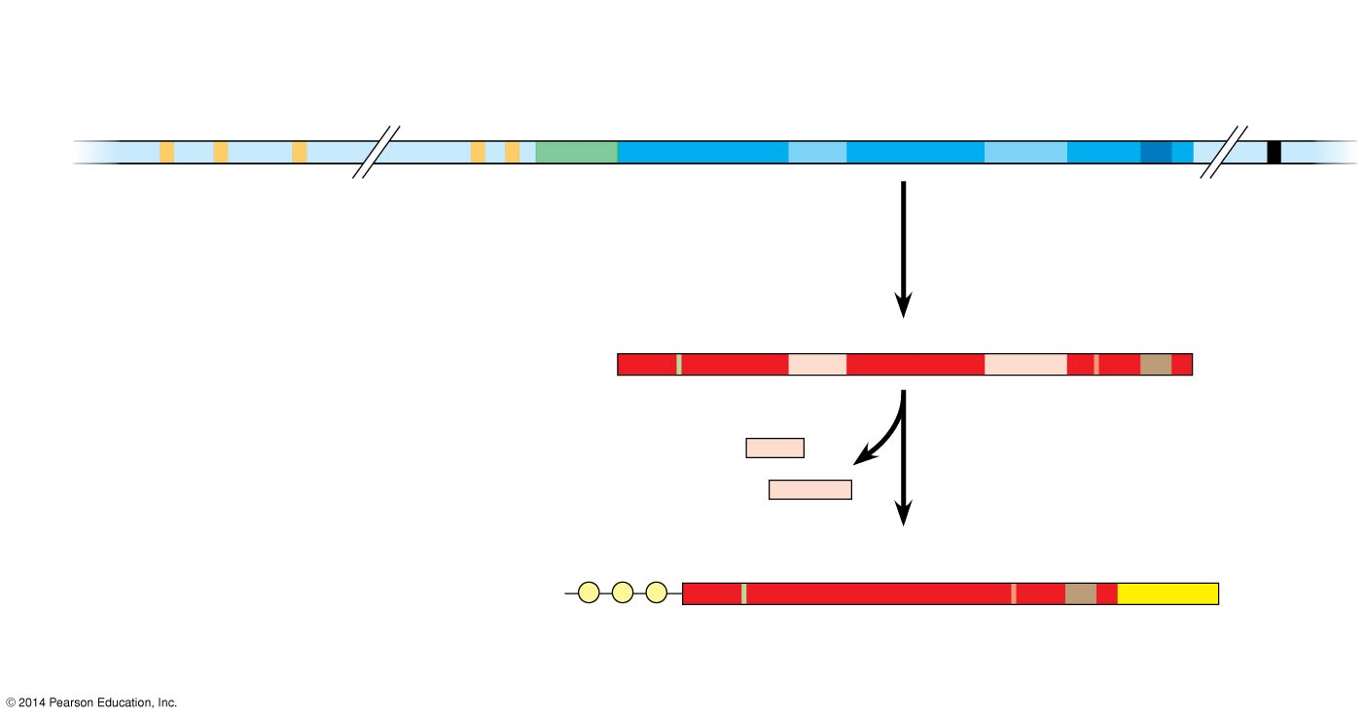
Enhancer (distal control elements)
Proximal control
elements
Poly-A signal sequence
Transcription termination region
Transcription start site
Exon
Intron
Exon
Intron
Exon
DNA
Upstream
Promoter
Down- stream
Transcription

Slide 23
Activation of Transcription
1) Activator proteins bind to enhancer control elements

Slide 24
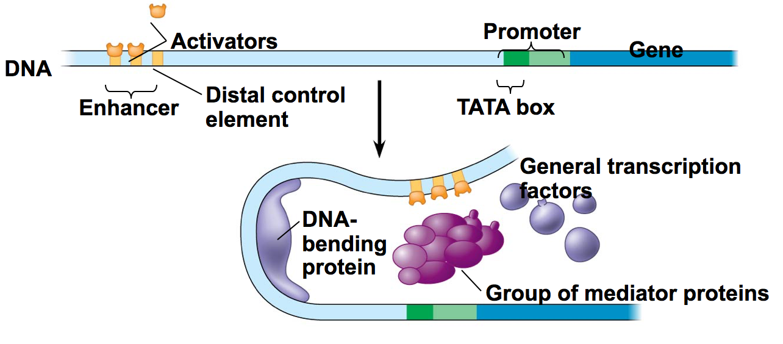
Activation of Transcription
2) DNA bending protein folds the DNA so that the activators are just above the promoter region

Slide 25
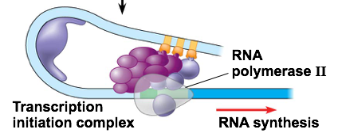
Activation of Transcription
3) Activator Proteins bind to mediator proteins and transcription factors helping form an active initiation complex with RNA Polymerase II on the promotor

Slide 26
Repressors in Eukaryotes
Repressors bind to enhancer which blocks activators from binding…stopping transcription

Slide 27
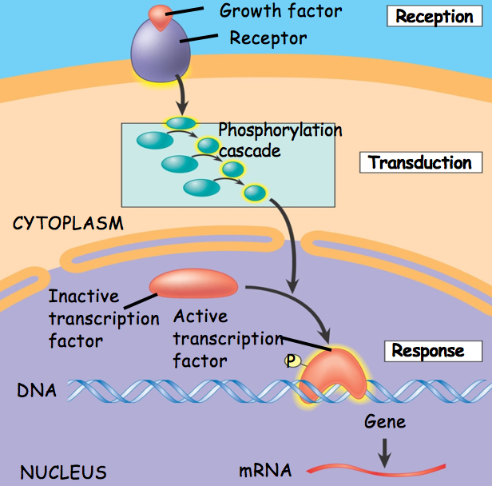
Nonsteroidal signaling molecules
Bind to surface receptor… starting a signal transduction pathway that leads to activation of activators or repressors

