Slide 1
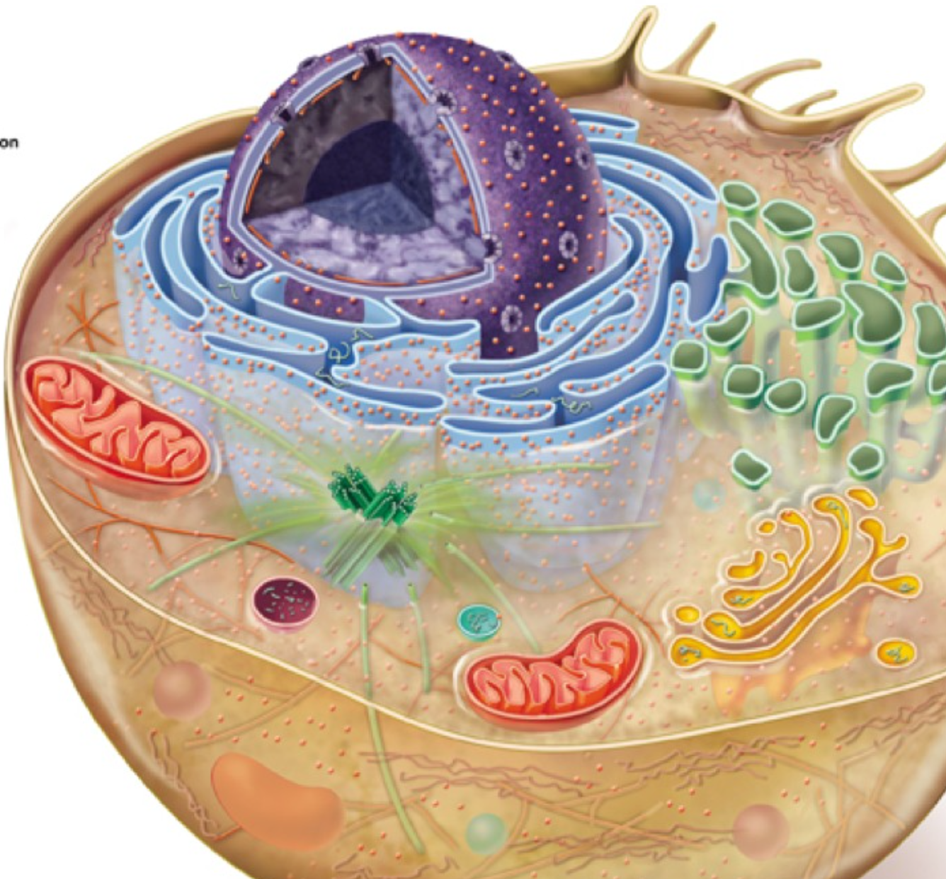
Eukaryote Gene Expression/Regulation

Slide 2
Gene Regulation
BIG IDEA!!!
Cells continuously turn genes on or off in response to signals from internal and external environments
-Hormones
-Death of surrounding cells
-Eating
-Temperature Changes
~ 20% of genes in a human cell are expressed at any given time

Slide 3
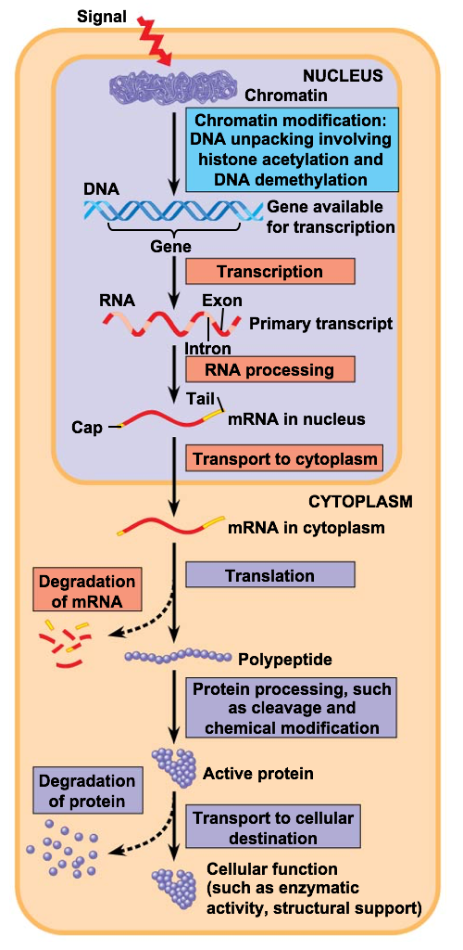
Levels of Eukaryote Gene Regulation
Three major ways eukaryote genes are regulated:
-At the chromatin level
-During Transcription
-Post Transcription (proteins)

Slide 4
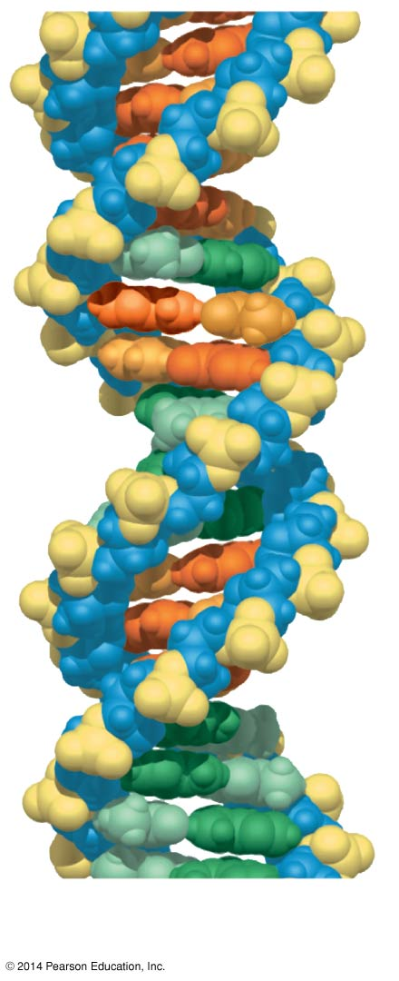
How much DNA is in one cell?
The DNA inside one of your cells is 6 feet long

Slide 5
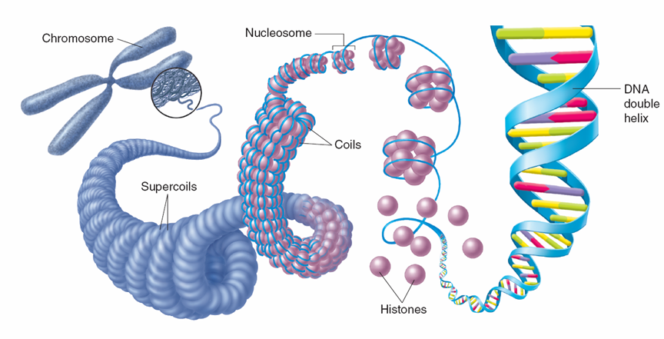
How does it all fit then?
DNA is wrapped up very tightly into structures we call chromosomes

Slide 6
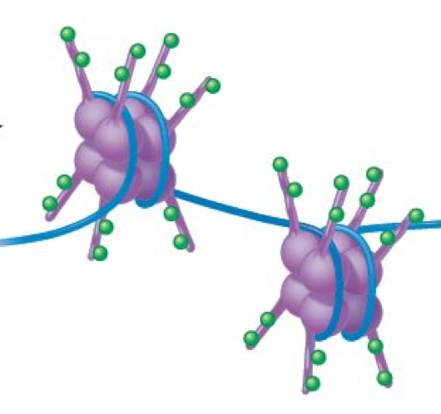
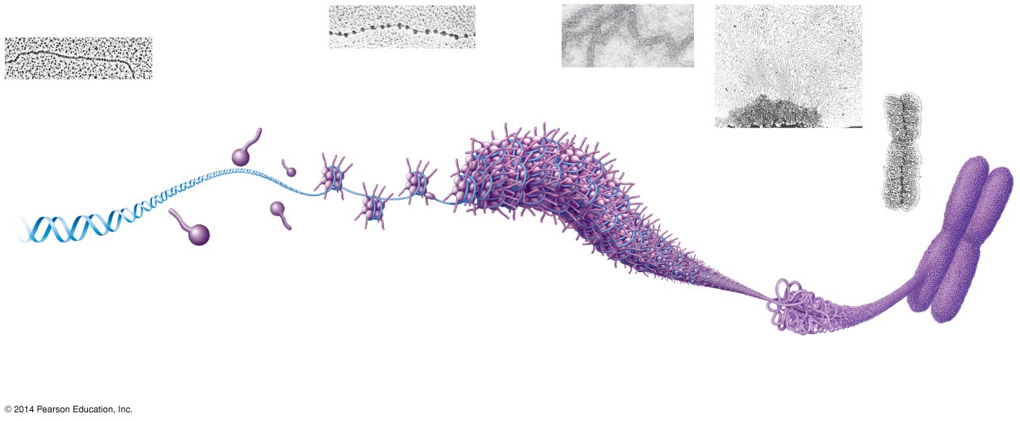
Parts of a Chromosome
DNA wraps around proteins called histones
Nucleosome = DNA + 8 histone proteins
Chromatin = DNA + histone proteins

Slide 7
Parts of a Chromosome
DNA wraps around proteins called histones
Nucleosome = DNA + 8 histone proteins
Chromatin = DNA + histone proteins

Slide 8
Gene Regulation: Regulation of Chromatin Structure
Basic control:
-The genes location of its promotor relative to the nucleosome
-Genes within highly condensed heterochromatin (turned off/not expressed)
-Modification to chromotin

Slide 9
Histone Modifications
Histone tails of a nucleosome can be modified by adding chemical groups
-Acetylation (-COCH₃) promotes transcription by decondensing chromatin
-Methylation (-CH₃) reduces trancription by condensing chromatin

Slide 10
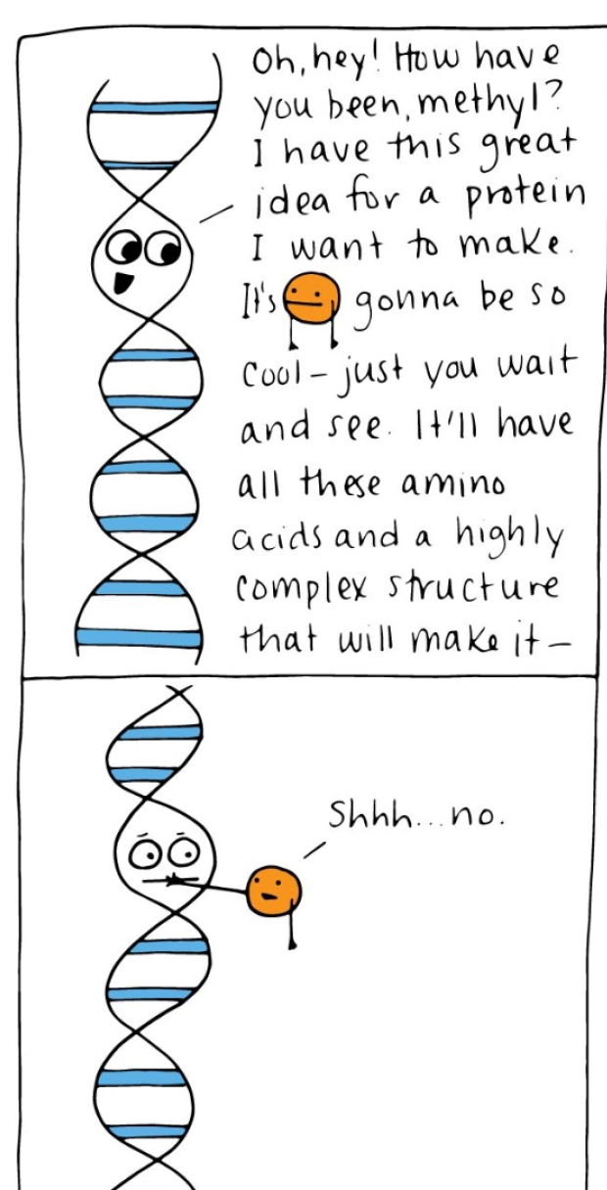
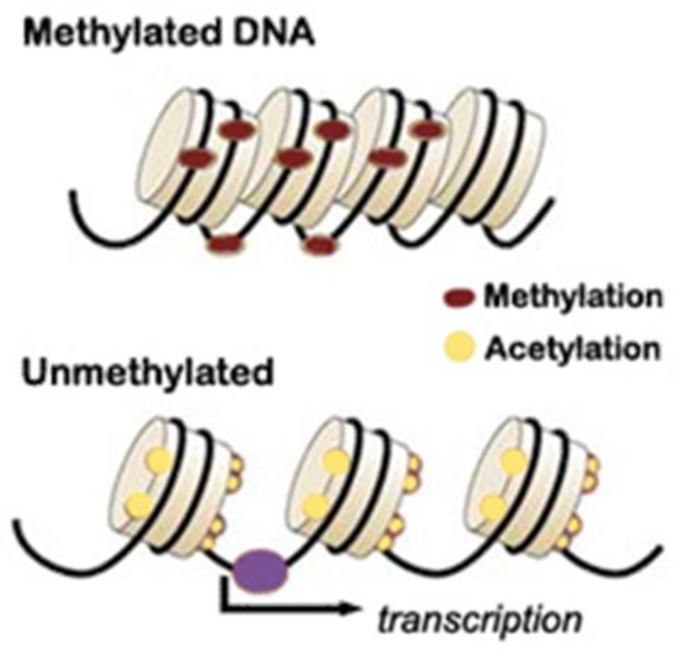
DNA Methylation
Methylation of DNA bases (usually cytosine) can reduce transcription
- Few methyl groups means gene is transcribed less
-Heavy methylation means genes are not expressed
- Removal of methyl groups can resume expression

Slide 11
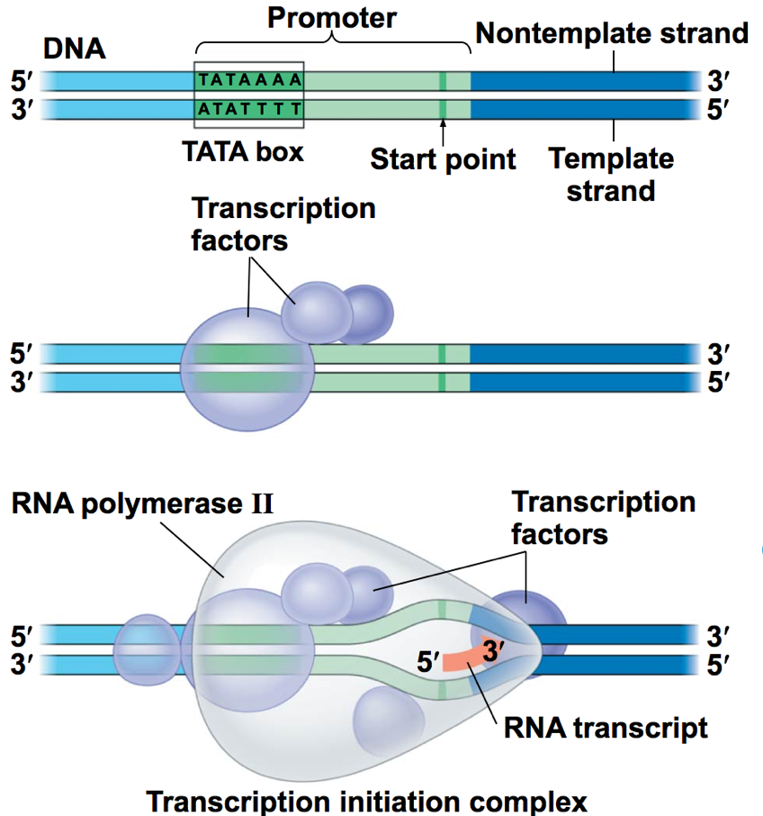
Regulation of Transcription Initiation
Basics…
The binding of proteins to the promotor region can either facilitate or inhibit the binding of RNA Polymerase

Slide 12
Components of Transcription
-Control Elements- DNA segments that are binding sites for transcription factors
*Enhancer- control elements upstream of the gene that must be bound for transcription to occur
-Transcription Factors- proteins that must bind to control elements and the promoter in order for RNA Polymerase to bind
*May be activators or repressors
-Mediator proteins- Additional group of proteins that must be present to interact with the promoter.

Slide 13
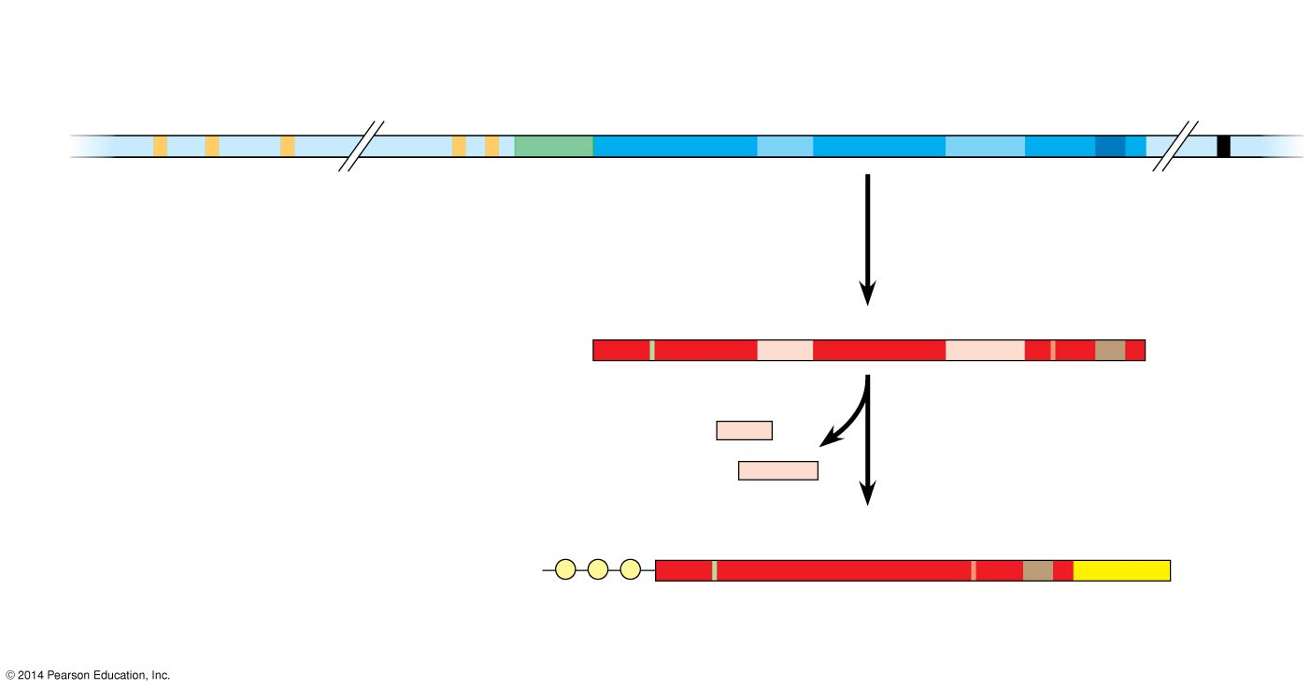
Enhancer (distal control elements)
Proximal control
elements
Poly-A signal sequence
Transcription termination region
Transcription start site
Exon
Intron
Exon
Intron
Exon
DNA
Upstream
Promoter
Down- stream
Transcription

Slide 14
Activation of Transcription
1) Activator proteins bind to enhancer control elements

Slide 15
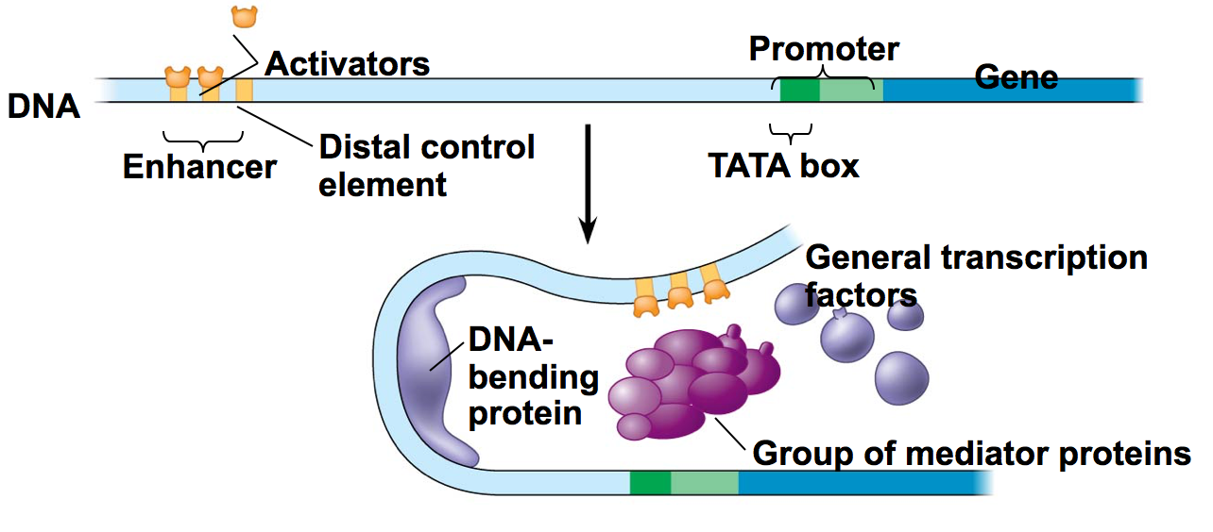
Activation of Transcription
2) DNA bending protein folds the DNA so that the activators are just above the promoter region

Slide 16
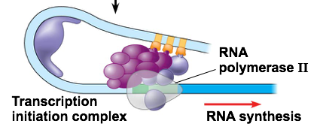
Activation of Transcription
3) Activator Proteins bind to mediator proteins, transcription factors and RNA polymerase on the promoters

Slide 17
Repressors in Eukaryotes
Repressors bind to enhancer which blocks activators from binding…stopping transcription

Slide 18
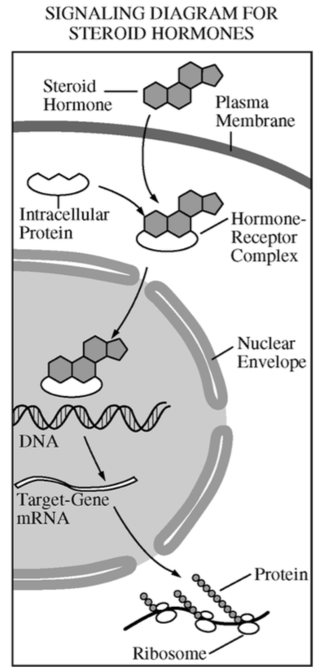
Steroid Hormones
Hormones bind to receptor protein and becomes an activator that can turn on a gene

Slide 19
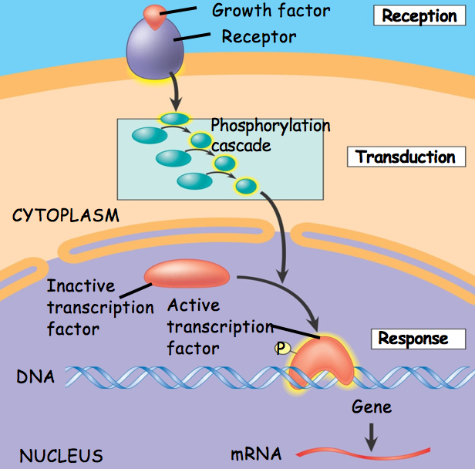
Nonsteroidal signaling molecules
Bind to surface receptor… starting a signal transduction pathway that leads to activation or activators or repressors

