Slide 1
Mutations

Slide 7
Twisty Cats

Slide 8
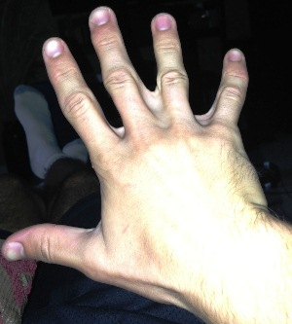

Slide 9
Explain in your own words how mutations may lead to a change in a species.

