Slide 1
Photosynthesis: Stage 1-Light dependent Reactions

Slide 2
Why?
The point of the light dependent reactions is…
To convert solar energy to chemical energy
stored in ATP and NADPH

Slide 3
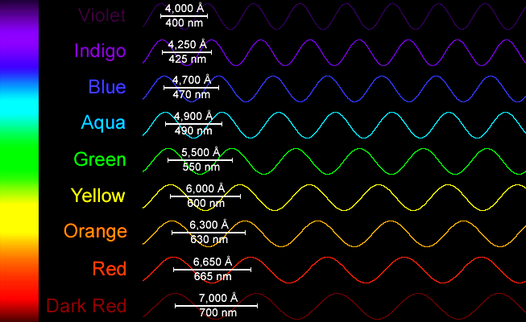
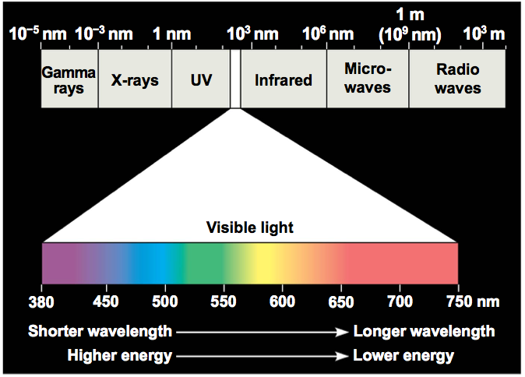
Sunlight
Light energy is known as electromagnetic energy or electromagnetic radiation
*Wavelengths are super
important for photosynthesis
380 nm to 770nm
Photons “particles” of light
-Shorter wavelengths > photon energy
-Longer wavelengths < photon energy
Notes:
Go over includes with the visual

Slide 5
Pigments
When light hits an object it can be reflected, transmitted or absorbed
Pigments are molecules
that absorb certain
wavelengths of light

Slide 6
Pigments of Photosynthesis
Main:
Chlorophyll a
Accessory Pigments:
Chlorophyll b
Carotenoids

Slide 7
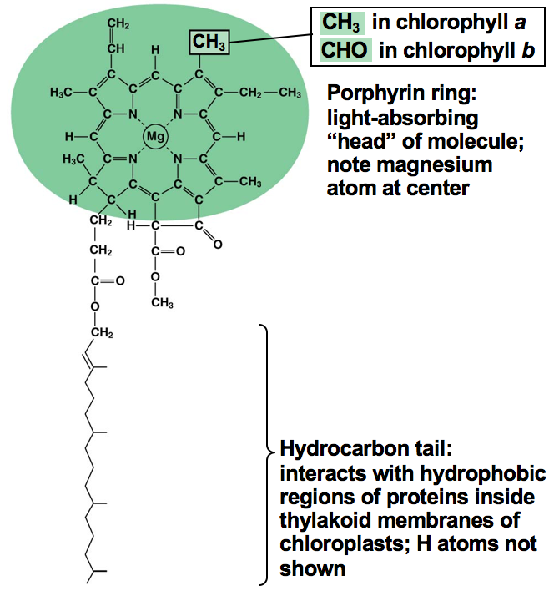

Slide 8
What happens when chlorophyll absorbs light?
When a photon is absorbed, an electron is moved to a higher electron shell
Ground state to Excited state

Slide 9
What happens when chlorophyll absorbs light?

Slide 10
PHotosystems
An organized structure found in thylakoid membrane that is used to capture energy from photons
Made of
Proteins
Chlorophyll a and b
Carotonoids
Other organic molecules

Slide 11
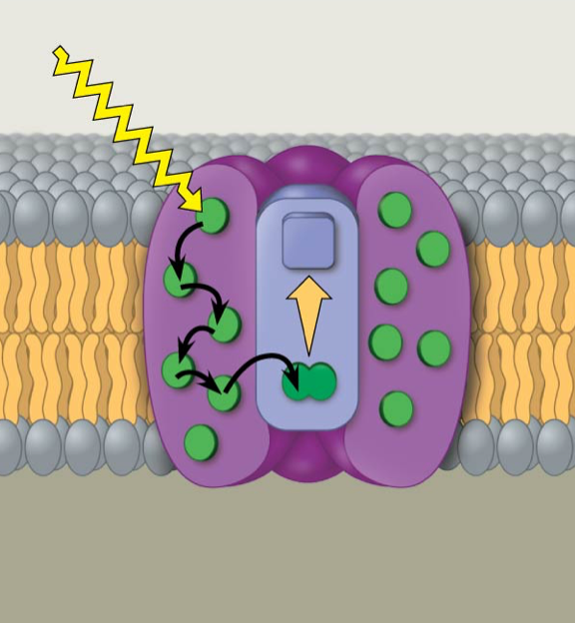
PHotosystems
Reaction Center Complex
Light Harvesting Complex
Primary Electron Acceptor
Pigment Molecules
Pair of
Chlorophyll a

Slide 12
PHotosystems
e

Slide 13
PHotosystems
Photosystem II
Photosystem I
P680
P700

Slide 14
Why?
The point of the light dependent reactions is…
To convert solar energy to chemical energy
stored in ATP and NADPH

