Slide 1
ATP

Slide 2
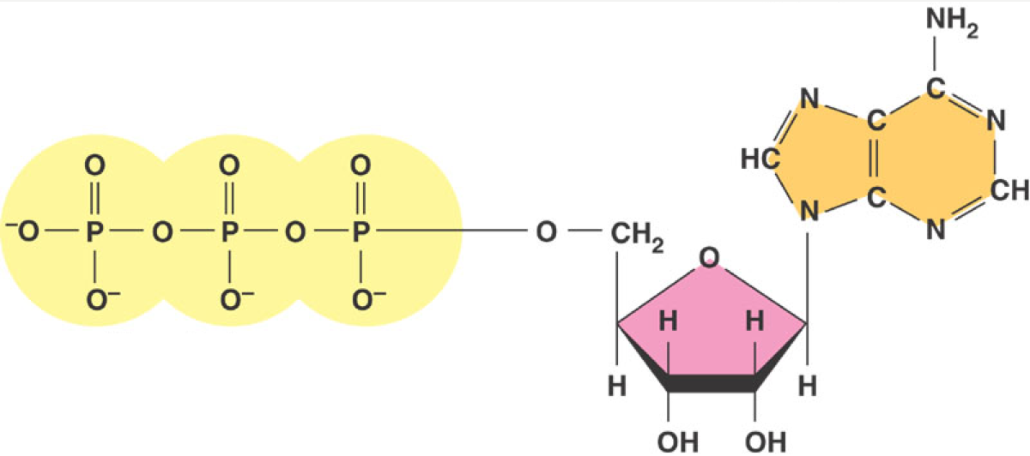
ATP Structure

Slide 3
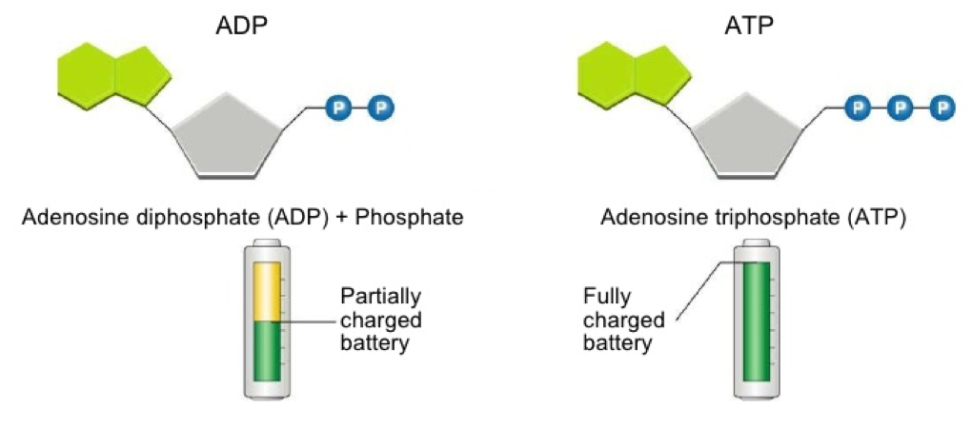
ADp ←→Atp
Both are energy storing molecules with one difference between them– the # of phosphates they have

Slide 4
ATP Hydrolysis
ATP Phosphorolation

Slide 5
How does ATP store energy?
O–
O–
O–
O–
O–
O–
O–
O–
P
P
P
P
P
P
P
P
–O
–O
–O
–O
O–
O–
–O
O–
–O
O–
O–
–O
O–
–O
O–
O–
O
O
O
AMP
O
O
O
O
O
ADP
ATP
Each negative PO₄ more difficult to add
- a lot of stored energy in each bond
*most energy stored in 3rd P_{i}
*3rd P_{i} is hardest group to keep bonded to molecule
Bonding of negative P_{i} groups is unstable
- P_{i} groups “pop” off easily & release energy
- Spring Loaded!
Instability of its P bonds makes ATP an excellent energy donor
Notes:
Not a happy molecule
Add 1st Pi → Kerplunk! Big negatively charged functional group
Add 2nd Pi → EASY or DIFFICULT to add? DIFFICULT→ takes energy to add = same charges repel → Is it STABLE or UNSTABLE? UNSTABLE = 2 negatively charged functional groups not strongly bonded to each other So if it releases Pi → releases ENERGY
Add 3rd Pi → MORE or LESS UNSTABLE? MORE = like an unstable currency • Hot stuff! • Doesn’t stick around • Can’t store it up • Dangerous to store = wants to give its Pi to anything

Slide 6
How does ATP transfer energy?
7.3
Free
energy
O–
O–
O–
P
P
P
O–
P
–O
–O
–O
O–
+
O–
O–
–O
O–
ATP
O
O
O
O
ADP
ATP → ADP
releases energy
Phosphorylation (adding phosphates!)
released P_{i} transfers to other molecules…
causing instability in them!!!
Kinase-the enzyme that phosphorylates
Notes:
How does ATP transfer energy?
By phosphorylating
Think of the 3rd Pi as the bad boyfriend ATP tries to dump off on someone else = phosphorylating
How does phosphorylating provide energy?
Pi is very electronegative. Got lots of OXYGEN!! OXYGEN is very electronegative. Steals e’s from other atoms in the molecule it is bonded to. As e’s fall to electronegative atom, they release energy.
Makes the other molecule “unhappy” = unstable. Starts looking for a better partner to bond to. Pi is again the bad boyfriend you want to dump.
You’ve got to find someone else to give him away to. You give him away and then bond with someone new that makes you happier (monomers get together).
Eventually the bad boyfriend gets dumped and goes off alone into the cytoplasm as a free agent = free Pi.

Slide 7
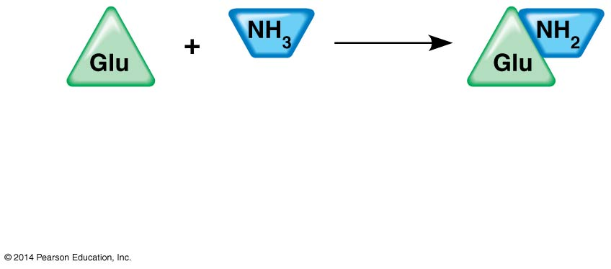
Energy
Glutamic acid
Ammonia
Glutamine

Slide 8
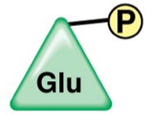
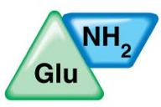
Energy Coupling and Phosphorylation
*Phosphorylated
Intermediate
+

Slide 9
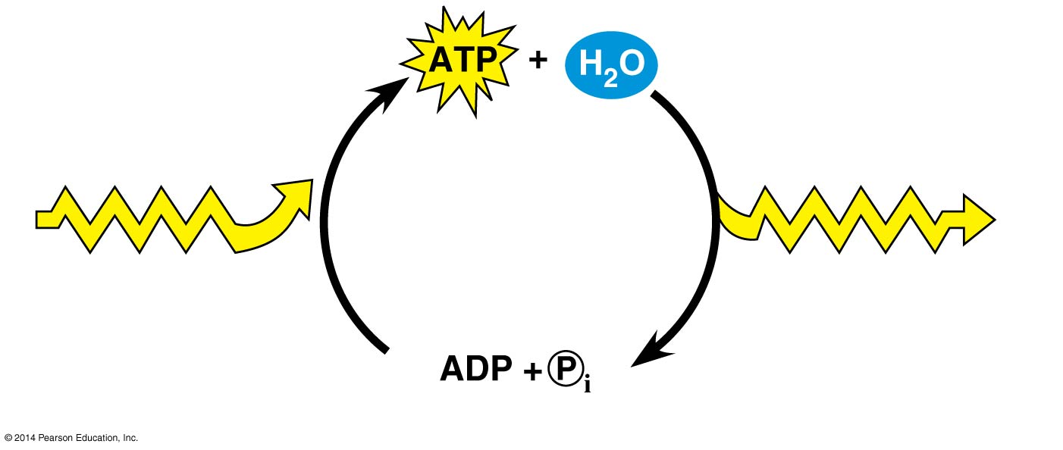
ATP Cycle
Used in Anabolic reactions and to power other chemical reactions
Catabolic Reactions:
Breaking down your food
ATP is too reactive to be stored!
Classified as short term energy storage
What does the cell use for long term energy storage?

