Slide 1
Enzymes

Slide 2
Chemical Reactions
A chemical reaction is a process that changes one set of substances into another set of substances by breaking and making chemical bonds

Slide 3
Chemical Reactions
A chemical reaction is a process that changes one set of substances into another set of substances by breaking and making chemical bonds
Reactants
Products

Slide 4
Chemical Reactions Inside Cells
Trillions of chemical reactions happen every second in your body as part of the metabolic pathways in each cell
Most of the chemical reactions that make life possible occur too slowly to make them practical for living tissue
Notes:
Transfer energy, make materials for organelles, break apart toxic substances

Slide 5
Activation Energy
Most chemical reactions in our metabolic pathways will not occur without energy being added to the reactant(s) to destabilize them…even exergonic ones.
The energy required to get a chemical reaction started is called activation energy

Slide 6
Enzymes
Enzymes are a type of protein that help speed up chemical reactions in metabolic pathways (aka catalyst)
Enzymes speed up reactions by lowering activation energy.

Slide 7
The GRAPH!!!

Slide 8
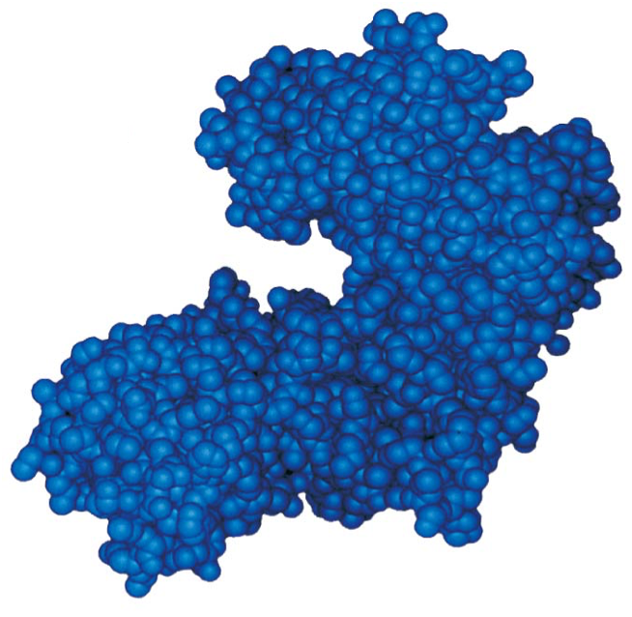
Enzyme Shape
3 Important parts to enzyme shape:
3D structure (aka tertiary structure)
Active site
Allosteric site

Slide 9
Enzyme Shape
Allosteric
Site
Active Site

Slide 10
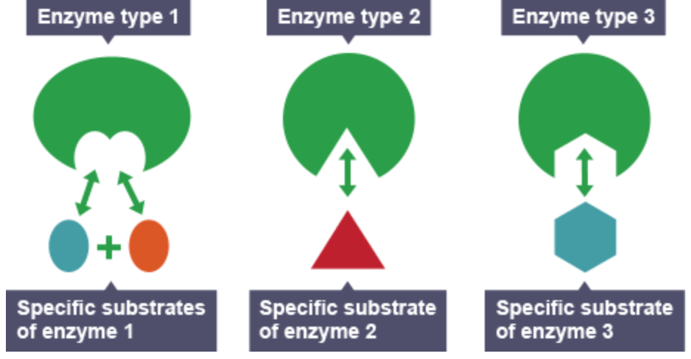
Enzymes and Substrates
Enzymes are very specific due to their shape
*They only work with specific molecules that we call substrates
The enzyme and substrate fit together like a lock and key
Notes:
Play prentice hall (walk through) and glenco videos

Slide 11
How do enzymes lower activation energy?...Induced fit
When the substrate binds to the activation site, the enzyme and substrate change shape to fit together even better
*Due to weak interactions between
substrate chemical groups and amino
acid R-groups in the active site
This change in shape weakens chemical bonds by destabilizing the substrate= less activation energy
Notes:
Video

Slide 12
4 Major Ways To Lower Activation Energy
1) Orienting two or more reactants in the correct position to each other
Notes:
More likely to react

Slide 13
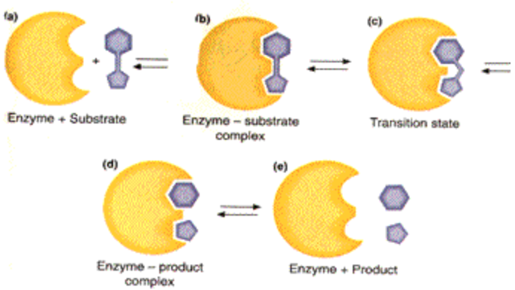
4 Major Ways To Lower Activation Energy
2) Induced fit may stretch or bend key chemical bonds to be broken
Notes:
More likely to react

Slide 14
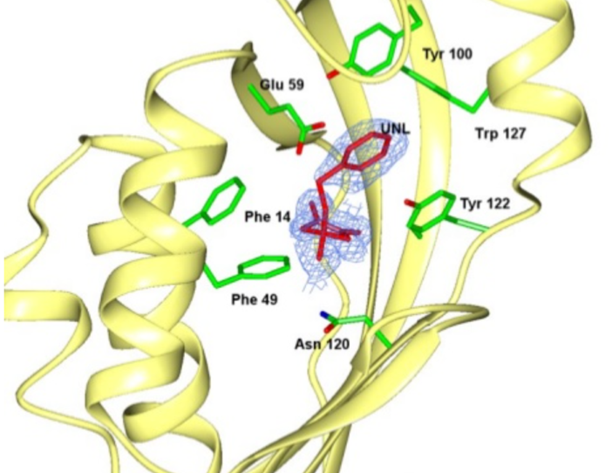
4 Major Ways To Lower Activation Energy
3) Creating a specific microenvironment
*Using R-groups to
lower or increase
pH, positive or
negative charges
Notes:
More likely to react

Slide 15
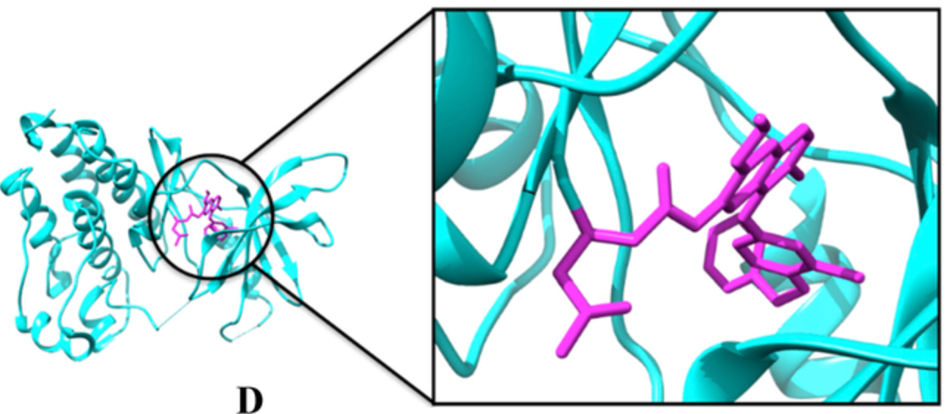
4 Major Ways To Lower Activation Energy
4) Covalent bonding between substrate chemical groups and amino acid side chains in active site
Notes:
More likely to react

