Slide 1
Change by Natural Selection

Slide 2
Nature “Selects”
Natural selection
-Environments change and favor individuals with specific traits good for the new environment—leading to change in how the species looks/behaves or extinction
Change in environment = Change in species

Slide 3
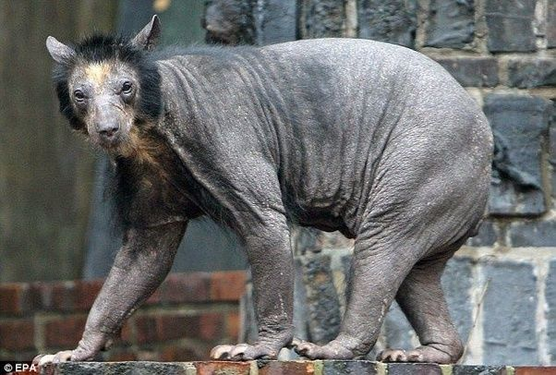

Slide 4
How do species become adapted to their environment?
Organisms do not choose to adapt to their environment
Little changes add up over long periods of time
-Individuals with the right traits for their environment reproduce and you see more of them
-Individuals who do not have the right traits die and you see less individuals until they are all gone

Slide 5
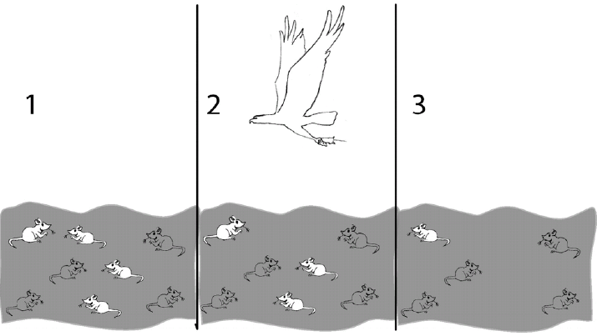

Slide 6
How did this environment change?
Which mouse trait (phenotype) is most likely to survive and reproduce? Why?
Did the change in the environment change the look of this species? Explain.
Notes:
Period 5

Slide 7
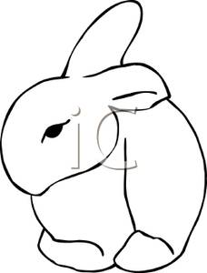
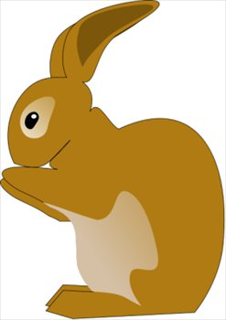
How do I describe change by natural selection?
There is a population of rabbits who have moved north to the snow because the food they eat has died out. 90% of the population is light brown to dark brown. 10% is white.

Slide 8
What kind of changes do you think will happen to this population of rabbits?
Explain how these changes will occur:
The rabbits that are ______________ are more likely to survive and reproduce because _____________________________________. The rabbits that are _________________ will slowly die off because _____________. Because of this, slowly over time the majority if not all the rabbits will be ____________________.

Slide 9
AKA: Survival of the fittest
Survival of the fittest is not about being the biggest and strongest its about having the right trait to survive
Fitness – surviving + reproduce
-Low fitness =dying and leaving few offspring
*do not pass on your genes
-High fitness = surviving with many offspring
*pass on your genes
Notes:
----- Meeting Notes (2/13/13 14:25) -----
How many people have heard of survival of the fittest?
What does it mean?

Slide 10
Divergent Evolution
Organisms have similar traits because of decent with modification (They share a relatively recent common ancestor)
Similar trait is referred to as a homologous structure

Slide 11
Convergent Evolution
Organisms have similar traits that evolved due to similar environmental pressures
These organisms are distantly related
Similar trait is referred to as an analogous structure

Slide 12
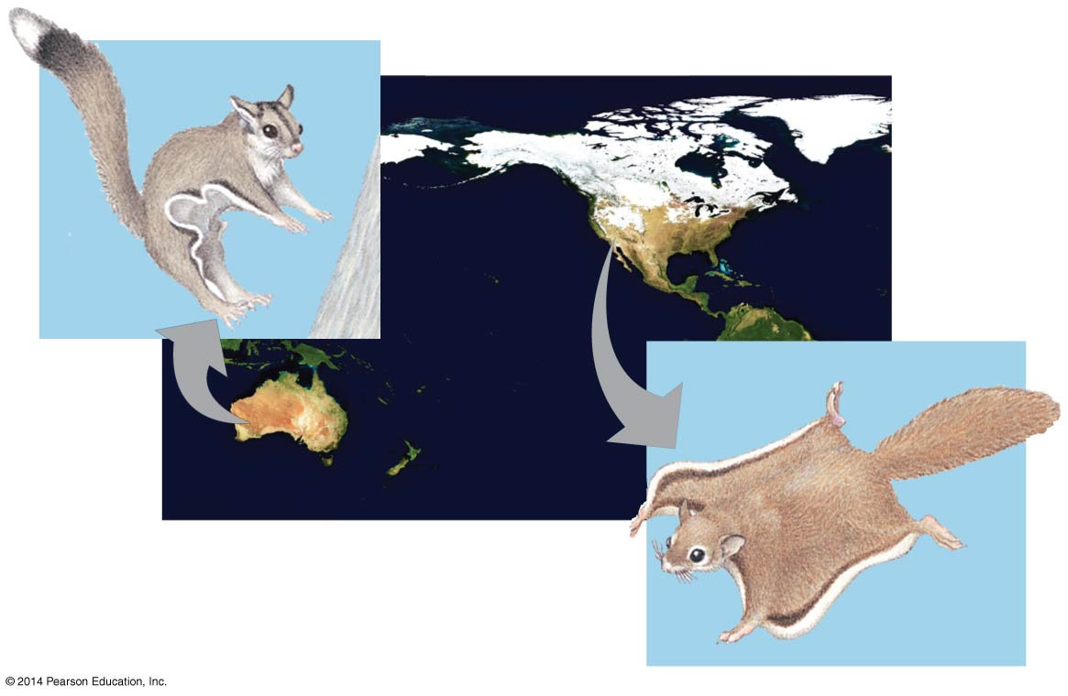
Figure 19.18
Sugar
glider
NORTH AMERICA
AUSTRALIA
Flying
squirrel
Notes:
12
Figure 19.18 Convergent evolution

Slide 13
Darwin's Theory of Change by Natural Selection
Reproductive potential- more individuals are born than will survive
Variability- variations occur among individuals in a population
Limited resources and intraspecies competition- biotic and abiotic resources are limited and organisms of the same species must compete with each other for survival
Differential Reproduction- Individuals with the most favorable traits will survive and produce more offspring
Generations- change is a gradual process that takes time to occur

Slide 14
What Darwin Observed

Slide 15
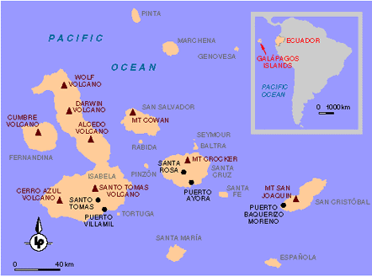

Slide 16
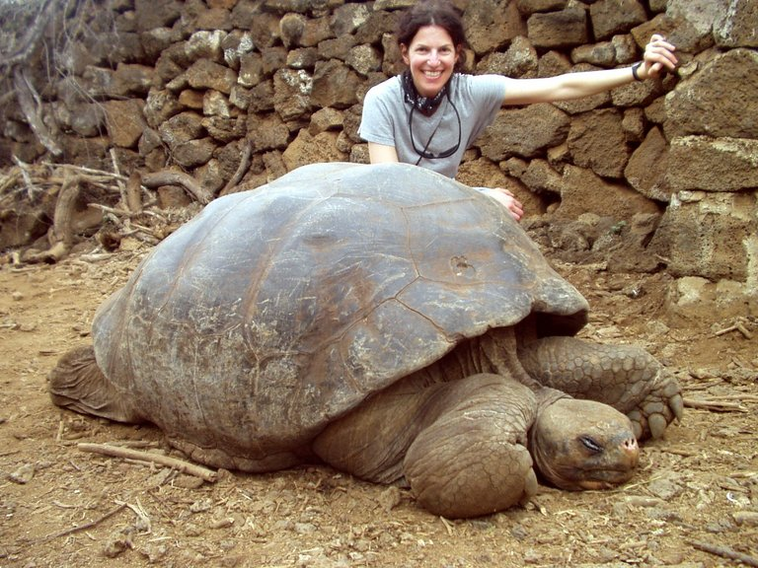

Slide 19
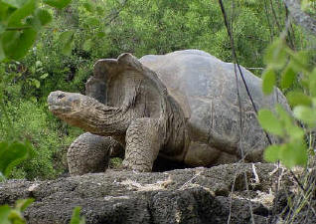
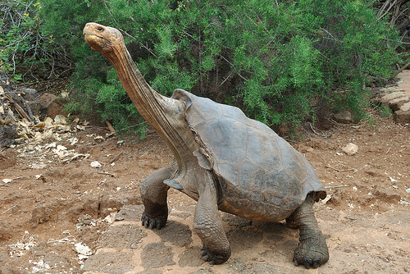

Slide 20
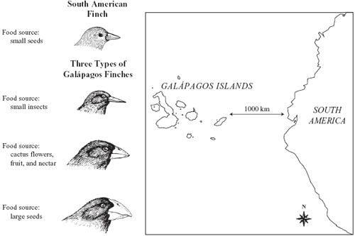

Slide 21
