Slide 1
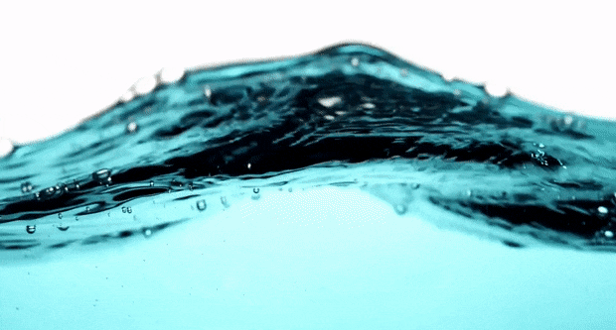
Properties of Water
Notes:
Water is one of the most important molecules for life on our planet
How long can humans go without water? Is that the same for other species? Tardigrades and Galapagos tortoises
Question then…why is it so important?

Slide 2
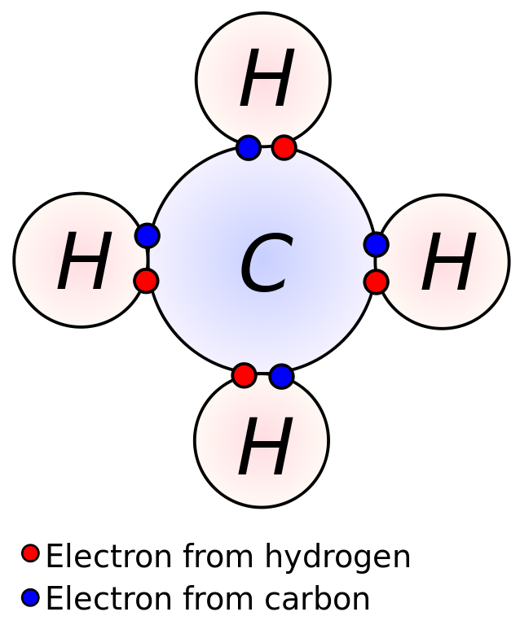
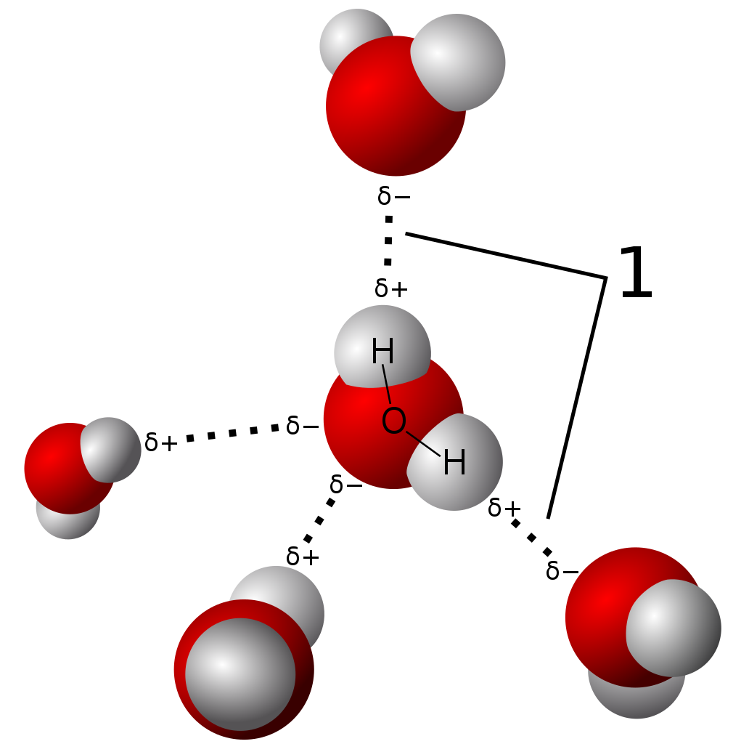
Review of Bonds
Ionic
Covalent
Hydrogen
Notes:
Ionic bond between metal and non metal with electronegativity so different the sharing becomes one losing one of its electrons to the other
Covalent shared paired of electrons usually between two nonmetals

Slide 3
What is the difference between ionic bonds and covalent bonds?
Which is stronger?

Slide 4
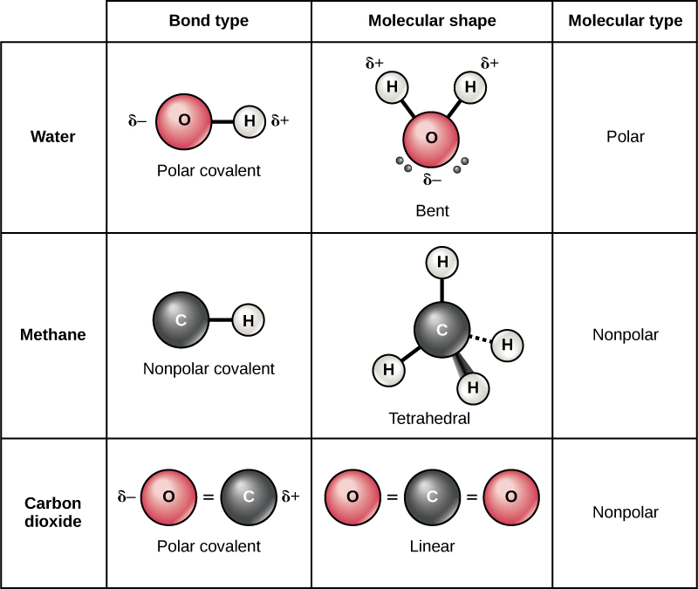
Covalent Bonds
Covalent bonds share electrons, but are all electrons shared equally?
Nope
Polar molecules do not share electrons evenly are known for being hydrophilic
Nonpolar molecules share molecules evenly and are known for being hydrophobic
Notes:
Bring up form/structure and function

Slide 5
H
H
Oxygen is one of the most electronegative elements and pulls the shared electrons towards its nucleus. This leaves the Hydrogens with a slightly Positive charge and the Oxygen with a slightly negative charge.
Oxygen
e⁻
e⁻
e⁻
e⁻

Slide 6
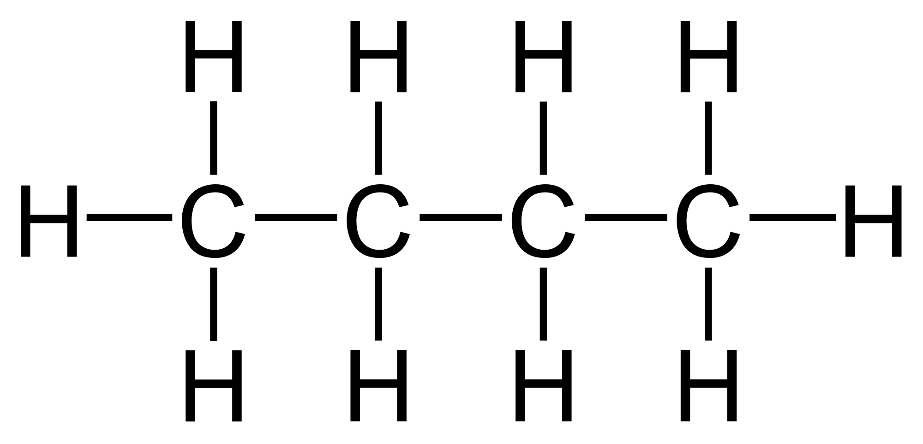
What would this molecule be?
This is also NONPOLAR because the charges are all shared equally.
Notes:
Include hydrophobic and hydrophilic here

Slide 7
What is the difference between nonpolar and polar covalent bonds?

Slide 8
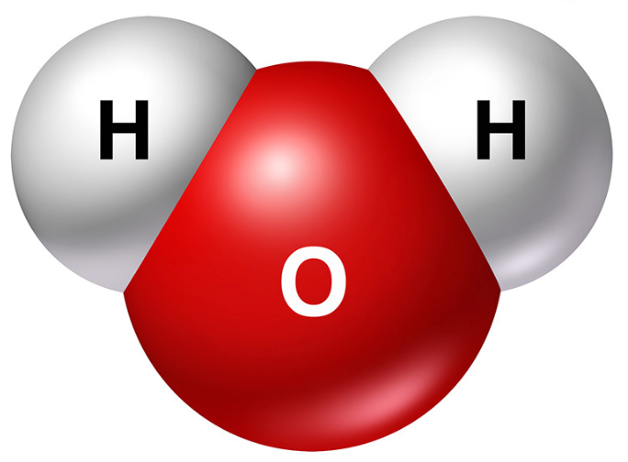
Hydrogen Bonds
The properties of water arise from the opposite charges within the water molecule:
The slightly positive H of one molecule is attracted to the negative O of a different water molecule.
The two molecules are therefore held together by a HYDROGEN bond. Each bond only lasts for a few trillionths of a second.
Notes:
What else will water want to interact with besides water?

Slide 9
Where do you find hydrogen bonds – in a water molecule or between water molecules?

Slide 10
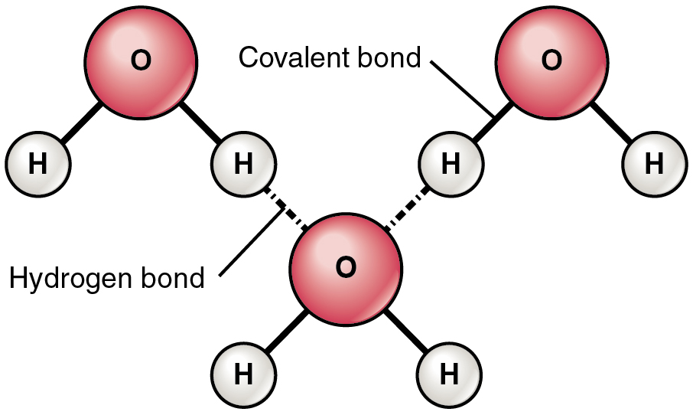
Review of Bonds in Water
Polar
Within
Molecules
Between
Molecules

Slide 11
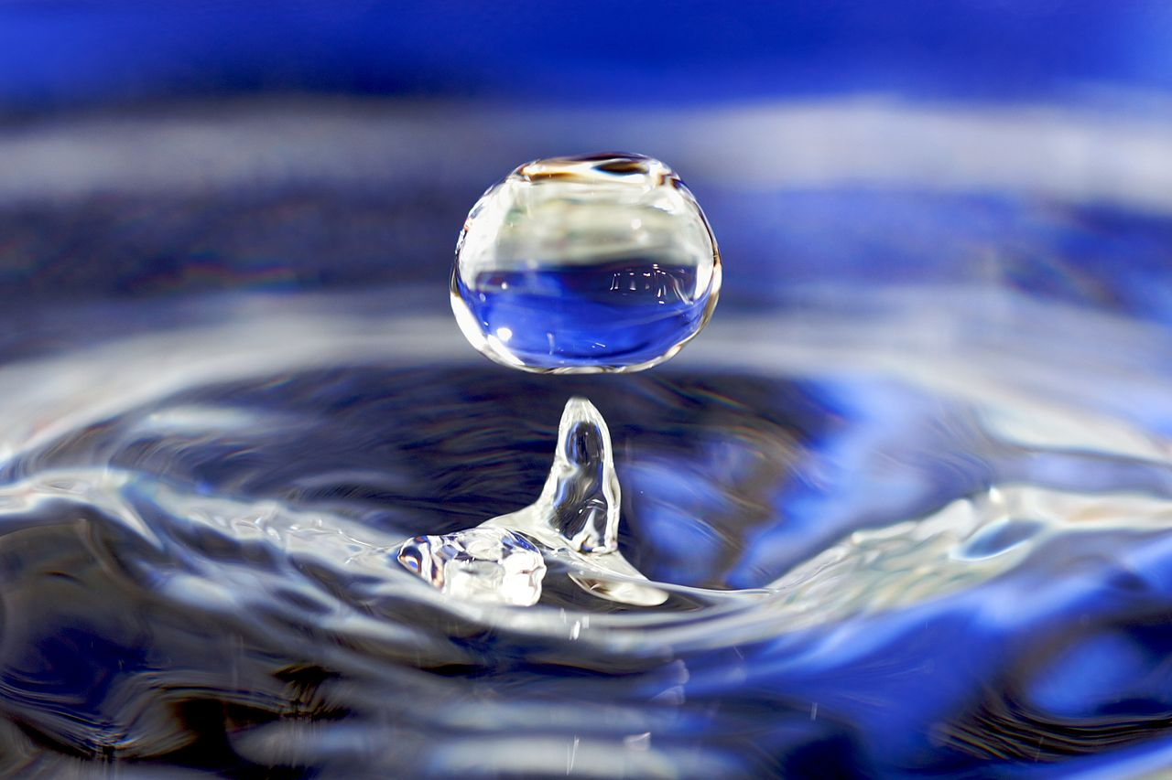
So, why talk about bonds in Biology? This isn’t a chemistry class, lol.
The unique properties of water make all life on earth possible! If water didn’t behave as it does, life as we know it, would be completely different!

Slide 12
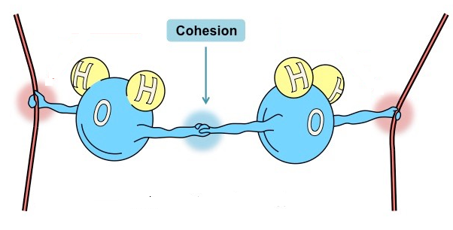
Properties of Water: Cohesion
Cohesion: Water molecules stay close to other water molecules due to hydrogen bonding. (Cohesion: hydrogen bonds holding the substance together)

Slide 13
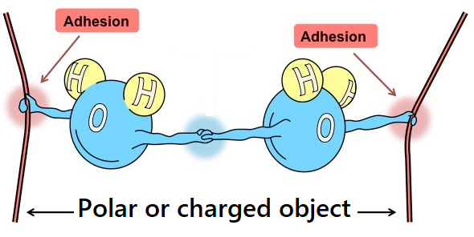
Properties of Water: Adhesion
Adhesion: Water molecules being attracted to and sticking to other molecules .
How would this look if the edges were a nonpolar substance?

Slide 14
Compare and contrast adhesion and cohesion.

Slide 15
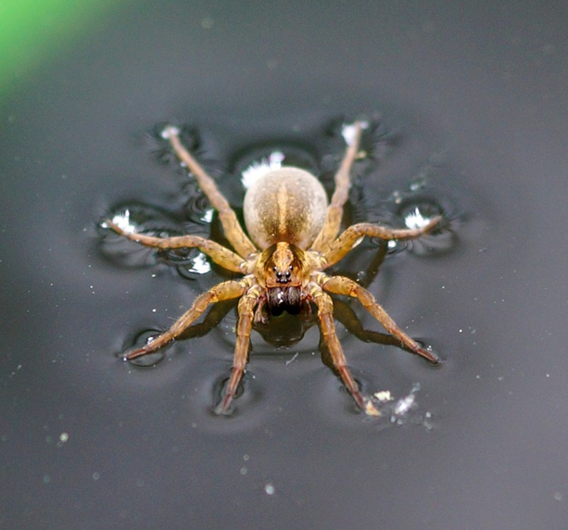
Surface Tension
Surface tension: a measure of how difficult it is to stretch or break the surface of a liquid

Slide 16
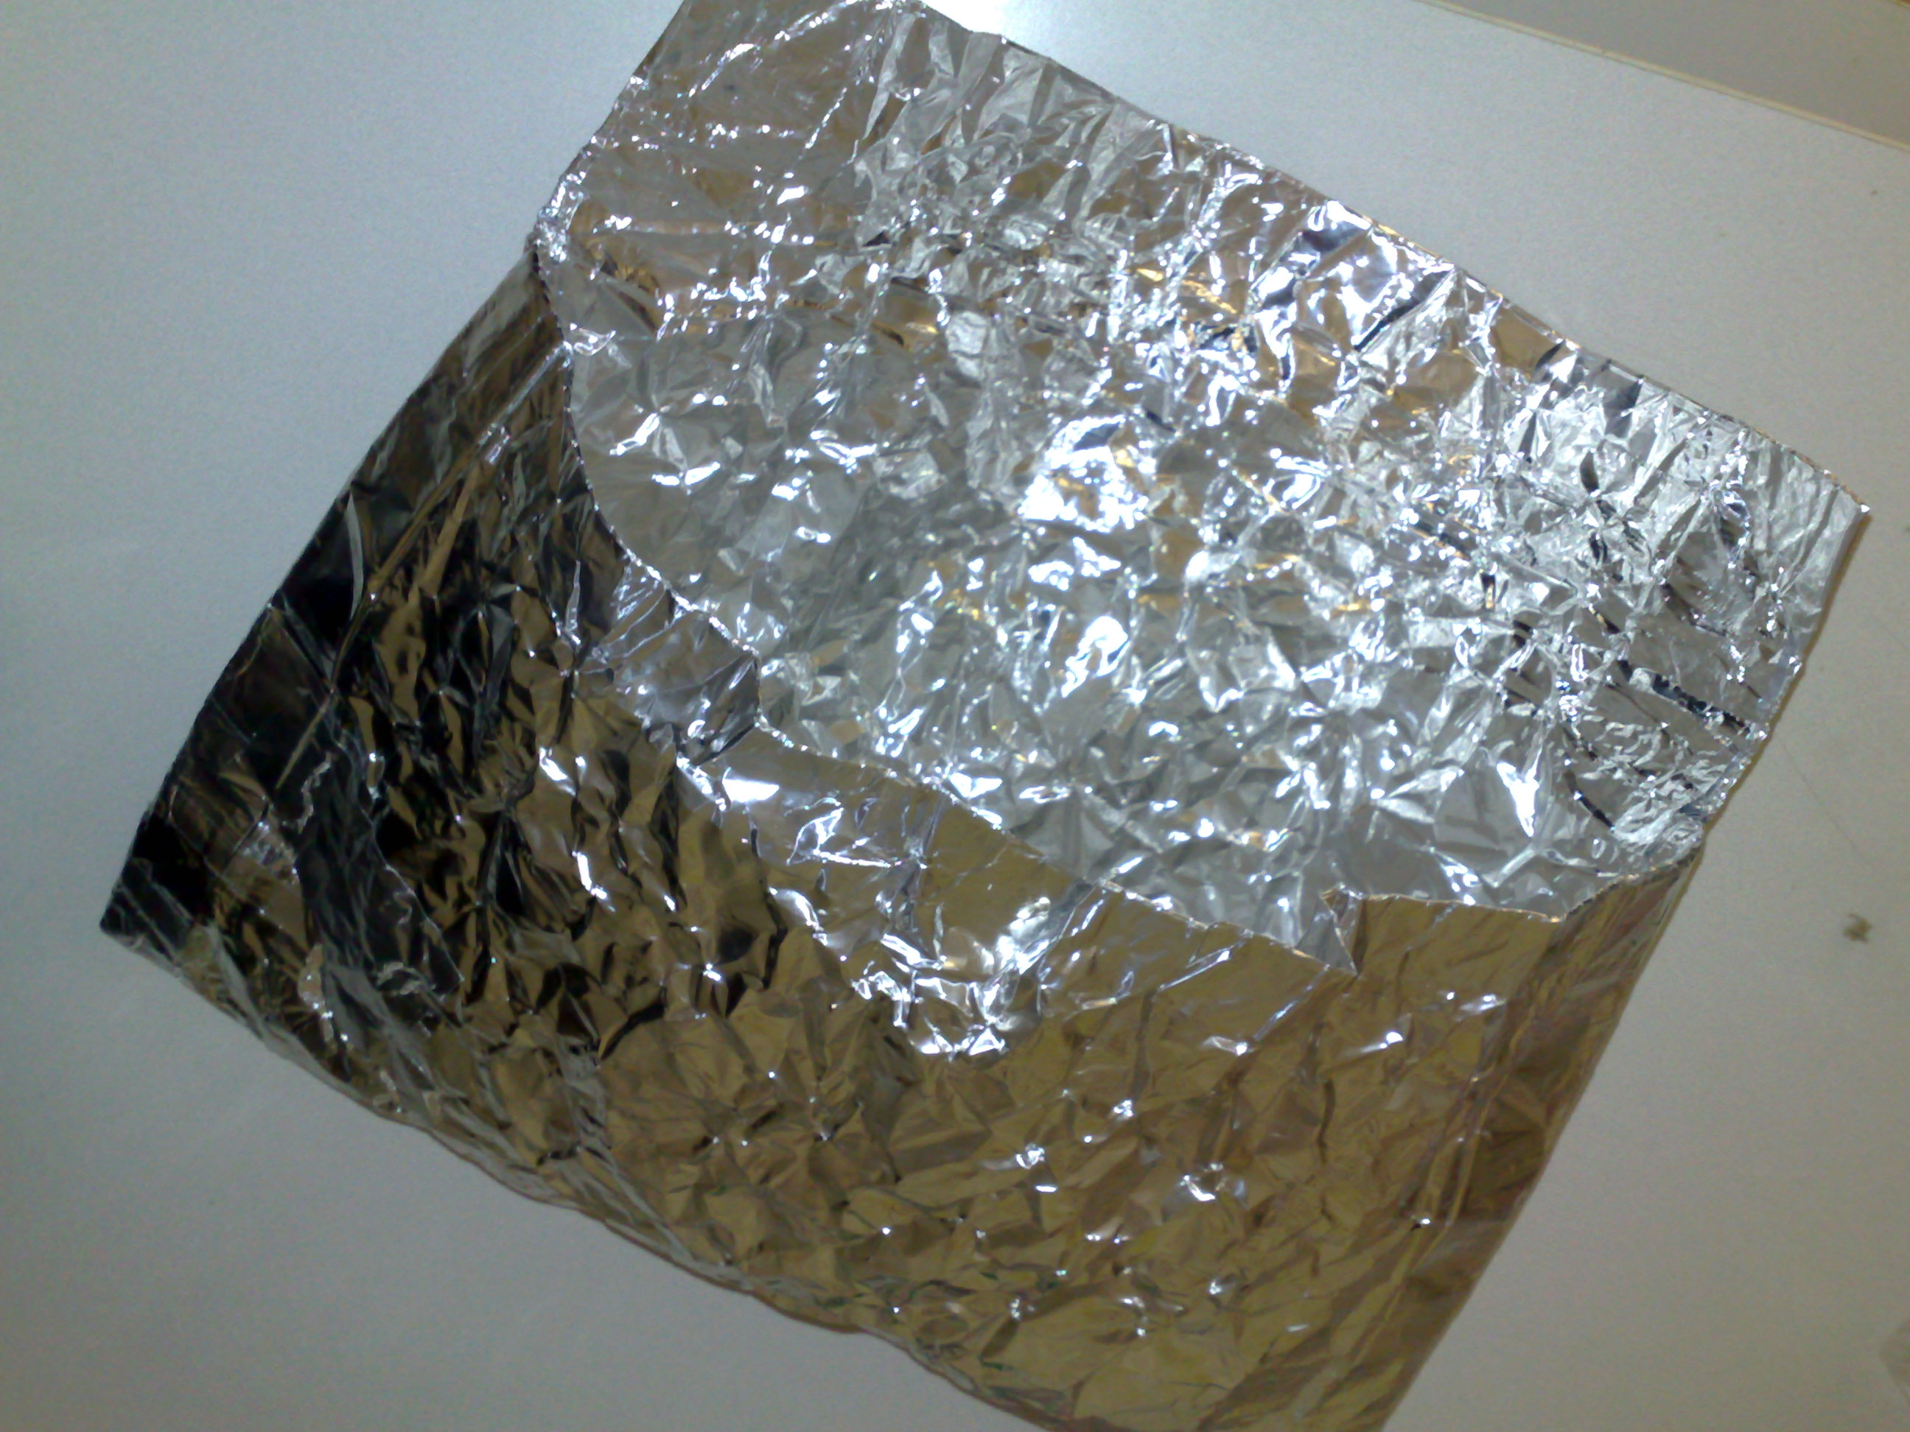
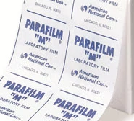
Practice with the Concepts
Foil Parafin Wax
Directions: Place 4-5 drops of water close together (but not so close that they merge and become one) on each of these materials. Try to get eye level with them and observe their behavior. Compare and contrast how the water interacts with each of the four surfaces.
*When we discuss at the end of the activity, be prepared to explain your observations with the terminology we have learned so far…

Slide 17
Some things to try/questions to ponder:
If you put a tiny drop on one of these materials and slowly turn the piece upside down the drop may remain on the material. Can you figure out which one does this? Why?
Why do water drops on some materials look round?
What shapes are the drops of water as they fall through the air?
Does water do the same thing on all surfaces? What evidence do you have to support your claim?

Slide 18
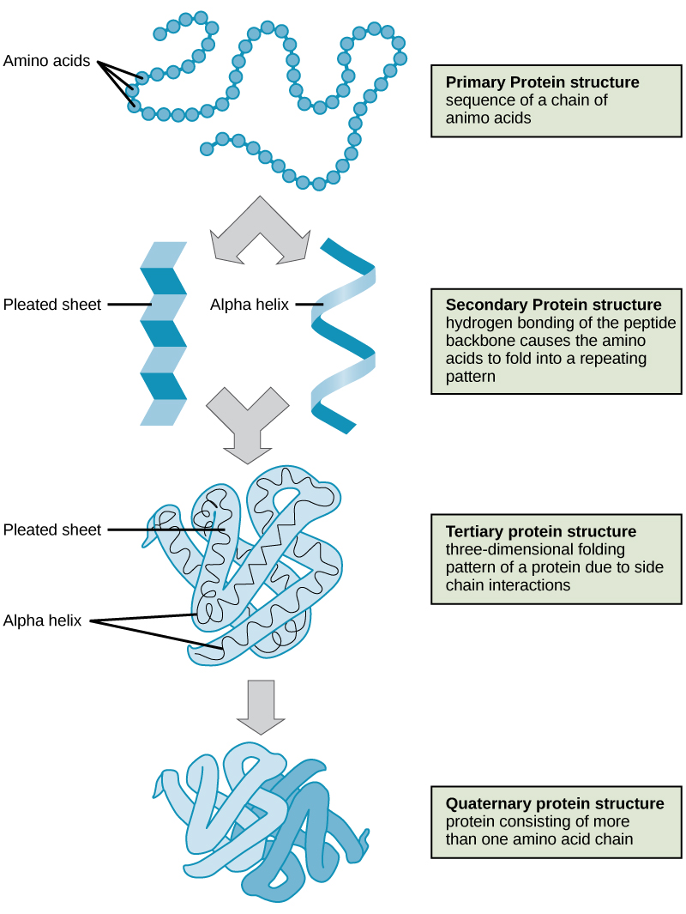
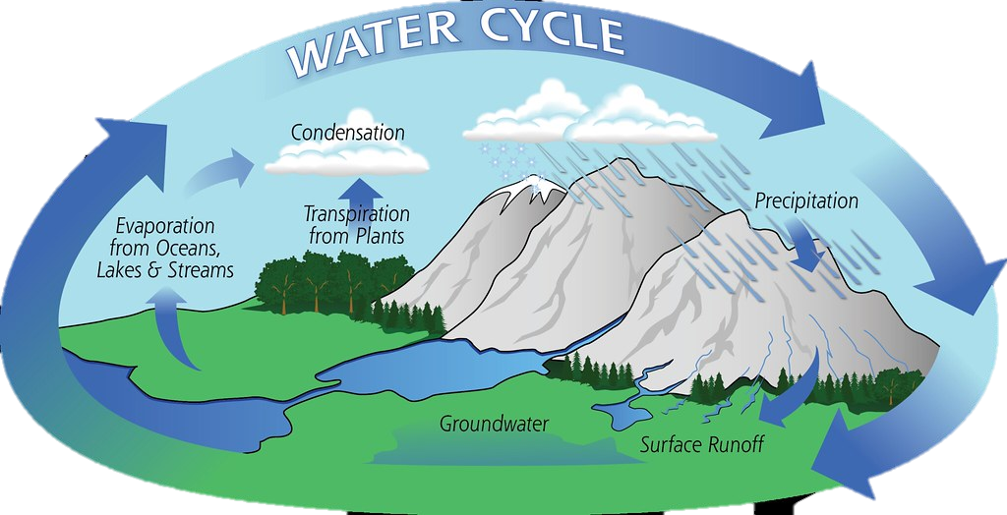
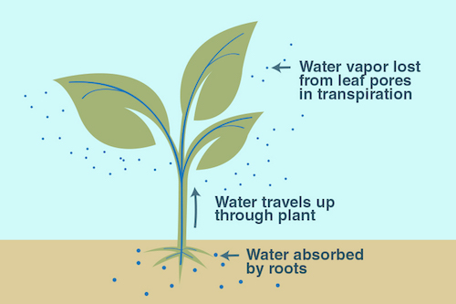
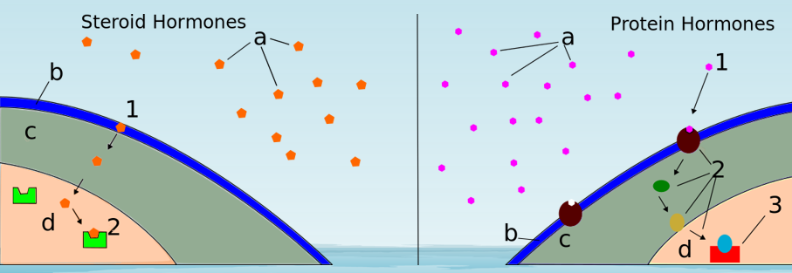
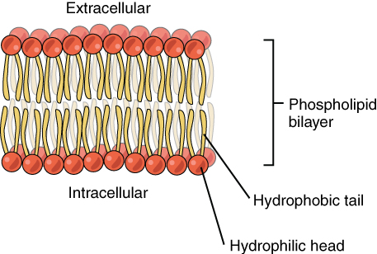
But how does this apply to biology in the real world???

Slide 19
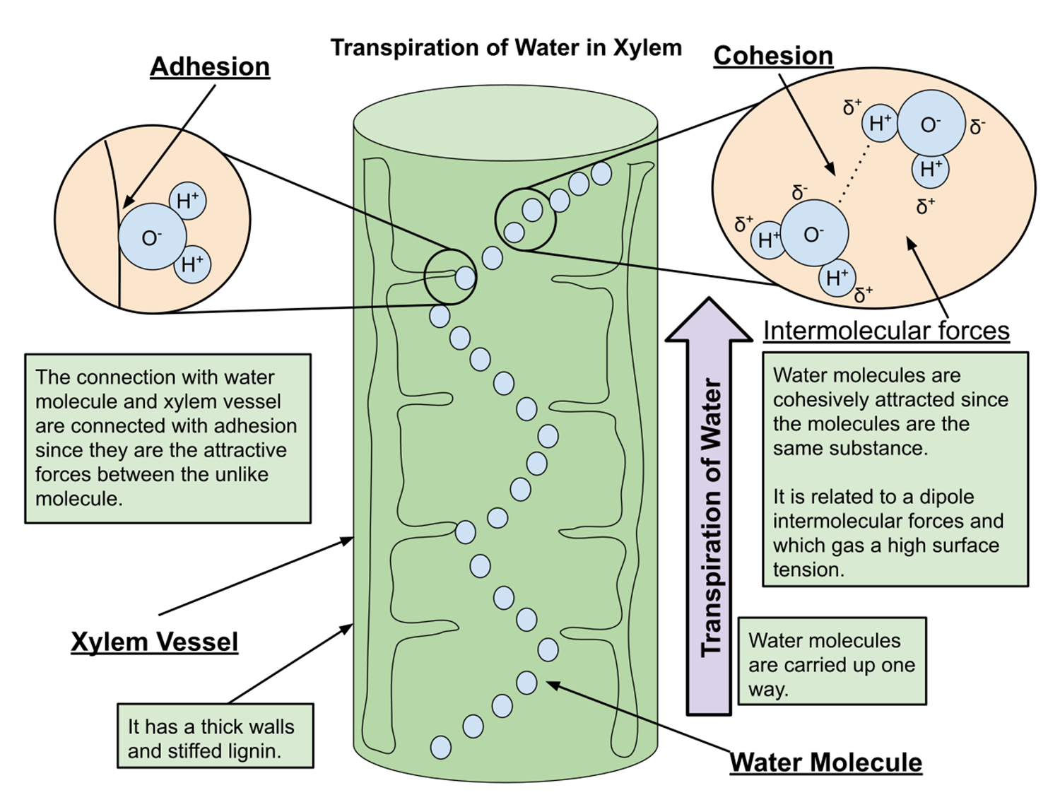


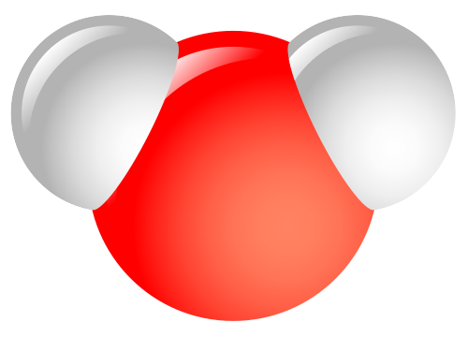
A Closer Look at Transpiration

Slide 20
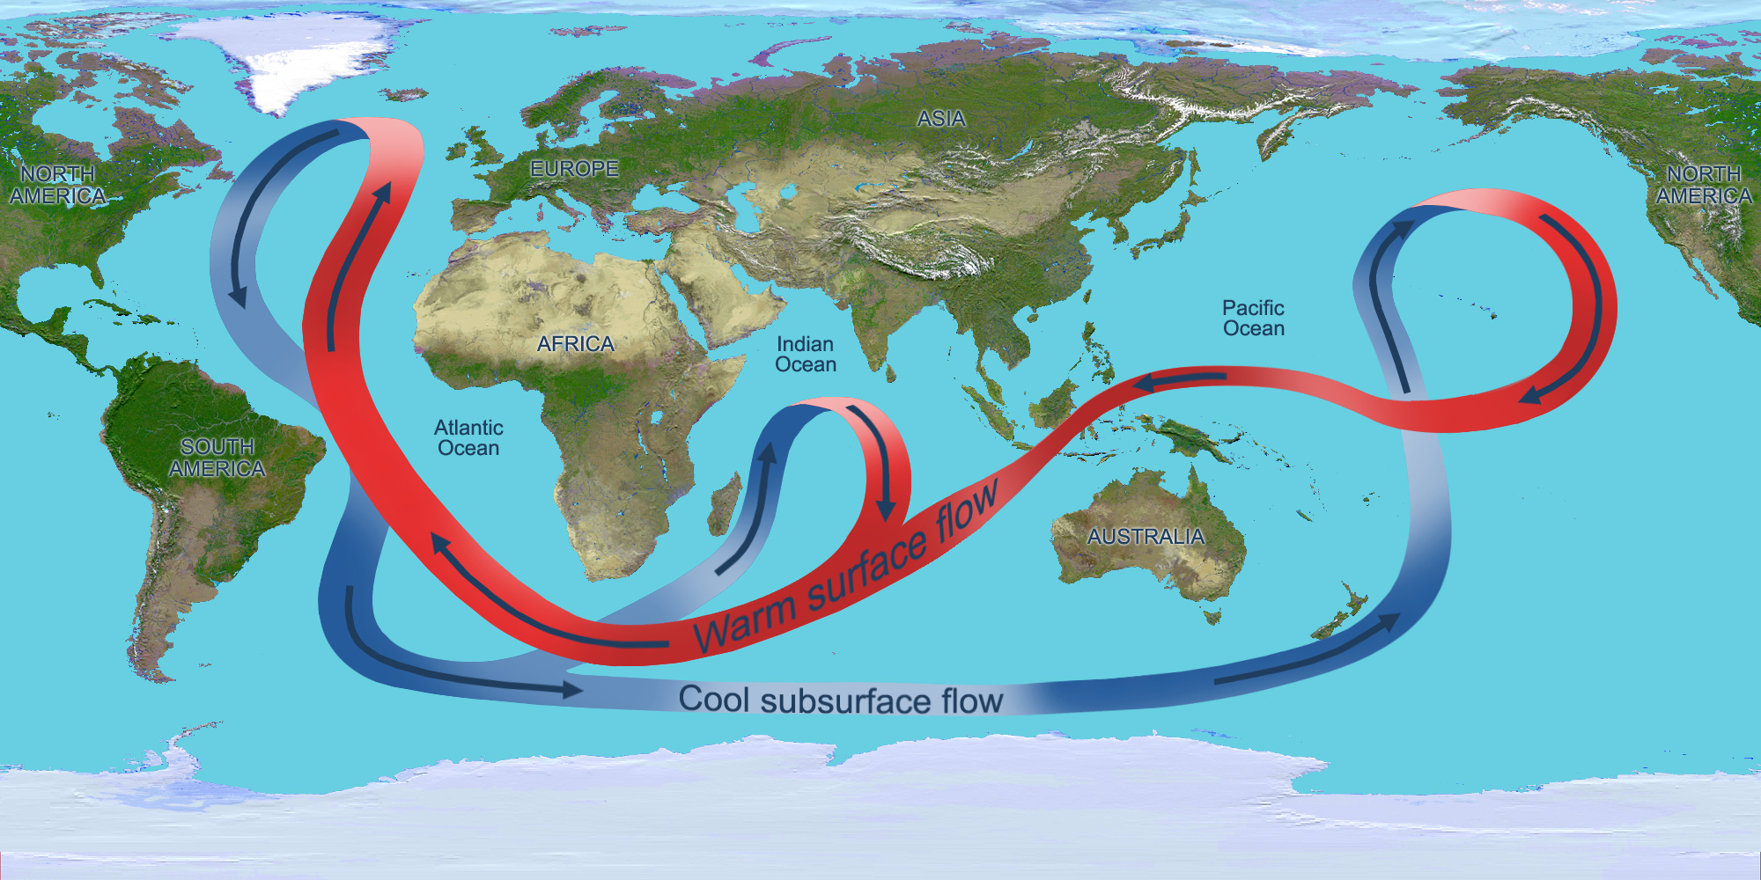
Additional Cool Factors about Water that make life on Earth Possible
Water’s high specific heat helps to regulate temperature

Slide 21

Additional Cool Factors about Water that make life on Earth Possible
Evaporative Cooling

Slide 22
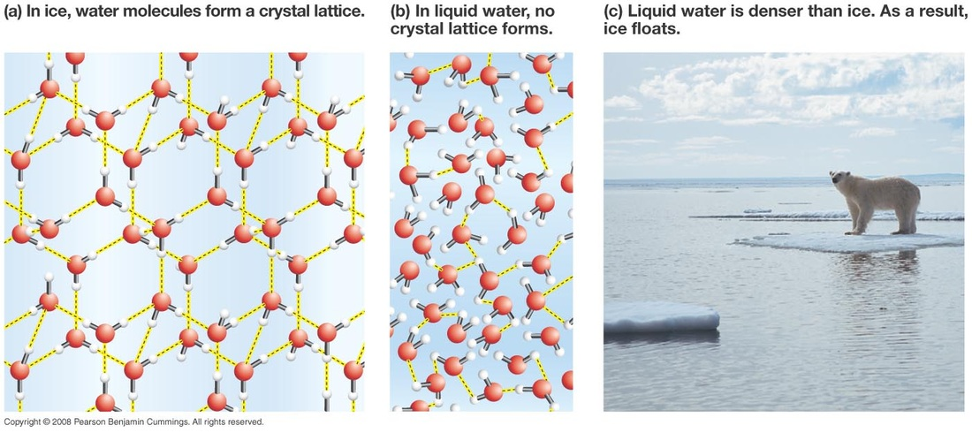
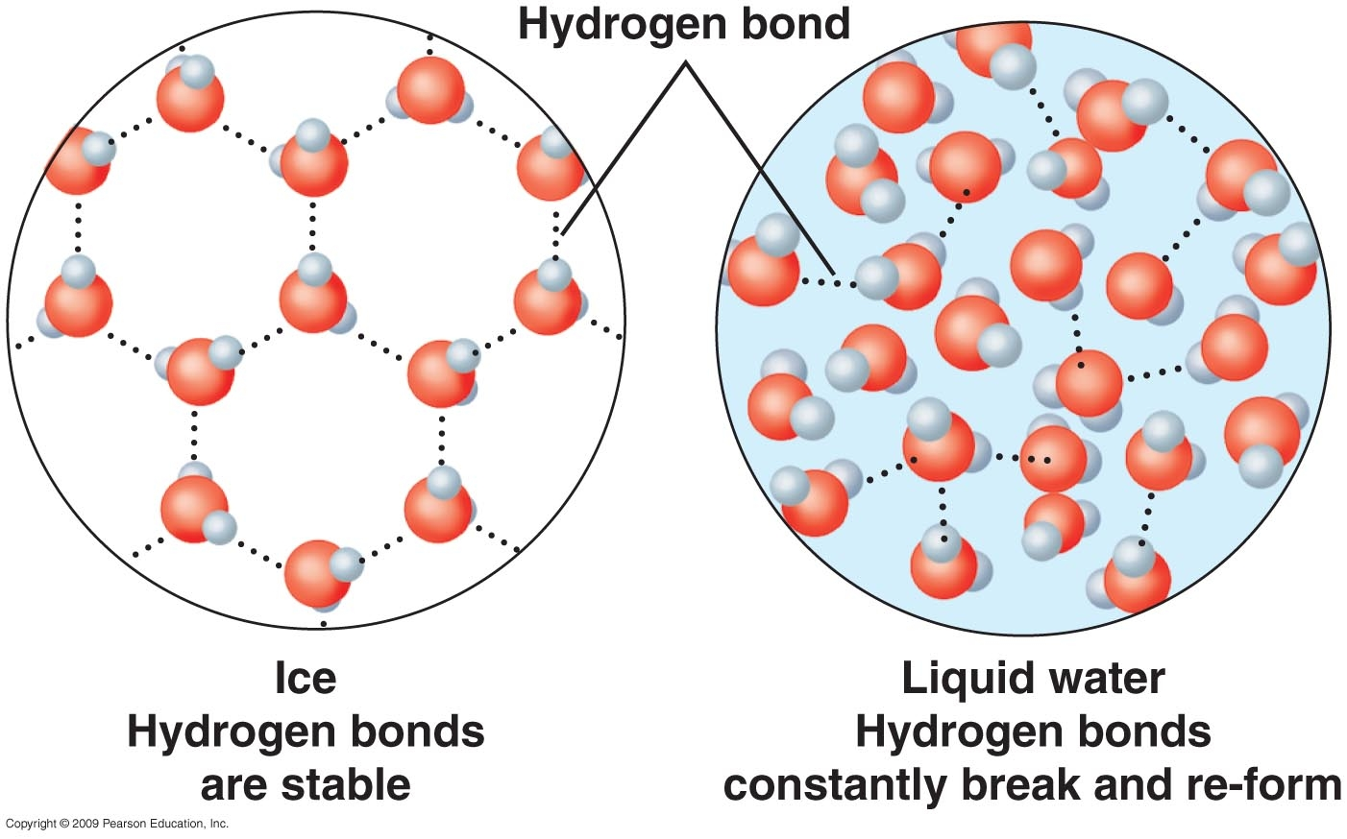
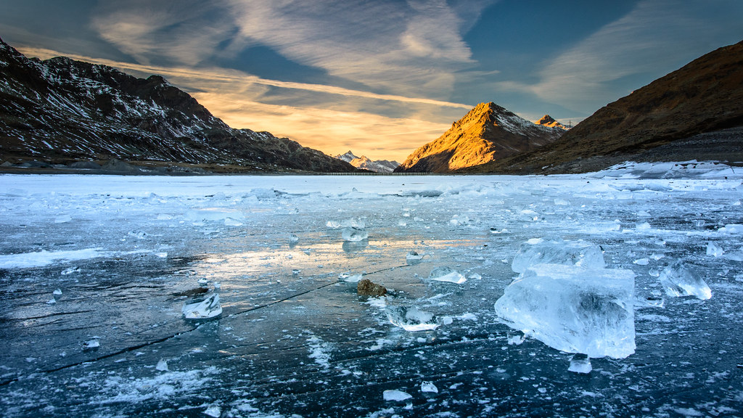
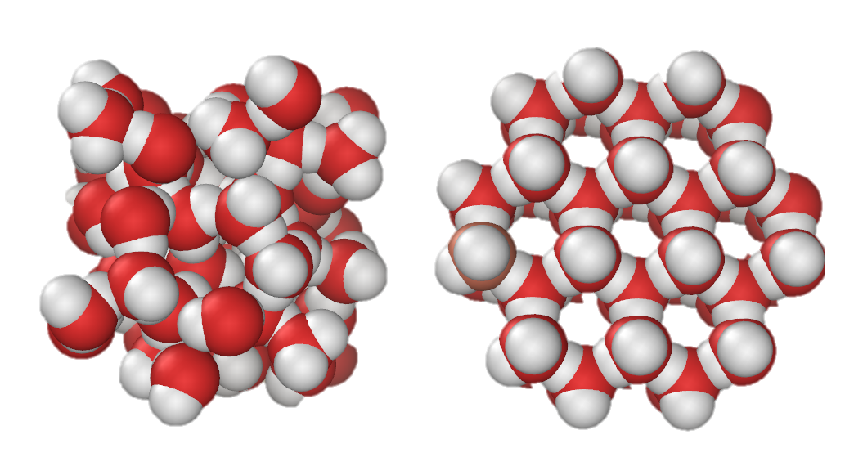
Additional Cool Factors about Water that make life on Earth Possible
Ice Floats – which keeps the temperatures below stable for life
Liquid Solid

Slide 23
What are some additional features of water that make life on earth possible?

