Slide 1
Transcription

Slide 2
DNA Review
DNA from all organisms is made up of the same chemical and physical components—nucleotides made out of a phosphate, deoxyribose sugar, and nitrogenous base (A,G,T,C)
A DNA sequence is the particular side-by-side arrangement of bases along the DNA strand (e.g., ATTCCGGA).
This order spells out the exact instructions required to create a particular organism with its own unique traits.

Slide 3
Small sequence of DNA for making insulin protein
Sequence 1 - Human insulin gene sequence
DNA: C C A T A G C A C G T T A C A A C G T G A A G G T A A
Sequence 2 – Cow insulin gene sequence
DNA: C C G T A G C A T G T T A C A A C G C G A A G G C A C

Slide 4
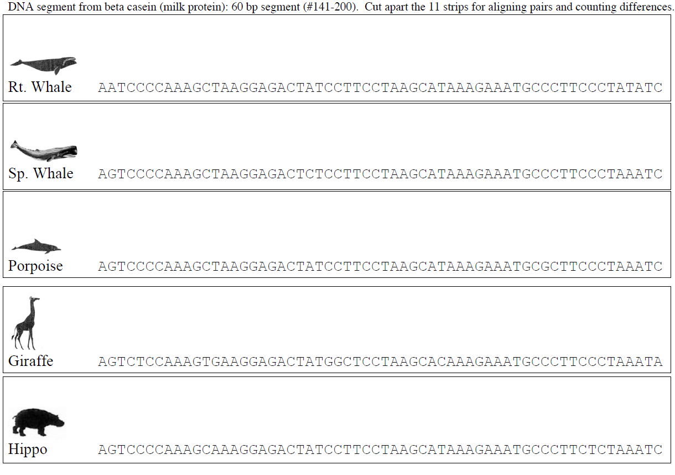

Slide 5
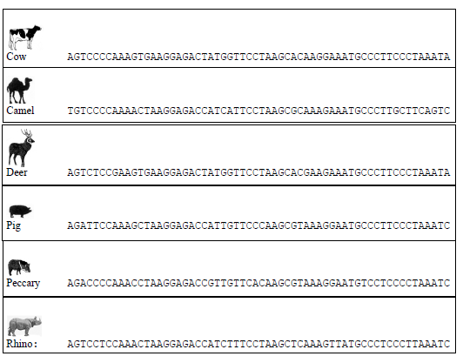

Slide 6
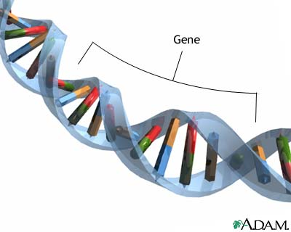
Genes: Your special instructions
Most of our DNA is “junk” DNA= no instructions
The parts of our DNA that do have
instructions are called Genes
Genes vary in length.
Some contain hundreds of base pairs
Some contain thousands of base pairs
19,000 human genes have been identified
The instructions in your genes are directions for synthesizing (making) specific polypeptides.

Slide 7
Proteins
Proteins:
Perform most life's functions (enzymes in
chemical reactions)
Make up the majority of cellular structures
Are made up of smaller subunits called
amino acids
Each protein is created from a particular number and arrangement of 20 different amino acids
A chain of seven amino acids = 1 billion possible combinations

Slide 8
Gene Expression and Protein Synthesis
Gene Expression and protein synthesis are the processes of re-writing the DNA instruction and then reading the instructions in DNA to make a protein
To read the instructions:
-1st rewrite the DNA instructions to RNA (Transcription)
-2nd read every 3 bases in the RNA (Translation)
The flow of instructions (central dogma) is symbolized as DNA RNA Protein

Slide 9
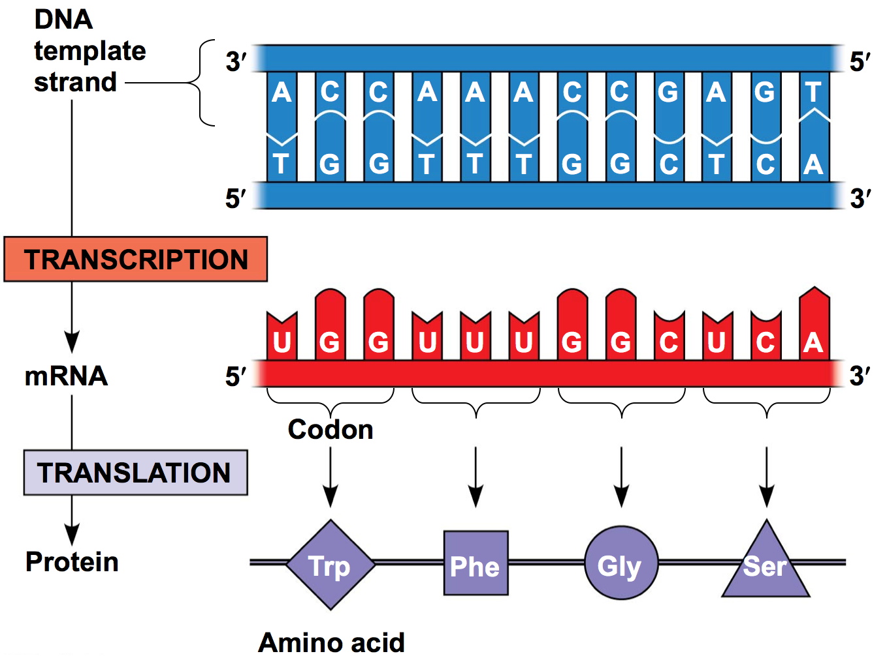

Slide 10
Transcription on paper
Transcribe each of these 2 sequence of DNA into mRNA (Remember A-U, T-A, G=C)
Sequence 1 – Human Insulin gene sequence
DNA: T A C G T A C A C G T T A C A A C G T G A A G G T A A
mRNA:
Sequence 2 – Cow Insulin gene sequence
DNA: T A C G T A C A T G T T A C A A C G C G A A G G C A C
mRNA:
A
U
G
C
A
U

Slide 11
What really happens inside the cell?

Slide 12
Transcription in the cell: DNA mRNA
This step takes place inside the nucleus
What happens? Basic of basics summary…
-a gene portion of the DNA unzips and one strand is used as a template to make an mRNA molecule
-mRNA leaves the nucleus to find a ribosome
-The DNA zips back up and is unchanged

Slide 13
Initiation
1)Transcription factors bind on or near the TATA box of the promoter
2) RNA Polymerase II binds with additional transcription factors forming a transcription initiation complex
3) RNA Polymerase begins to unwind the DNA

Slide 14
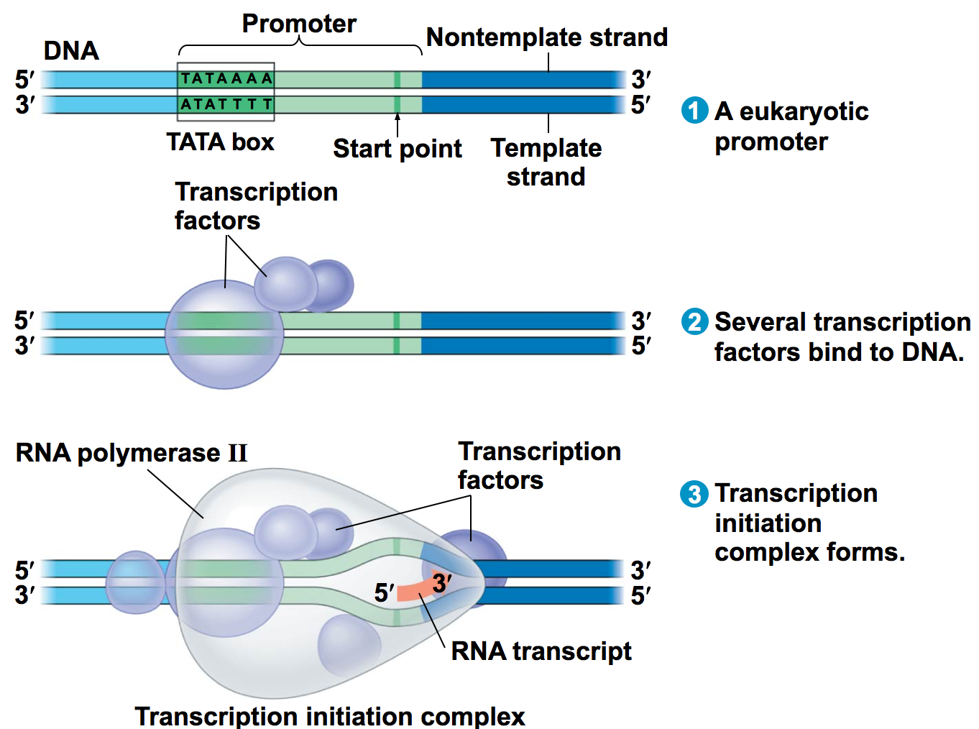

Slide 15
Elongation
RNA polymerase unwinds the DNA
2) RNA Polymerase adds new nucleotides to the 3’end of the pre-mRNA molecule in the 5’ → 3’ direction
3) mRNA begins to peel away from the DNA and the DNA zips back up

Slide 16
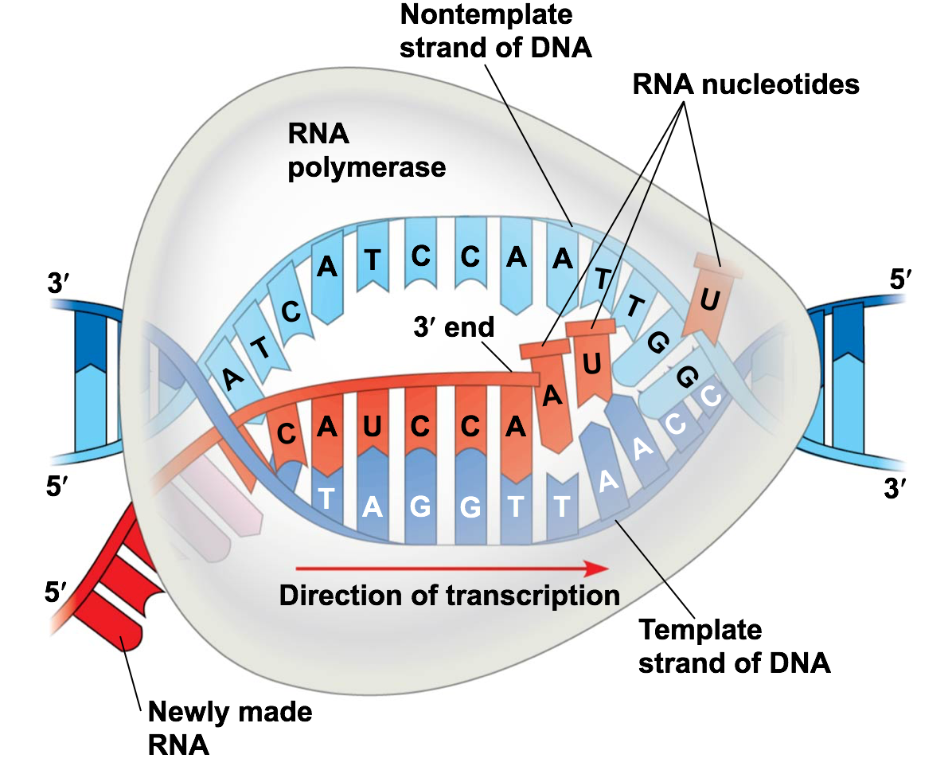

Slide 17
Termination
*In prokaryotes it stops at a termination sequence
*Eukaryotes:
1)RNA polymerase transcribes polyadenylation signal (AAUAAA)
2) Proteins cut the pre-mRNA free

Slide 18
RNA Processing
5’ end gets a 5’ cap (modified guanine nucleotide)
3’ end gets a poly-A tail by adding 50-250 more adenines (A)
WHY???
*Facilitates the export of mature mRNA
*Helps protect the mRNA from degradation
*Helps 5’ end attach to ribosome

Slide 20
RNA Splicing
Not all parts of the pre-mRNA are needed to code for a polypeptide in eukaryotes
-Introns are cut out by spliceosomes
-Exons are spliced together
*Alternate RNA splicing – one gene can code for 2 or more polypeptides
5’ Cap
Intron
AUG Exon
Intron
Exon
Poly A tail

