Slide 1
Transcription

Slide 2
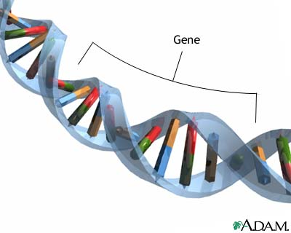
Genes: Your special instructions
Most of our DNA is “junk” DNA= no instructions
The parts of our DNA that do have
instructions are called Genes

Slide 3
Gene Expression and Protein Synthesis
Central Dogma

Slide 4
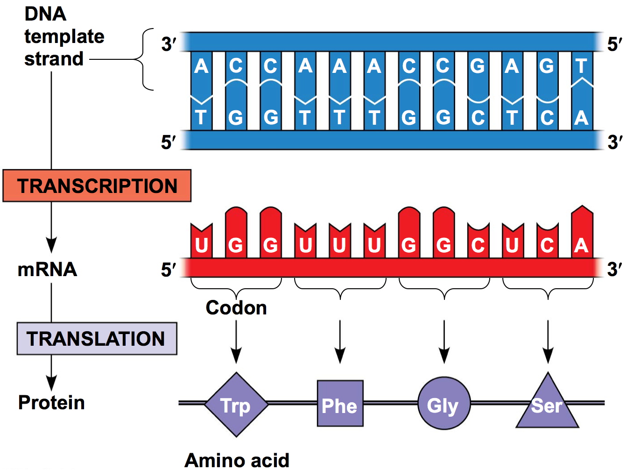

Slide 5
Transcription on paper
DNA: T A C G T A C A C G T T A C A A C G T G A A G G T A A
mRNA:

Slide 6
What really happens inside the cell?

Slide 7
Initiation
1)Transcription factors bind on or near the TATA box of the promoter
2) RNA Polymerase II binds with additional transcription factors forming a transcription initiation complex
3) RNA Polymerase begins to unwind the DNA

Slide 8
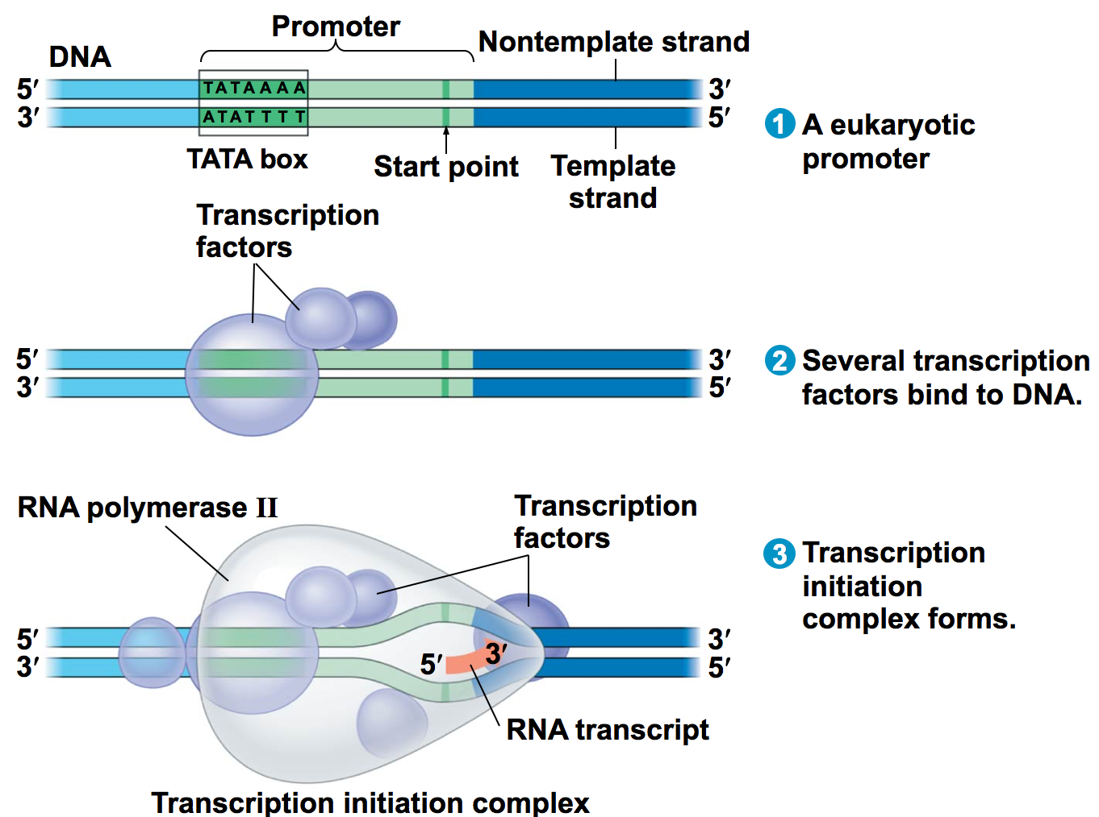

Slide 9
Activation of Transcription
1) Activator proteins bind to enhancer control elements

Slide 10
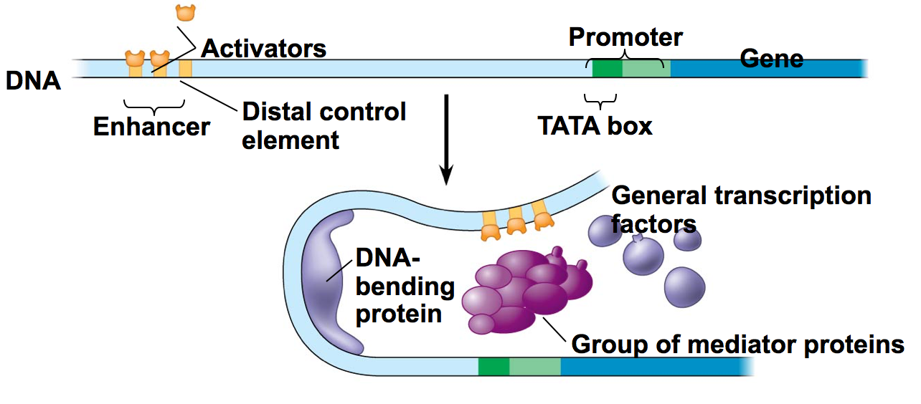
Activation of Transcription
2) DNA bending protein folds the DNA so that the activators are just above the promoter region

Slide 11
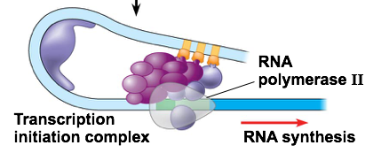
Activation of Transcription
3) Activator Proteins bind to mediator proteins, transcription factors and RNA polymerase on the promoters

Slide 12
Elongation
RNA polymerase unwinds the DNA
2) RNA Polymerase adds new nucleotides to the 3’end of the pre-mRNA molecule in the 5’ → 3’ direction
3) mRNA begins to peel away from the DNA and the DNA zips back up

Slide 13
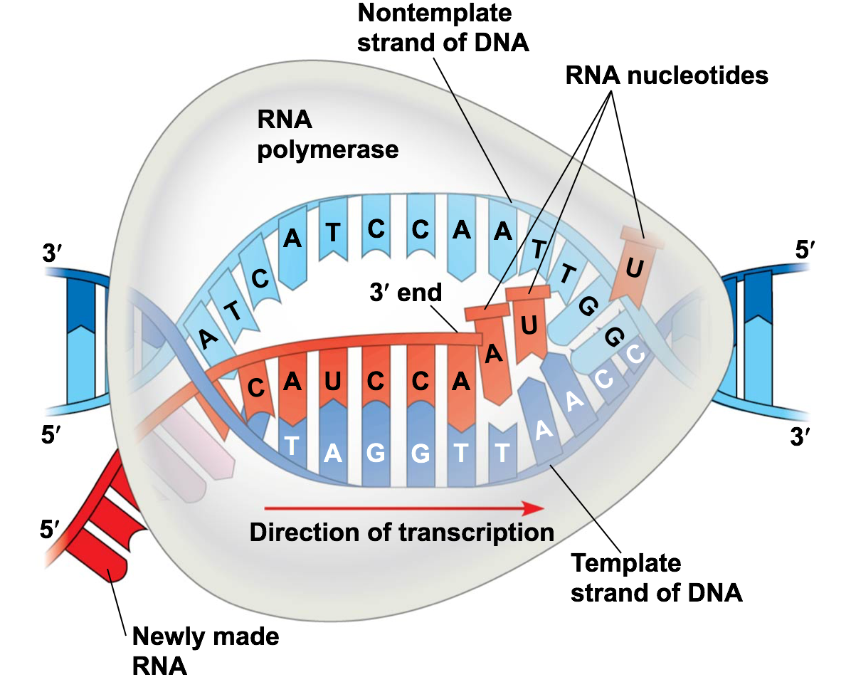

Slide 14
Termination
Termination sequence is reached

Slide 15
RNA Processing
5’ end gets a 5’ cap (modified guanine nucleotide)
3’ end gets a poly-A tail by adding 50-250 more adenines (A)
WHY???
*Facilitates the export of mature mRNA
*Helps protect the mRNA from degradation
*Helps 5’ end attach to ribosome

Slide 17
RNA Splicing
Not all parts of the pre-mRNA are needed to code for a polypeptide in eukaryotes
-Introns are cut out by spliceosomes
-Exons are spliced together
*Alternate RNA splicing – one gene can code for 2 or more polypeptides
5’ Cap
Intron
AUG Exon
Intron
Exon
Poly A tail

